Slide 1
Section 1:
COVID-19 Mitigation

Slide 2
COVID-19 Prevention Model
Multiple tools are necessary for COVID-19 mitigation

Slide 3
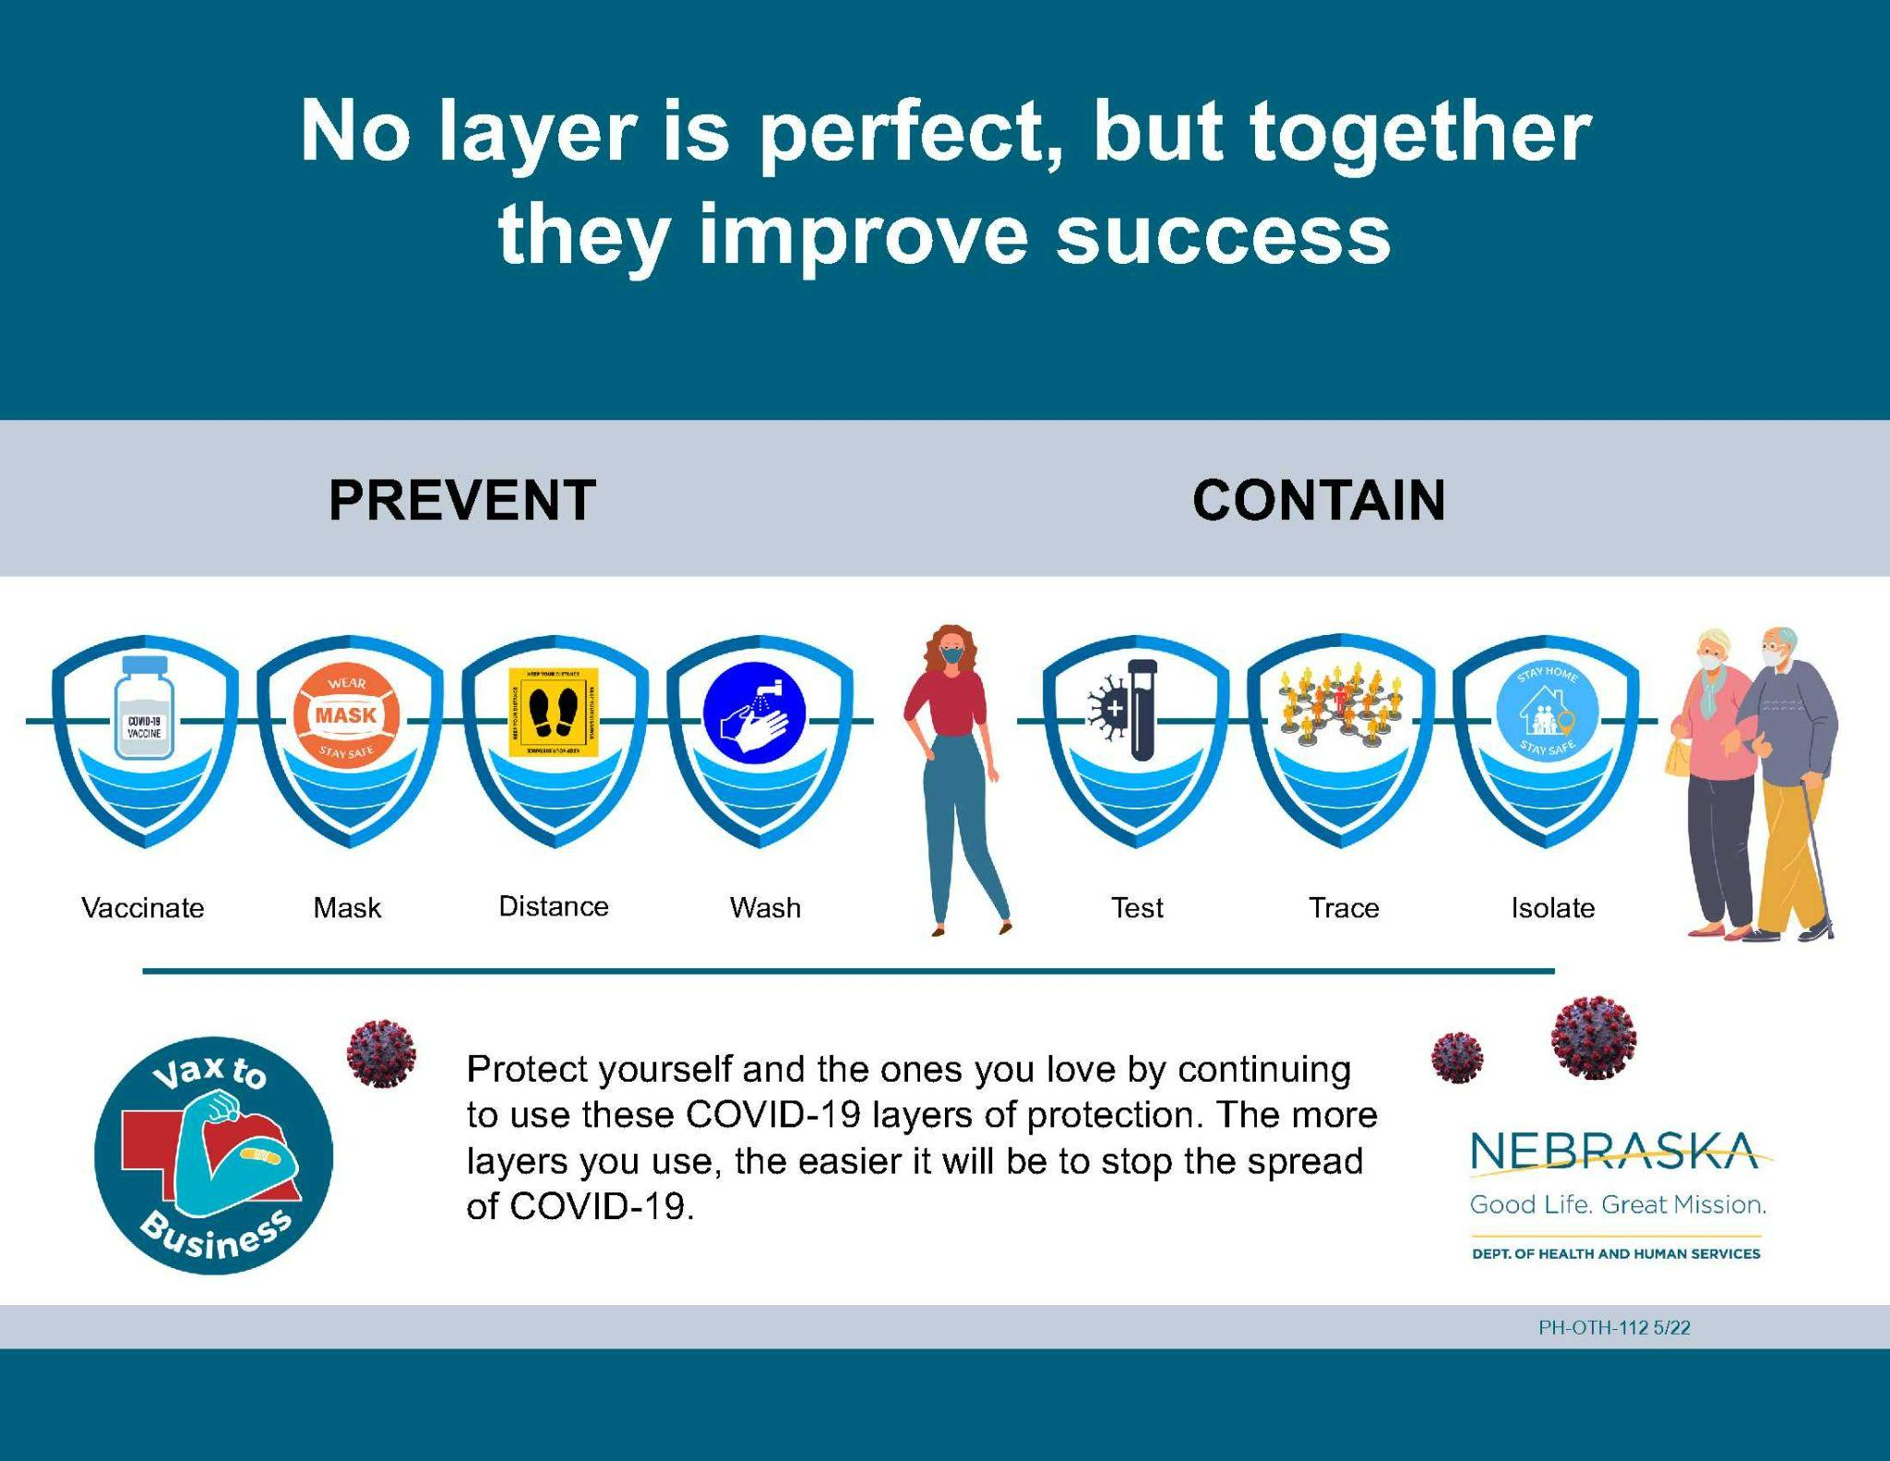
Notes:
update with DHHS specific graphic once completed

Slide 4
COVID-19 Prevention Measures
Multiple prevention measures are necessary for COVID-19 mitigation

Slide 5

Hand Hygiene
Regular hand washing is an important way to prevent spreading germs and getting sick during COVID-19 outbreaks and everyday life.
Important to wash hands:
  After using the restroom
  After sneezing, coughing, or blowing your nose
  Before eating
  Before touching your nose, eyes, mouth, or face
  After touching something dirty
  When your hands are physically dirty
Source & more information on hand hygiene: CDC | Handwashing in Communities: Clean Hands Save Lives

Slide 6
Mask Use
It is important for the community to know when to use masks. Masks are:
Recommended when COVID-19 activity in your community is elevated, especially when you are in high-risk settings (i.e. nursing home, school, shopping mall, or other crowded indoor spaces, etc.).
Needed when someone is exposed to the virus and unable to keep distance from others.
Needed when someone is sick and unable to stay home.
It is also important for the community to know where they can find high quality masks, or have some on hand if they are needed in the future.

Slide 7
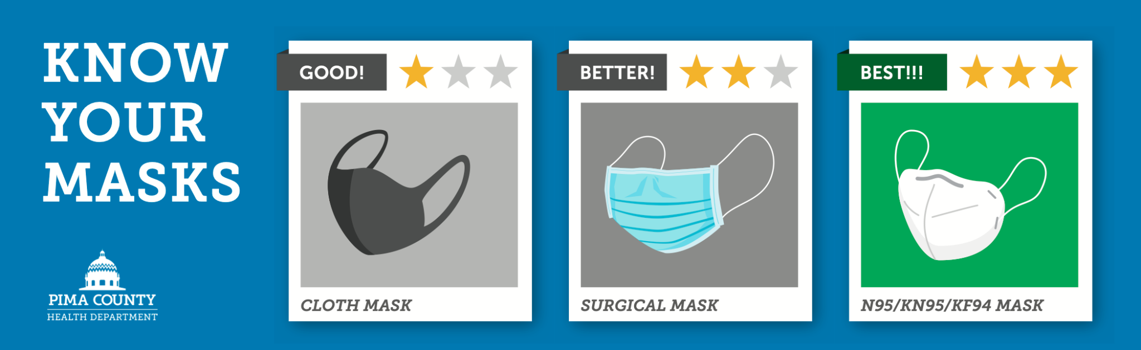
Mask Types
Learn more about masks: CDC | Masks and Respirators

Slide 8
Mask Facts
Not all masks offer the same protection.
A mask (of any quality) is better than no mask.
Higher quality masks increase level of protection to yourself and others.
People should choose the mask that is the most comfortable to them and offers the highest level of protection.
Source & to learn more about masks: CDC | Masks and Respirators

Slide 9
Testing
It is important for the community to know when testing is needed, where it is available, and how to access it. Testing is:
An important tool to identify potential COVID-19 outbreaks and allow a faster outbreak response to limit the spread of the virus.
Needed when someone is exposed to the virus so they can avoid potentially spreading the virus to others and limit disruption to their daily life.
Needed to know that someone is infected with COVID-19 so they can avoid spreading the virus to others and get needed treatments.

Slide 10
Testing Access
Two testing options:
Get tested by a health care provider at a testing site, clinic, or other location available in your community.
Get an at-home test. These can be ordered for free from the government (here: https://www.covid.gov/tests or here: https://dhhs.ne.gov/Pages/COVID-19-Testing.aspx) or purchased at a local pharmacy.
If you get an at-home test for COVID-19, there are many resources to help make sure it is done correctly.
CDC | Self-Testing Videos
UNMC | How to do a COVID-19 self test
iHealth COVID-19 test

Slide 11
Social / Physical Distancing
Important during an outbreak to keep the virus from spreading easily between people.
Important to practice if feeling ill. People can use this mitigation strategy by staying home or maintaining a distance of at least 6 feet while wearing a mask if staying home is not possible.

Slide 12
Isolation & Quarantine Definitions
Isolation: staying home for recommended length of time after testing positive for COVID-19.
Quarantine: staying home when exposed to someone who has COVID-19 and watching for symptoms and/or awaiting COVID-19 test results.

Slide 13
Isolation & Quarantine During an Outbreak
It’s important to stay home when sick or after testing positive for COVID-19. When unable to stay home it’s important to wear a high quality mask around others.
It’s important to distance from others when exposed to COVID-19, and if unable to quarantine, to wear a mask around others. For more information: CDC | COVID-19 Quarantine and Isolation

Slide 14
Wellbeing During COVID-19
In addition to COVID-19 mitigation strategies attending to your wellness is important

Slide 15
COVID-19 Impacts Beyond Illness
The virus that causes COVID-19 can make someone physically sick, but it can also have negative impacts on mental health and wellbeing.
During the pandemic many people have changed their behaviors, experienced loss, stress, and uncertainty.
Some behavioral changes like physical distancing for COVID-19 mitigation are helpful during an outbreak but there are many changed behaviors that were not needed or recommended. These are unintended consequences that are harming people’s health.

Slide 16
Unintended Consequences
Some examples of these behaviors and consequences harming health are:
Harmful coping mechanisms like increased alcohol consumption
Decreased physical activity
Changes in food consumption or access
Stress, hopelessness and mental health impacts
Decreased social connections leading to loneliness

Slide 17
Wellness with Preventative Care
Research shows that many people postponed dental visits, cancer screenings, yearly check-ups, and other regular medical care.
It’s important for people to resume wellness visits with their healthcare providers. This includes getting recommended screenings and preventative care.
To find a primary care provider in your community or get connected to local resources and facilities to help navigate any barriers and access appropriate care, visit: DHHS | Facilities Designed for Underserved Populations

Slide 18
Wellbeing to Support Your Immune System
Taking care of yourself and encouraging those around you to be mindful as well helps make sure your immune system is healthy and ready when you need it.
It can be challenging, but it is important to:
  Get enough sleep.
  Eat a well balanced diet (even if it’s small changes).
  Limit alcohol consumption.
  Move your body and get regular exercise.
  Take time to rest and recharge.
  Develop healthy coping mechanisms to take care of mental health.
Resources to help manage wellbeing during COVID-19 will be included in the additional resources handout.

Slide 19
Assessing COVID-19 Risk
Knowing COVID-19 risk in your community informs prevention behaviors

Slide 20
Assessing Your Risk
The COVID-19 risk in your community is ever changing and based on many factors.
It may difficult to know what prevention measures you should take, but there are resources to help you make those decisions.
The CDC developed a tool to estimate what the risk is in your community. Select your county and you will see COVID-19 community risk, and recommended prevention steps.
No tool is perfect, but can help you make informed choices to protect yourself, your family, and your community.

Slide 21
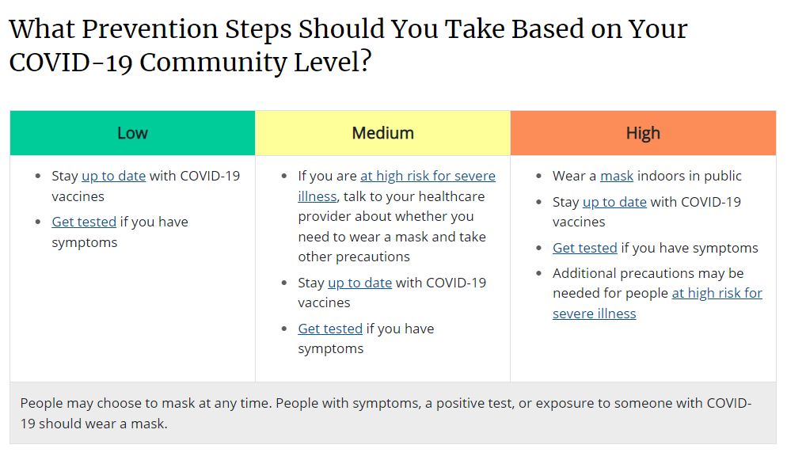
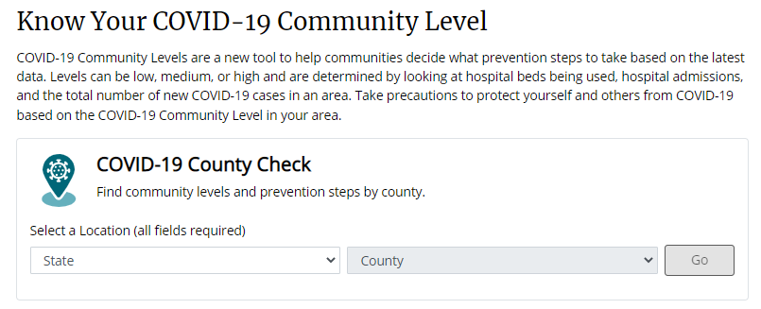
Community Risk Level Tool
Link for the tool: CDC | COVID-19 by County (this is a great resource to share with others)

Slide 22

“Tools” in the “Toolbox”
The prevention and mitigation strategies just covered can also be thought about like tools in a tool box.
The more tools you have the more prepared you are to have to right tools in any situation.
Not all “tools” are equal and some are more helpful than others. The same is true with COVID-19 prevention measures.
Research has shown vaccines are one of the more powerful tools in the toolbox.
The other “tools” are important and when combined with vaccines offer individuals and communities protection from many impacts of COVID-19.

Slide 23
Vaccination
Eligibility, Availability, & Importance

Slide 24
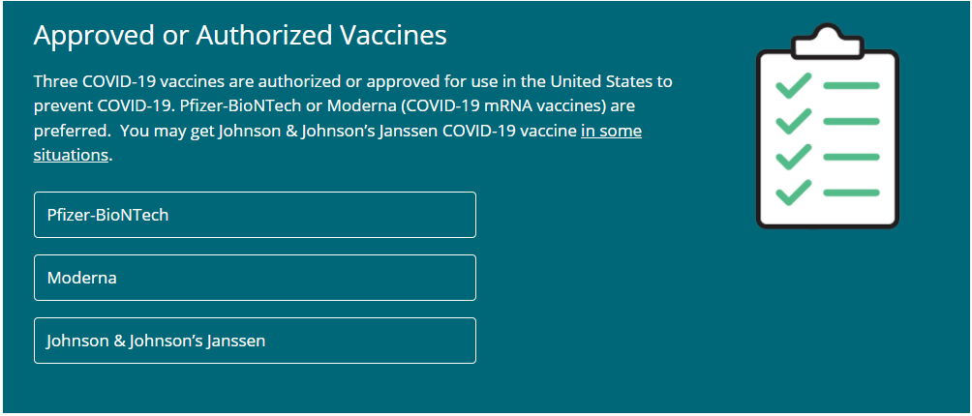
COVID-19 Vaccines Available
Graphic Source: CDC
For more information on each vaccine type: CDC | Different COVID-19 Vaccines

Slide 25
Eligibility: COVID-19 Vaccine
A COVID-19 vaccine is available to all adults and most children. Visit this CDC link for the most up-to-date eligibility: CDC | Different COVID-19 Vaccines
Many children are eligible to receive a COVID-19 vaccine at thousands of pediatric healthcare provider offices, pharmacies, Federally Qualified Health Centers, and more. CDC | COVID-19 Vaccines for Children and Teens
People who are pregnant or breastfeeding are eligible to get the COVID-19 vaccine. CDC | COVID-19 Vaccines While Pregnant or Breastfeeding

Slide 26
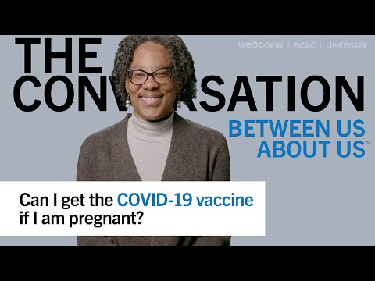

Slide 27
Eligibility: COVID-19 Vaccine Booster
COVID-19 vaccine boosters are available to many people who have already received their 1 dose of Johnson & Johnson vaccine or their 2 doses of Pfizer or Moderna COVID-19 vaccine. At the time this training was made, boosters were still being studied so recommendations may change as new information becomes available. Visit this CDC link for updated recommendations: CDC | Who Is Eligible for a COVID-19 Vaccine Booster Shot?
People who are pregnant are able to get the COVID-19 vaccine booster.

Slide 28
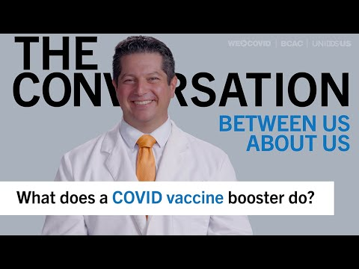

Slide 29
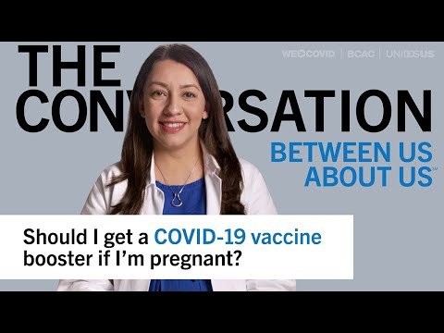

Slide 30
Reasons to Get Vaccinated
In the coming slides you’ll hear from healthcare and public health experts on:
  Why people should get vaccinated after they have already had COVID-19.
  Why getting vaccinated is recommended over waiting to get COVID-19 and build protection that way.

Slide 31
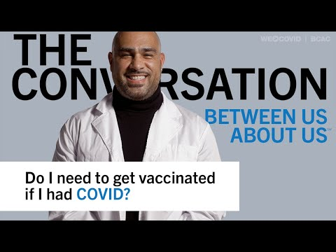

Slide 32
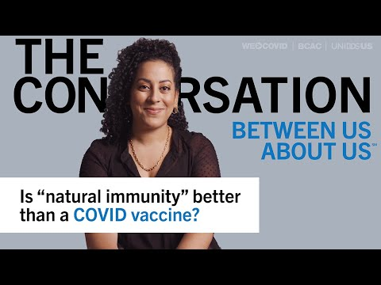

Slide 33


Immune System: B-cells & T-cells
T-CELLS VS. B-CELLS
How your immune system protects you from viruses.
T-Cell
B-Cell
WHAT THEY DO
Kill infected cells to prevent you from getting sick from a virus after you've been exposed.
Produce antibodies to recognize a virus as a pathogen and fight the virus in the future.
IN OTHER WORDS
Attackers, respond to virus detections like an immune system security guard.
Immune system security commission, makes sure there are enough trained security guards.
WHY ARE THEY NEEDED
Both are needed to have a powerful immune response when a person is exposed to a virus.

Slide 34


Immune System: Vaccines & Infection
VACCINE VS. INFECTION
How your immune system protects you from viruses.
Vaccines
Infections
T-CELLS AND B-CELLS
Produces T-Cells and B-Cells at a level that ensures predictable immune response.
Doesn't produce T-Cells and B-Cells at a level that ensures predictable immune response.
OVERALL RESPONSE
Produces long lasting protection from severe COVID-19.
Provides unpredictable protection from severe COVID-19.

Slide 35
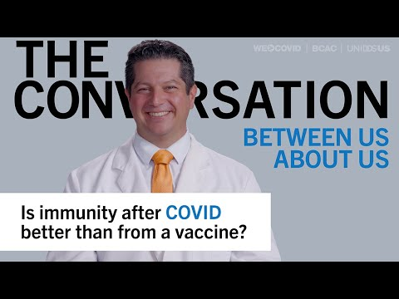

Slide 36
Key Points From The Videos
It’s important to understand that immunity from infection with the virus that causes COVID-19 is different than immunity from the COVID-19 vaccine.
Immunity from getting the virus is variable in different people so it’s hard for experts to know how long or how well a person will be protected in the long term with future outbreaks and variants.
Immunity from getting the COVID-19 vaccine is being studied and will continue to be watched.
Getting vaccinated after having COVID-19 offers even more protection because it strengthens both the B-cell and T-cell immune response.
It’s important for people that did have COVID-19 to still get vaccinated to reduce their risk of reinfection with the same or
different variants.

Slide 37
Concern For Getting COVID-19 & Vaccination
Many people haven't gotten vaccinated and are not concerned about getting sick with COVID-19 even with new variants.
Hear from healthcare and public health experts on:
  Weighing unknown risks of COVID-19 infection versus known mild side effects and rare treatable severe side effects.
  The risk associated with unknowingly spreading the virus to someone who is at risk or worried about COVID-19.

Slide 38
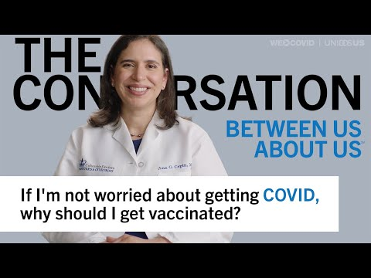

Slide 39
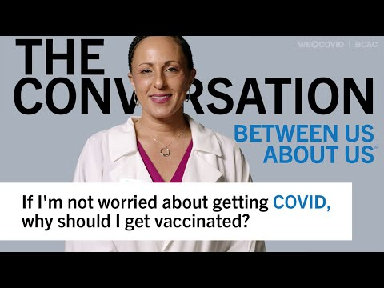

Slide 40
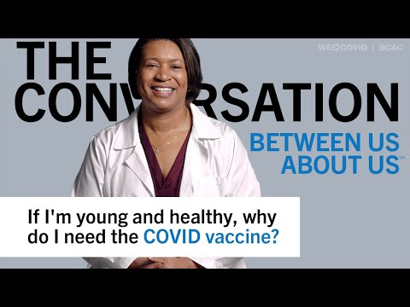

Slide 41
Key Points From The Videos
COVID-19 infection has more risks than COVID-19 vaccination. Think about some of these risks. Some might be:
  Financial- loss of work due to being sick or household member(s) getting sick, medical bills
  Physical- lasting symptoms, Long COVID
  Social- missing activities or commitments, infecting someone else who is at higher risk
  Emotional- stress from any of the above

Slide 42
Infection After Vaccination
We know COVID-19 vaccines don’t prevent 100% of infections, but infections after vaccination are less likely to:
  Be severe
  Require hospitalization
  Result in Long COVID
  Result in death

Slide 43
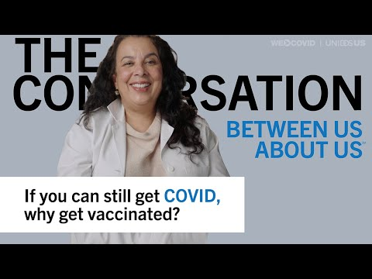

Slide 44
Importance of Vaccinating Children
Children can be infected with COVID-19 just like adults and can:
  Get severely sick from COVID-19.
  Have both short and long-term health problems from COVID-19.
  Spread COVID-19 to others, including at home and at school.
Vaccination helps keep children from getting seriously sick even if they do get COVID-19.
Source & to learn more: CDC | COVID-19 Vaccines for Children and Teens

Slide 45
Importance of Vaccinating Children (Cont.)
Vaccinating children can also help protect family members, including siblings who are not eligible for vaccination and family members who may be at increased risk of severe illness. For more information on protecting specific groups of people visit: CDC | COVID-19 Information for Specific Groups of People
Vaccinating children can help keep them in school and help them safely participate in sports, playdates, and other group activities that are important for their well being.

Slide 46
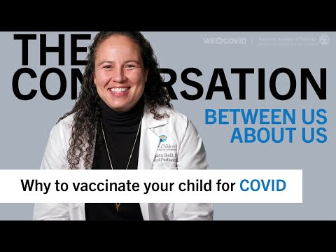

Slide 47
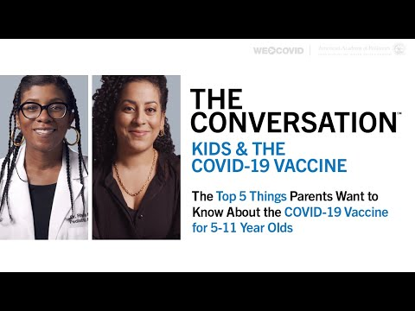

Slide 48
Accessing The Vaccines
COVID-19 vaccines are free
Do not require insurance
Do not require proof of residency or citizenship proof
Many people are still concerned about the access issues above. It’s important to convey that these will not prevent someone from getting vaccinated.

Slide 49
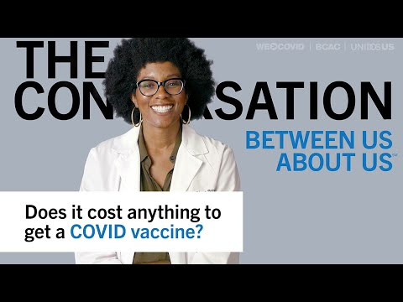

Slide 50
Section 1 Summary
You should know and be able to communicate:
The COVID-19 prevention “tools” in the “toolbox”.
How more “tools” give more protection.
Which COVID-19 vaccines are available and recommended.
Who is eligible for a COVID-19 vaccine and booster.
The benefits of getting vaccinated.
That there is no cost to get a COVID-19 vaccine or booster.

Slide 51
Complete Section 1
Please click the following link to check your understanding and get credit for completing this section.
https://cip-dhhs.ne.gov/redcap/surveys/?s=W7NK49LD3RD7NPAE

