Slide 1
Section 2:
Vaccine Safety, Effectiveness, & Side Effects

Slide 2
Safety & Development
Overview of the vaccine development process & how scientists ensure vaccine safety

Slide 3
Vaccine Development Stages
The general stages of the development of all vaccines are:
Exploratory stage (discovery)
Pre-clinical stage
Clinical development (three phases)
Regulatory review and approval
Manufacturing
Quality control
Source and to learn more: Vaccine Testing and Approval Process | CDC

Slide 4
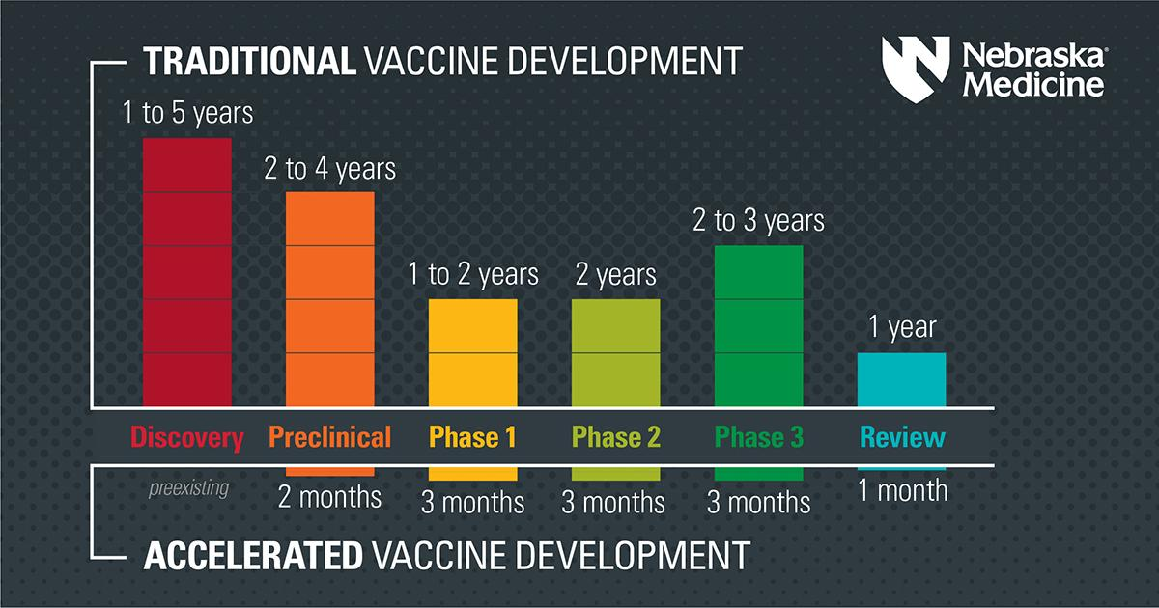
COVID-19 Vaccine Development Comparison
Source: https://www.nebraskamed.com/COVID/were-the-covid-19-vaccines-rushed

Slide 5
COVID-19 Vaccine Development
The graphic in the last slide shows that vaccine developers did not cut corners, but completed each step faster. The following factors helped save a lot of time:
Scientists used research that already existed for the family of viruses that the new virus that causes COVID-19 falls into.
Scientists have been studying mRNA vaccine technology for many years prior to the COVID-19 pandemic.
The was a lot of public interest. Thousands of participants volunteered for clinical trials and they enrolled fast.
Facilities for manufacturing the vaccine were built before vaccine development was completed. In the past these were built after the whole process is completed.
There was overlap in some of the phases.
Teams of people from all over the world collaborated, and worked overtime, on the weekends, and in the evenings to get the vaccine through all steps of the process. They also stopped working on other projects to focus on only the COVID-19 vaccine.
Source and for more information on each step visit: https://www.nebraskamed.com/COVID/were-the-covid-19-vaccines-rushed

Slide 6
How Vaccines Work
In the coming slides you’ll watch short videos from experts on:
  The technology in the different types of vaccines.
  How the vaccines work to safely protect you from the virus without the unknown risks of getting the actual virus.

Slide 7
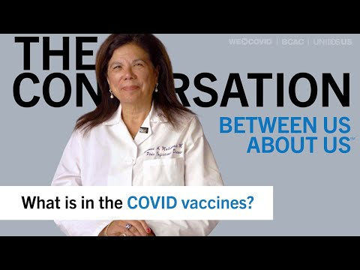

Slide 8
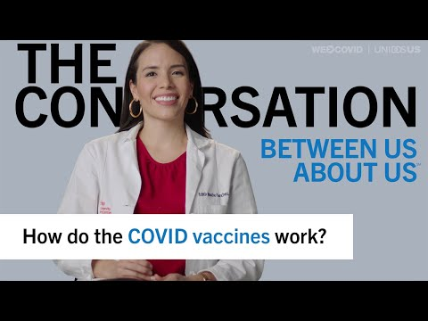

Slide 9
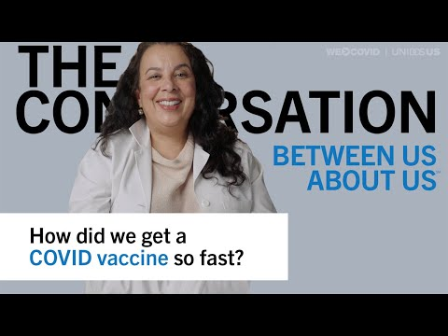

Slide 10
Vaccine Safety
Safety of the vaccines is very important.
Many people still have questions and concerns about vaccine safety.
In the coming slides you’ll hear from experts on how we know the vaccines are safe, and how the vaccine research was expanded to include people from more communities that may not have been represented in the past.
For more information visit:
CDC | Ensuring COVID-19 Vaccine Safety in the US

Slide 11
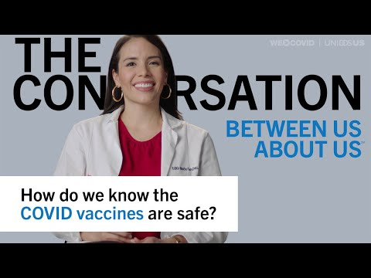

Slide 12
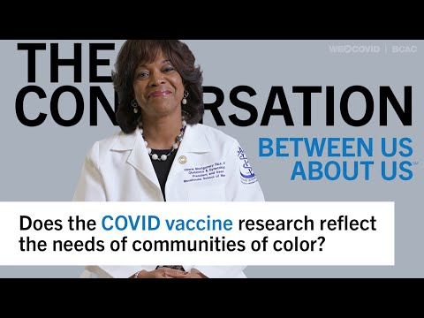

Slide 13
Effectiveness
Information on how the vaccines are preventing serious infection & death

Slide 14
Purpose of Vaccines
The main goal of vaccines are to prevent severe illness and death.
Preventing infection altogether is a secondary goal of vaccines.
All COVID-19 vaccines available in the United States offer high levels of protection from severe illness and death when a person is fully vaccinated and boosted.

Slide 15
Length of Protection
Public health experts are still studying how long protection from the COVID-19 vaccines lasts.
Recent studies show that protection against the virus may decrease over time and may vary by age and health status.
The CDC recommends boosters as a reminder to the immune system to ensure lasting protection.

Slide 16
Vaccine Effectiveness
Getting vaccinated offers protection from severe illness and death in most age groups and health statuses eligible for vaccination.
As of December 2021, DHHS found that vaccinated people were 11X less likely to be hospitalized with COVID-19 than unvaccinated people.
No vaccine is 100% effective so some people will still get sick or test positive.
Check out CDC resources for the latest on vaccine effectiveness: CDC | Vaccine Effectiveness
NE DHHS Study Source: https://dhhs.ne.gov/Pages/Pressrelease/11Xlesslikely46Xlesslikely.aspx

Slide 17
Booster Effectiveness
Getting vaccinated and getting boosted offers high levels of protection from severe illness and death in all eligible age groups with different health needs.
As of December 2021, DHHS found that vaccinated and boosted people were 46X less likely to be hospitalized than unvaccinated people.
No vaccine is 100% effective at preventing people from getting sick so breakthrough cases (testing positive after getting vaccinated) will still occur but are far less likely to result in severe illness or death.
For more information on booster shots visit: CDC | COVID-19 Vaccine Booster Shots
NE DHHS Study Source: https://dhhs.ne.gov/Pages/Pressrelease/11Xlesslikely46Xlesslikely.aspx

Slide 18
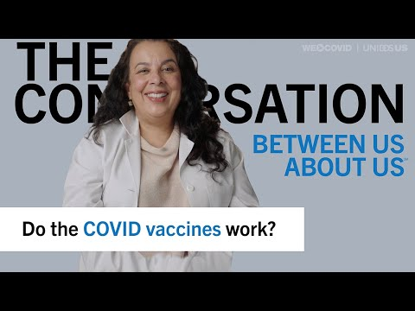

Slide 19
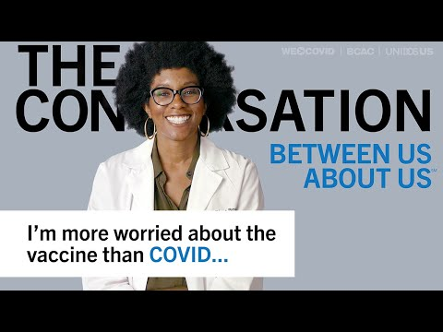

Slide 20
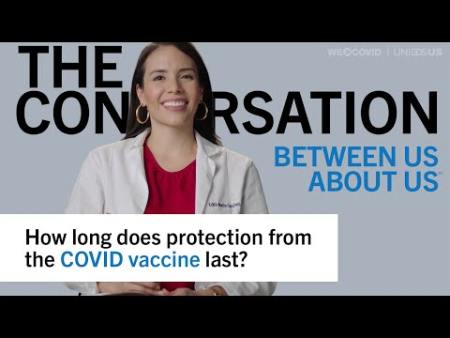

Slide 21
Variants
Variants occur when the virus learns and mutates, or changes, to become:
  More severe
  More easily spread (transmissible)
  More easily able to infect those that already have some protection (from either vaccination, infection, or both)
  A combination of more severe, more transmissible, and/or able to dodge existing protection
More vaccinated people means it is harder for the virus to infect people, learn how the body fights it, then mutate to dodge the immune system. This helps protect our communities, especially those most vulnerable, from future variants.
Source: IDSA | SARS-CoV-2 Variants

Slide 22
Variants and Vaccines
Vaccines help prevent infection and fight the virus giving it less opportunity to learn and create meaningful mutations.
Vaccines can reduce the vulnerability of communities and make large outbreaks from new variants less likely to be severe and negatively impact the community.
Vaccines are still effective against all currently known variants. For more information on variants visit: CDC | What You Need to Know About Variants

Slide 23
Side Effects
What to expect after vaccination, common vs. rare side effects

Slide 24
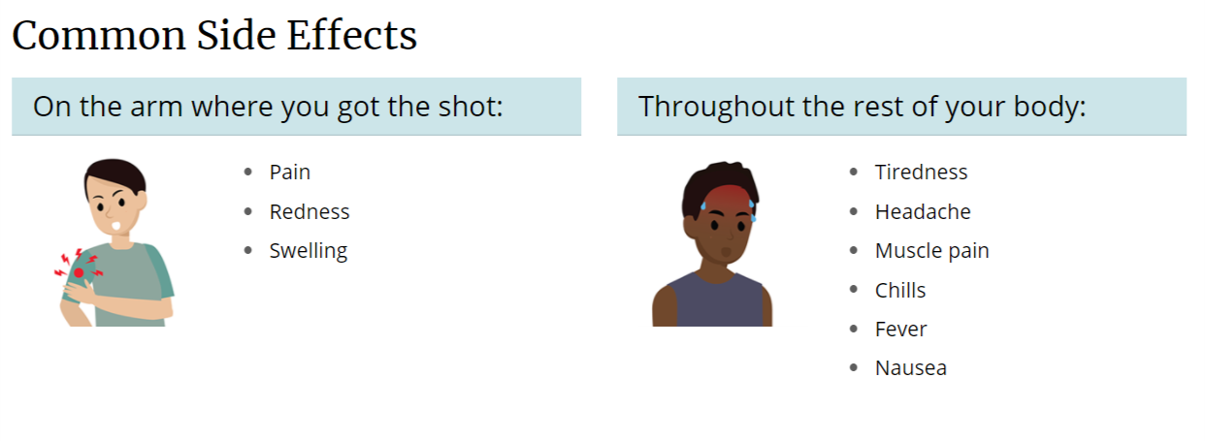
Side Effects
Graphic Source: CDC
Severe side effects and allergic reactions are rare and usually occur in the first 15 minutes after vaccination.
For more information on side effects, reporting side effects, and easing side effects visit: CDC | What to Expect After a Covid-19 Vaccine

Slide 25
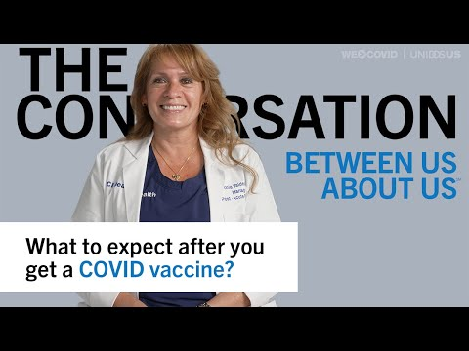

Slide 26
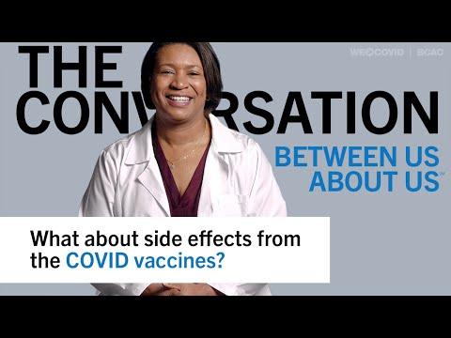

Slide 27
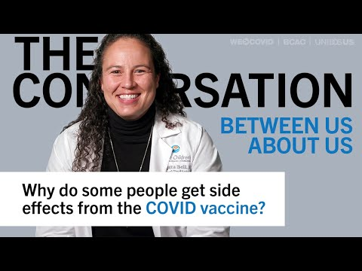

Slide 28
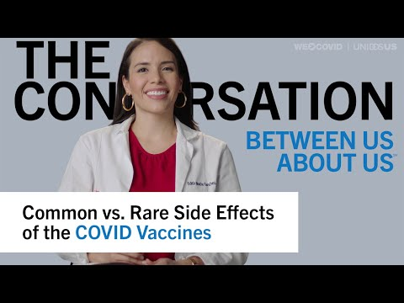

Slide 29
Key Points From the Side Effect Videos
Mild side effects from getting the COVID-19 vaccine are normal and vary in different people and go away quickly.
Not getting side effects does not mean that the vaccine isn’t working. It just means that your body responds differently which is normal and shouldn’t cause you to be concerned.
There are systems in place for detecting and understanding rare side effects.

Slide 30
Rare Side Effects Concerns
One concern for some people is myocarditis, or inflammation of the heart muscle.
This is very rare, and actually happens more frequently from a COVID-19 infection. Doctors are able to treat this condition easily so patients recover fully.
Hear from an infectious disease expert in the next video on why this is not something that should prevent someone from getting the COVID-19 vaccine.

Slide 31
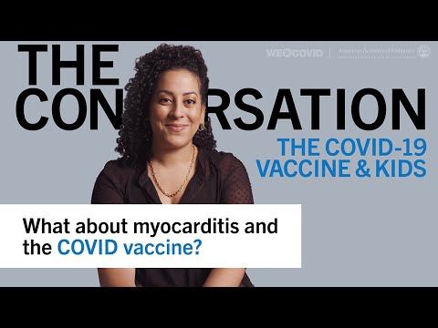

Slide 32
Section 2 Summary
You should know and be able to communicate:
The basics of vaccine development.
What is in the vaccine and how they work.
How we know the vaccines are safe.
Vaccine effectiveness and why boosters are needed.
Common side effects and rare side effects.

Slide 33
Complete Section 2
Please click the following link to get credit for this section, check your understanding, and receive your certificate of completion.
https://cip-dhhs.ne.gov/redcap/surveys/?s=YYHH9MEKAWHATC88

