Slide 1
Section 3:
Myths & Misinformation

Slide 2
Common Myths & Misinformation
Those currently spreading, anticipating future ones, and sources of accurate information

Slide 3
Getting The Vaccine During Pregnancy
There is incorrect information spreading about the COVID-19 vaccines and pregnancy.
The COVID-19 vaccines are safe and recommended for those that are pregnant and breastfeeding, and people that want to have a baby in the future.
For more information visit:
CDC | COVID-19 Vaccines While Pregnant or Breastfeeding
CDC | COVID-19 Vaccines for People Who Would Like to Have a Baby

Slide 5
Myths and Truths
There are many myths and incorrect information that prevent people from being confident in choosing to get the COVID-19 vaccine.
It’s important to emphasize what public health experts know to be true.
In the coming slides you’ll hear experts explain some common myths and misinformation.

Slide 6
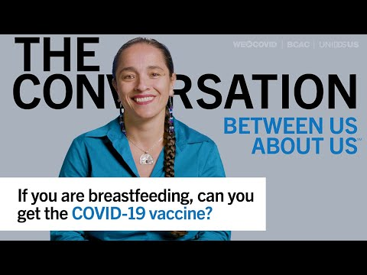
Truth: Breastfeeding People Should Get Vaccinated

Slide 7
Truth: Vaccines Do Not Change Your DNA

Slide 8
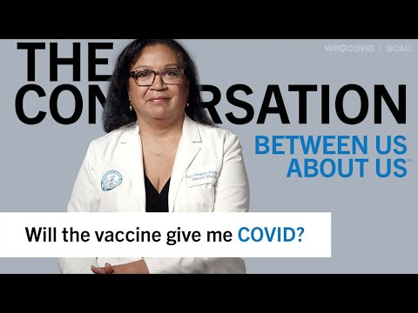
Truth: Vaccines Do Not Cause COVID-19

Slide 9
Truth: Vaccines Do Not Contain a Live Virus

Slide 10
Truth: It’s About Your Health

Slide 11
Top Myths Debunked

Slide 12
Myths Debunked With Other Sources
For more myths and facts about COVID-19 vaccines visit:
CDC | Myths and Facts About COVID-19 Vaccines
For information on figuring out how to respond to new misinformation visit: PHCC | Misinformation Alerts
For an updated report on COVD-19 misinformation and its impact on vaccine confidence view CDC’s insight reports:
CDC | Vaccine Confidence and Misinformation Reports

Slide 13
Spotting Misinformation
Spotting misinformation can be tricky, but it is very important skill to learn.
Quick-guide to spotting misinformation: Stronger | Detecting Misinformation
This source covers 4 simple steps:
Check the source
Check the date
Check the data & motive
Use a fact checking site of you are still unsure

Slide 14
Sources of Accurate Information
Federal, State, Local, Tribal, & National Organizations We Trust

Slide 15
Federal
Centers for Disease Control and Prevention (CDC)
CDC | Coronavirus Disease 2019 (COVID-19)
U.S. Department of Health and Human Services (HHS)
HHS | Coronavirus
Office of Minority Health (HHS)
HHS | Office of Minority Health
U.S. Food and Drug Administration (FDA)
FDA | Coronavirus Disease 2019 (COVID-19)
Federal Emergency Management Agency (FEMA)
FEMA | Coronavirus (COVID-19) Response

Slide 16
State & Healthcare Systems
Nebraska Department of Health and Human Services (DHHS): NE-DHHS | Coronavirus Disease (COVID-19)
Bryan Health: Bryan Health | COVID-19
CHI Health: CHI Health | Coronavirus (COVID-19)
Methodist: Methodist | COVID-19 Information
Nebraska Medicine: Nebraska Medicine | Coronavirus (COVID-19)
Community Action Partnership: Community Action of Nebraska

Slide 17
Local
Local Health Departments
Find your local health department here: Nebraska Local Health Departments
Local Medical Schools & Colleges of Public Health
UNMC | Coronavirus (COVID-19) Resources
Local Community Based Organizations

Slide 18
Tribal
Indian Health Services (IHS)
Indian Health Services | Coronavirus
Winnebago
Winnebago Public Health Department | COVID-19
Ponca
Ponca Tribe of Nebraska | COVID-19 News

Slide 19
Other Organizations
World Health Organization (WHO)
WHO | Coronavirus disease (COVID-19) pandemic
Ad Council
COVID Collaborative
Health Action Alliance (HAA)
HAA | Resources
National Association for the Advancement of Colored People (NAACP)
NAACP | Covid Know More
Infectious Diseases Society of America (IDSA)
IDSA | Equitable COVID Care for Diverse Patients

Slide 20
Getting Specific Medical Advice
Encourage clients to seek information from their healthcare provider regarding specific medical concerns.
If clients do not have a regular healthcare provider contact a Federally Qualified Health Center (FQHC) or Indian Health Services Center (IHS)
Find the FQHC nearest you: HRSA | Find a Health Center
American Indians and Alaskan Natives find IHS nearest you: IHS | Find a health Center

Slide 21
Section 3 Summary
You should know and be able to communicate:
Common misinformation and misconceptions about vaccines.
How to spot misinformation.
Why the vaccine is recommended for those who are pregnant.
How to access information on myths and misinformation.
Where to find more information and get questions answered.
That medical professionals can answer questions a person may have based on their specific health concerns.

Slide 22
Complete Section 3
Please click the following link to get credit for this section, check your understanding, and receive your certificate of completion.
https://cip-dhhs.ne.gov/redcap/surveys/?s=CAHR9W3TFDW87TL7

