Slide 1
Criteria and Standards for a New Credential – Behavior Analysts
Presented by Desiree J. Dawson, M.A., BCBA
Notes:
Insert Citations as links throughout
Make sure dots are consistent throughout

Slide 2
Distinct Profession
Pp 1-3 of Supplemental Information Sheet
Behavior is the primary focus with thousands of studies identifying and validating laws of behavior
Treatments based on the principles of behavior analysis have empirical support across various populations
University training programs specific to this profession
This profession has its own peer-reviewed literature base and profession-specific educational textbooks
34 states currently have some form of licensing laws for behavior analysts
CPT codes published by the American Medical Association approved distinct codes for behavior analysis
National Provider Identifier Database (NPID) recognizes Behavior Analyst as a distinct profession
Scope of Practice influenced by a profession-specific job task analysis. – Nearly no overlap with other professions
APBA, Behavior Analysis is a distinct discipline
Notes:
University Training Programs: There are hundreds of university training programs dedicating to teaching the principles, conceptualizations, and application of the science
CPT Codes: It is important to note the distinct codes approved by the American Medical Association are Category 1 CPT codes. For a profession to be permitted to bill Category 1 CPT codes, the AMA must deem the
The NPI Database is operated by the Centers for Medicare and Medicaid Services and issues a service provider number to healthcare providers for billing information. The NPI database distinguishes Behavior Analyst as a distinct healthcare provider category separate from other professions.
Scope of Practice influenced by the job task analysis. The task analysis identifies necessary areas of competency that must be demonstrated before being permitted to take the national certification exam and enter the professional workforce. There is nearly no overlap in the task list for behavior analysts with other professions. A representative for the Nebraska Hospital Association whom has reviewed our proposed scope of practice and application information agrees with the minimal overlap in scopes with other professions employed by Nebraska Hospitals, including mental health and psychology. We also have a colleague whom is an LIMHP with experience in both mental health and behavior analytic professions willing to attest to the differences in practice between the two professions.

Slide 3
Distinct Profession
P. 4 of Supplemental Information Sheet
Seven dimensions
Applied
Behavioral
Analytical
Technological
Conceptually Systematic
Effective
Generalized
Baer, D.M., Wolf, M.M., & Risley, T.R. (1968) Some current dimensions of applied behavior analysis. Journal of Applied Behavior Analysis, 1 91-97
Notes:
The seven dimensions of applied behavior analysis, published in the Journal of Applied Behavior Analysis in 1968 by Baer, Wolf, and Risley, outline the unique dimensions that practicing behavior analysts need to incorporate into all individualized, evidence-based practice.
These dimensions include
Applied: addresses behaviors that are important to the client and others in their life
Behavioral: Focuses on the client behaviors in need of improvement and directly measures those behaviors
Analytical: scientific evaluation of the effectiveness of the interventions. Ensures there is consistently a change in the behavior of interest when the intervention is in place compared to when it is not.
Technological: The procedures are described in enough detail that it can reasonably be replicated
Conceptually Systematic: Interventions are grounded in the conceptualization that behavior is a function of environmental events
Effective: improvements in target behaviors are to a practical degree
Generalized: changes in behavior last over time, in situations other than the initial intervention setting and/or spread to other behaviors not directly treated
These dimensions and their application are a center point in the education and training of behavior analysts.

Slide 4
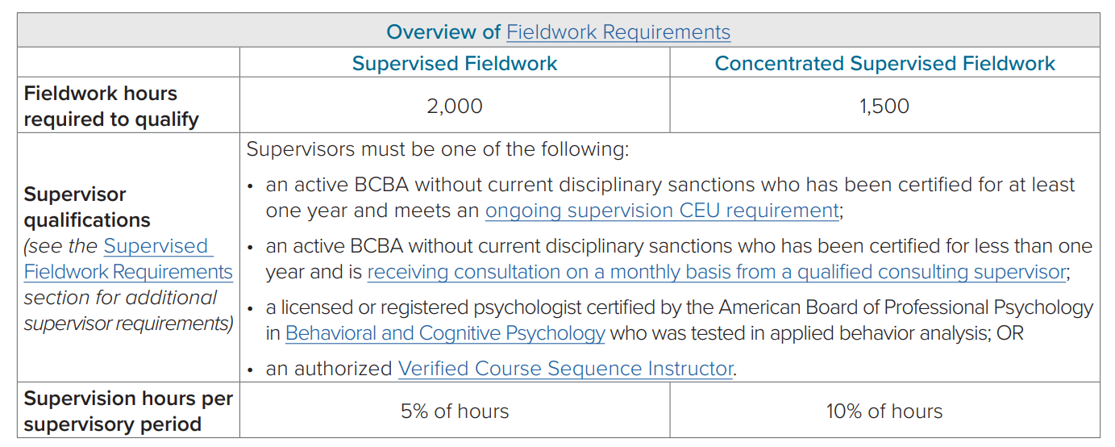
Pathways to becoming a BCBA
P. 5 of Supplemental Information Sheet
https://www.bacb.com/wp-content/uploads/2022/01/BCBAHandbook_220415.pdf

Slide 5
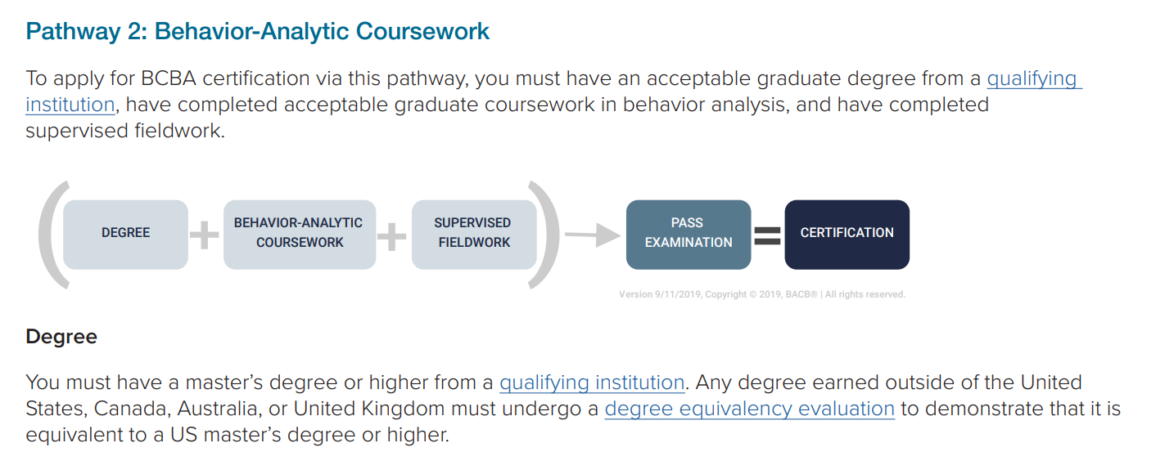
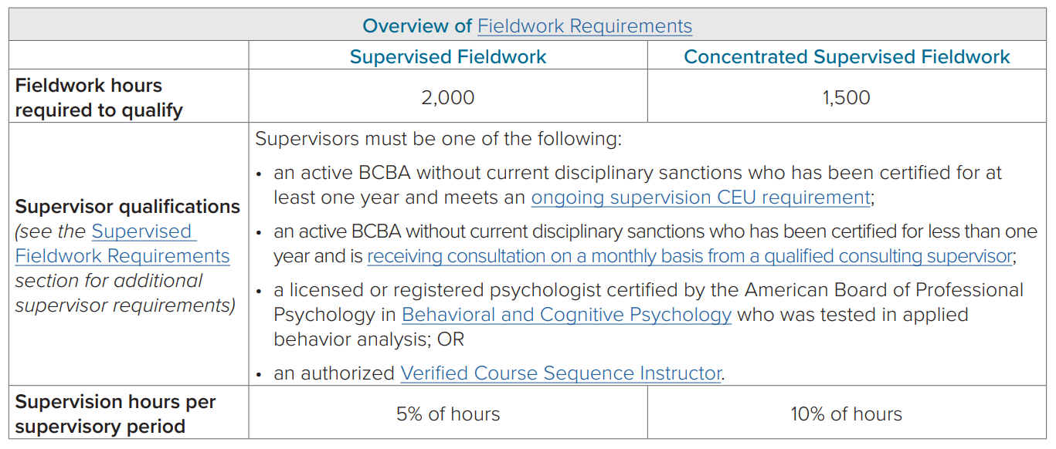
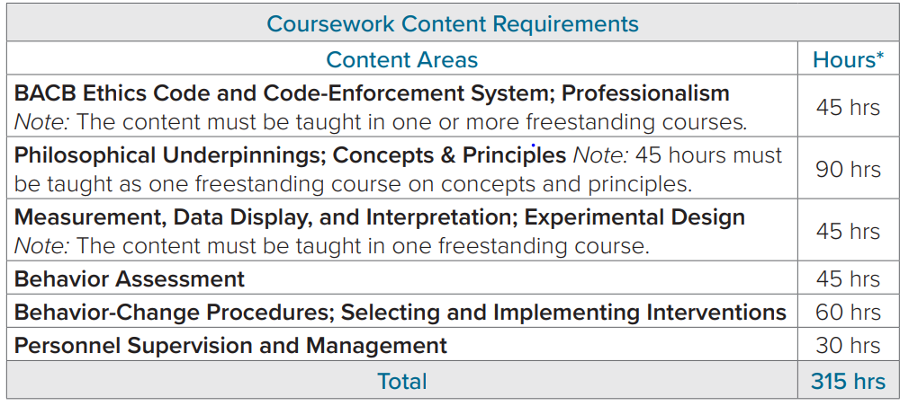
Pathways to becoming a BCBA
P. 5 of Supplemental Information Sheet
https://www.bacb.com/wp-content/uploads/2022/01/BCBAHandbook_220415.pdf

Slide 6
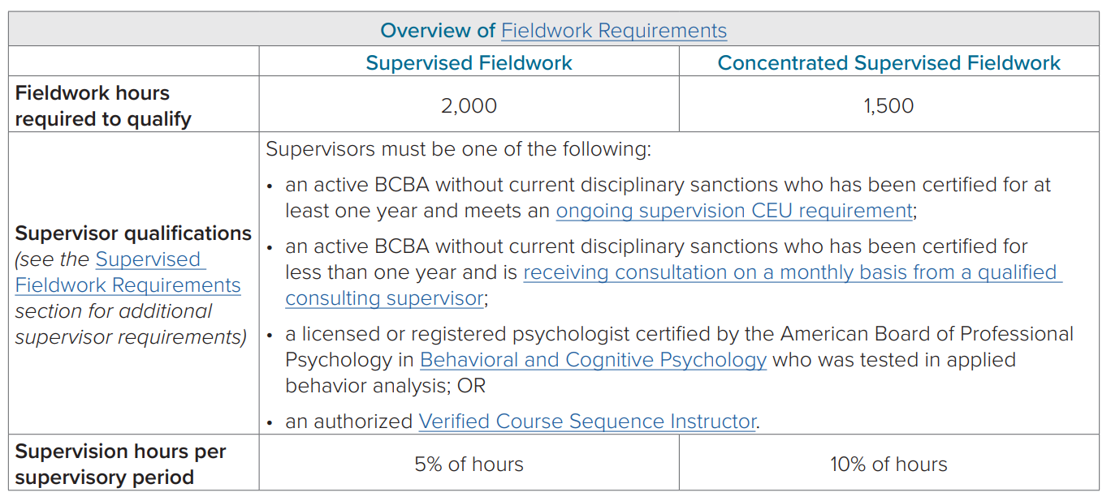
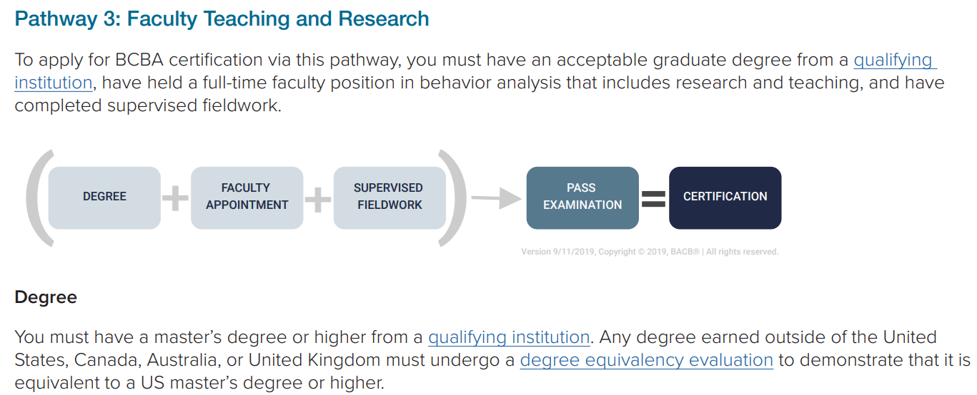
Pathways to becoming a BCBA
P. 5 of Supplemental Information Sheet
https://www.bacb.com/wp-content/uploads/2022/01/BCBAHandbook_220415.pdf

Slide 7
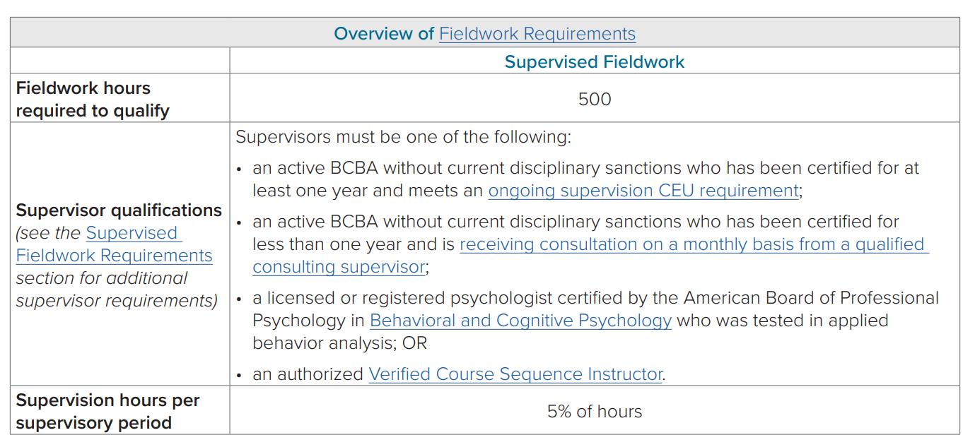
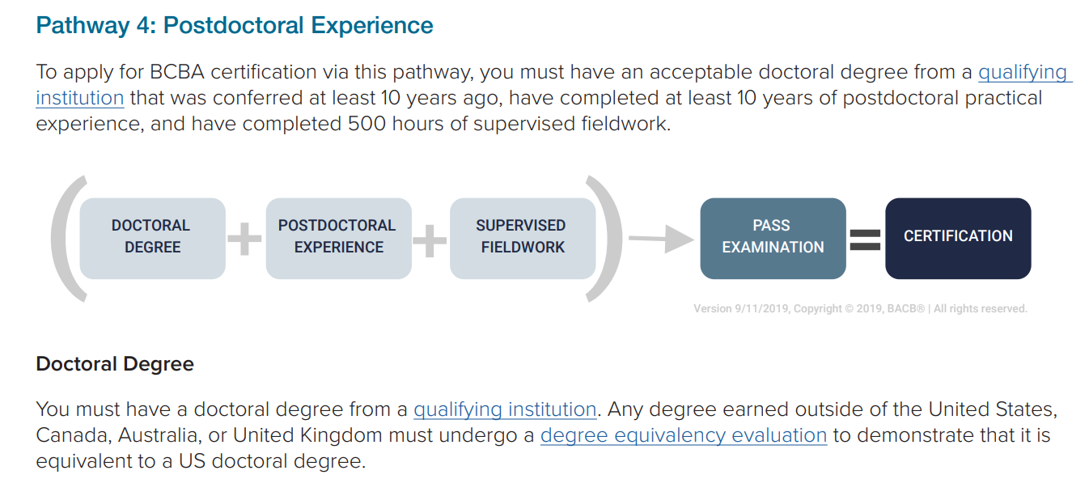
Pathways to becoming a BCBA
P. 6 of Supplemental Information Sheet
https://www.bacb.com/wp-content/uploads/2022/01/BCBAHandbook_220415.pdf

Slide 8
Changes in Eligibility – 2032
P. 6 of Supplemental Information Sheet
https://www.bacb.com/upcoming-changes/
Notes:
The requirements to become a BCBA are becoming more strict, indicating that a standardized method of training from institutions deemed to provide competent education and training are warranted
Even those with higher education will not be permitted to become a BCBA unless they complete a full Master’s degree from an ABAI accredited or recognized program plus fieldwork. Education in another related discipline with supervised fieldwork will no longer be sufficient.

Slide 9
Criteria Definitions – 172 NAC 4. 003
003.01. Criterion One. Unregulated practice can clearly harm or endanger the health, safety, or welfare of the public.
003.02. Criterion Two. Regulation of the health profession does not impose significant new economic hardship on the public, significantly diminish the supply of qualified practitioners, or otherwise create barriers to service that are not consistent with the public welfare and interest.
003.03. Criterion Three. The public needs assurance from the state of initial and continuing professional ability.
003.04. Criterion Four. The public cannot be protected by a more effective alternative.

Slide 10
Criterion 1 – Protection from Harm
172 NAC.4.003.01. - Unregulated practice can clearly harm or endanger the health, safety, or welfare of the public.

Slide 11
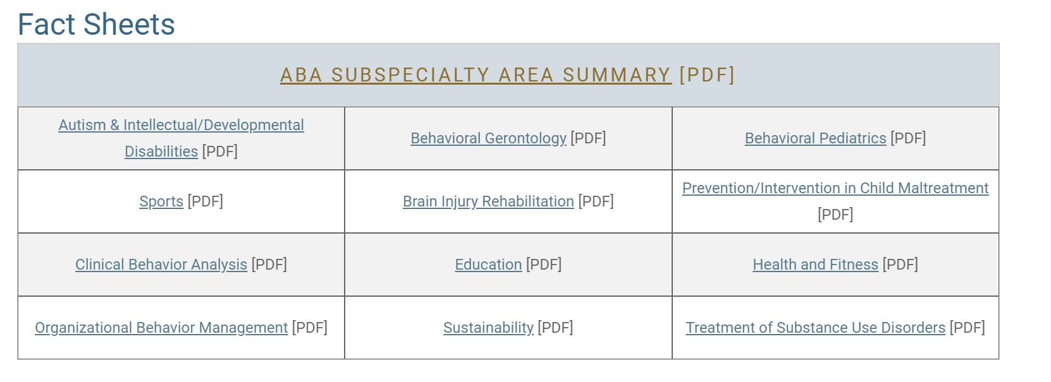
Criterion 1 – Protection from Harm
P. 7 of Supplemental Information Sheet
This profession systematically changes environmental variables to impact other’s behavior. That is powerful and dangerous if abused.
Many BCBAs work with vulnerable populations
Among Others (IDD, Corrections and Delinquency, etc. )
https://www.bacb.com/about-behavior-analysis/

Slide 12
Criterion 1 – Protection from Harm
Pp 8-9 of Supplemental Information Sheet
Parent was left feeling like finding a provider was a daunting task
Terrible experience with a provider
Child’s challenging behavior got worse
No gains in new skills
1 time contact with the provider
No physical address for this service provider
Parent was unaware of where to direct complaints or have the provider investigated for ethical practice
Sought another provider and contacted quality services
Child made meaningful gains in skills

Slide 13
Criterion 1 – Protection from Harm
Google Search “Anti-ABA Self-Advocates”
“Experienced torture and shutdown due to ABA cannot understand my own needs and am unable to ask for basic things to survive from being taught my needs wont’ matter. Cannot communicate effective and have not learnt any skills to live independently. Don’t know who I am and always taught whatever I might be was wrong. It’s a struggle to try to learn who I am at 40.”
https://stopabasupportautistics.home.blog/2019/08/11/personal-stories-from-those-formerly-enrolled-in-aba/

Slide 14
Criterion 1 – Protection from Harm
Google Search “Anti-ABA Self-Advocates”
“Trying to change who I am a person mentally abusing me as a way to train me to ‘be better’ was the hardest thing I’ve ever had to go through. It was disconnected me from my family as I felt I couldn’t trust them nor that I was loved by them. It made me fearful of all face-to-face interactions because I am still mentally afraid of the consequences, even though it’s been over a decade since my last ABA session. I have lifelong PTSD over ABA and it needs to be banned.”
https://stopabasupportautistics.home.blog/2019/08/11/personal-stories-from-those-formerly-enrolled-in-aba/

Slide 15
Criterion 1 – Protection from Harm
Google Search “Anti-ABA Self-Advocates”
“I had to wear plaster boots to stop me stimming by toe walking, I was not damaging my feet, it just didn’t look ‘normal”, this is alongside electronic shocks and other harmful practices.”
https://stopabasupportautistics.home.blog/2019/08/11/personal-stories-from-those-formerly-enrolled-in-aba/

Slide 16
Criterion 1 – Protection from Harm
BACB took over all national certification in 2005
The first state didn’t pass licensure until 2009
Prior to that, a handful of states had state-level certification, but outside these states, and completely before the 1990s, the profession was unregulated
We are now hearing testimony to the long-term effects of harm that happen from unregulated practice with the current Anti-ABA movement.
It’s easy to find testimony of adults who received services during a time when the profession was unregulated who report trauma and abuse from unregulated services. The risk of harm associated with unregulated practice is clear, real, and easy to find.
Johnston, Carr, & Mellichamp, 2017

Slide 17
Criterion 1 – Protection from Harm
P 10 of Supplemental Information Sheet
BCBA Employers in Nebraska
Data Extrapolations
Marked Increases since 2020
Since 2020, only 1/3 are Nebraska-based
Others are national chain companies
This percentage does not include the 4 additional Companies looking to establish, none of which are Nebraska-based.
Does not include companies in which the BCBA is out of state
May not include all independent practitioners

Slide 18
Criterion 2 – Does Not Impose Hardship or Diminish Supply, or Create Barriers
172 NAC.4.003.02. Regulation of the health profession does not impose significant new economic hardship on the public, significantly diminish the supply of qualified practitioners, or otherwise create barriers to service that are not consistent with the public welfare and interest.

Slide 19
Criterion 2 – Does Not Impose Hardship or Diminish Supply, or Create Barriers
Regulation of this profession will not cause harm or danger to the public’s safety.
It would provide consumers an avenue of assurance their providers have met minimum standards to be providing services.
34 States have licensure for behavior analysts
An additional 4 states have current bills that have been introduced
All states surrounding Nebraska, except Colorado, have licensure for behavior analysts
https://www.bacb.com/u-s-licensure-of-behavior-analysts/

Slide 20
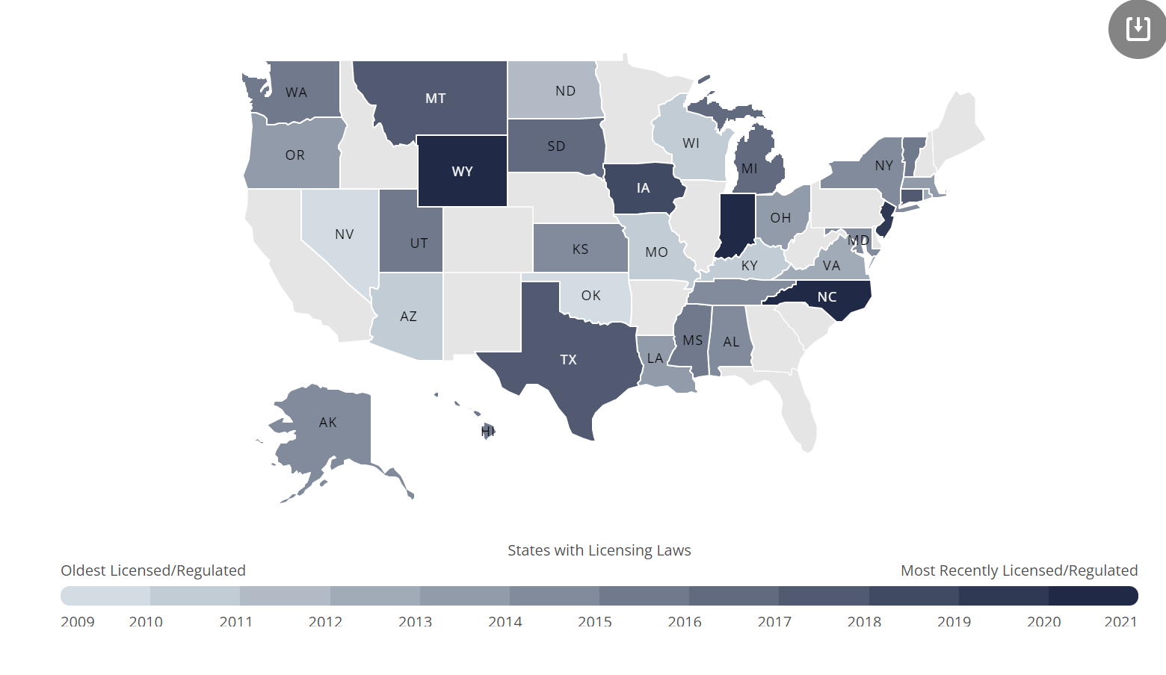
Criterion 2 – Does Not Impose Hardship or Diminish Supply, or Create Barriers
P 11 of Supplemental Information Sheet
https://www.bacb.com/u-s-licensure-of-behavior-analysts/

Slide 21
Criterion 2 – Does Not Impose Hardship or Diminish Supply, or Create Barriers
Pp 12-13 of Supplemental Information Sheet
As of February 2022, there were 167 BCBAs and BCBA-Ds in Nebraska
2021 Job market analysis found 265 job postings seeking a BCBA
42% demand increase since 2020
There are not enough BCBAs to meet demand - Yet
https://www.bacb.com/u-s-licensure-of-behavior-analysts/
https://www.bacb.com/wp-content/uploads/2022/02/BurningGlass2022_220208.pdf

Slide 22
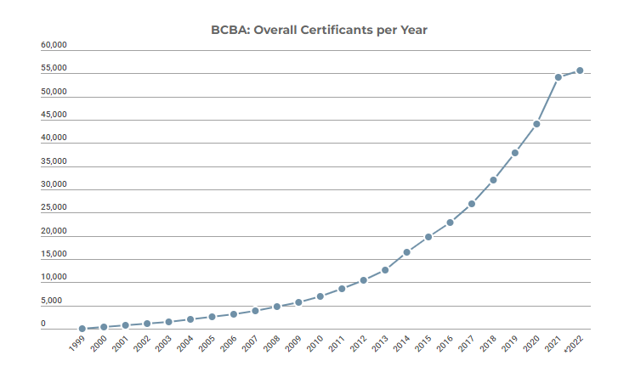
Criterion 2 – Does Not Impose Hardship or Diminish Supply, or Create Barriers
P 14 of Supplemental Information Sheet
Based on current certification trends, there will be substantially more BCBAs in the upcoming years.
By the end of 2021 there were 54,23 BCBAs
10,460 of these passed in 2021 alone
1/5 of the BCBA workforce became
certified last year
No signs of leveling off
https://www.bacb.com/bacb-certificant-data/

Slide 23
Criterion 2 – Does Not Impose Hardship or Diminish Supply, or Create Barriers
No concern with BCBAs meeting the demand, but many will be green
Protections need to be in place for largely young practitioner base
Proposed qualifications for determining minimum competency is that of the current qualifications required to become a BCBA
Includes completion of specific coursework requirements, required practicum hours and passing a national certification exam held to such rigor the pass rate is around 60%.
Specific information provided in the first portion of this presentation

Slide 24
Criterion 2 – Does Not Impose Hardship or Diminish Supply, or Create Barriers
Licensure removes barriers caregivers have in reporting concerns to a local body that can investigate and enforce sanctions and remove licenses.
Ensure consumers there is quality control for practitioners working with largely vulnerable populations
Scope of practice is distinct from other professions
Exemptions addresses concerns with consumers accessing quality services from quality professions practicing under their scope
Will not compete with other professions. Behavior Analysis is a distinct profession with an ethics code that requires collaborating with other professions

Slide 25
Criterion 3 – Need for Public Assurance
172 NAC.4.003.03. The public needs assurance from the state of initial and continuing professional ability..

Slide 26
Criterion 3 – Need for Public Assurance
Certification alone does not protect the consumer in Nebraska
If a person does not hold a board credential, the board does not have jurisdiction over that person. The state is expected to have protections in place.
BCBA and BCBA-D are qualified to practice independently.
Members of the public have the autonomy to choose their behavior analytic provider
As it currently stands, anyone in Nebraska can claim to be a provider for a family or individual for the purpose of obtaining them as a client, even though the provider has not met competency to practice.
If a person not board certified is claiming to hold a board certification, the certification board can issue a cease and desist, but the board does not hold disciplinary jurisdiction over the person

Slide 27
Criterion 3 – Need for Public Assurance
The national Certification board was established in 1999 and took sole oversight of certification at the national level in 2005. Because the profession has only been issuing all national credentials for 17 years, many members of the general public do not know how to verify if their provider holds a credential indicating minimum competencies
Licensure would make the process of finding a quality provider easier on a family or person seeking behavior analytic services. They would only need to verify their license. Should a potential provider not be licensed, there would be an avenue for reporting and disciplinary action.
Johnston, Carr, & Mellichamp, 2017

Slide 28
Criterion 4 – More Effective Alternative
172 NAC.4.003.04. Criterion Four. The public cannot be protected by a more effective alternative.

Slide 29
Criterion 4
This profession systematically changes variables to produce changes in others’ behaviors. This is powerful and needs a level of oversight from professionals skilled in the profession.
When implemented incorrectly, the consequences can terribly life-altering for the individual
We believe the level of licensure is the level needed to protect consumers from unqualified practitioners, especially in future years as the demand continues to grow.
Notes:
The details of therapy are individualized and nuanced that it requires a professional skilled with the profession to identify appropriate practice.

Slide 30
Criterion 4
P 15 of Supplemental Information Sheet
Sample of logistics with a stand-alone board
Kentucky began providing licenses in 2011
2011 - 20 licenses issued
2020 – nearly 400 issued
Each fiscal year since the onset of licensure the cost of revenue has been greater than the cost of expenses
Cash carried over into the next fiscal year
https://aba.ky.gov/Documents/March%202021%20ABA%20Newsletter.pdf
Notes:
We present Kentucky's financial information because this state has one of the longest stand-alone licensing boards and serves as a prediction that a stand-alone board in Nebraska would generate revenue exclusively through licensees paying their fees

Slide 31
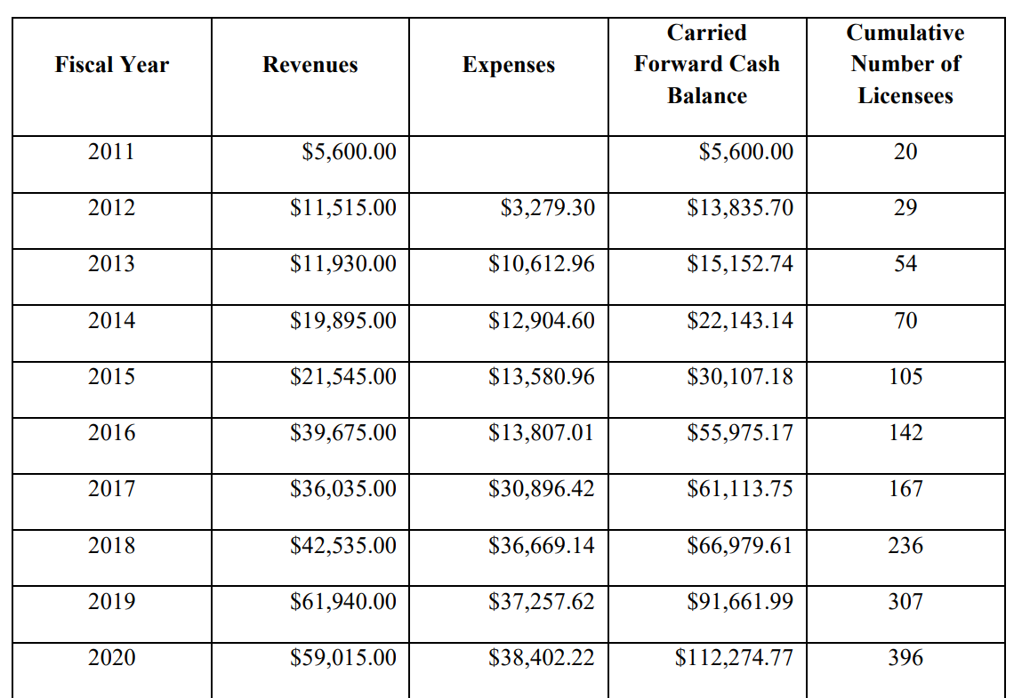
Criterion 4
P 15 of Supplemental Information Sheet
.
https://aba.ky.gov/Documents/March%202021%20ABA%20Newsletter.pdf

Slide 32
Criterion 4
P 16 of Supplemental Information Sheet
Problematic behaviors associated with various diagnoses such as autism, Intellectual Disability, Brain Injury are costly and often result in unnecessary use of psychotropic medication, hospital resources and residential services. (e.g., Houghton, Ong, & Bolognai, 2017; Mandell, 2008; Montes & Halterman, 2008; Tsakanikos, Costello, Holt, Sturmey, & Bouras, 2006)
Competently designed and delivered ABA-based interventions are effective at reducing the problematic behaviors that are costly to families and to taxpayers (e.g., Campbell, 2003; Hagopian, Rooker, & Rolider, 2011; Hassiotis, Canagasabey, Robotham, Marston, & Romeo, 2010; Heyvaert, Maes, Van den Noortgate, Kuppens, & Onghena, 2012; Lang et al., 2009; Ontario Association for Behaviour Analysis, 2019)
Incompetent interventionists can actually increase these problematic behaviors (e.g., Lovaas, Freitag, Gold, & Kassorla, 1965; Lovaas & Simmons, 1969; Mason & Iwata, 1990; also see Hanley, Iwata, & McCord, 2003)
Notes:
Many people with autism and related disorders, intellectual disabilities, traumatic brain injuries, and other conditions exhibit behaviors that directly jeopardize their health and safety, such as self-injury, elopement, pica (ingesting inedible items), feeding problems, and aggression. Such behaviors often result in costly and largely ineffective use of psychotropic medications, emergency room services, psychiatric hospitalizations, and residential services as well as tremendous emotional and financial burdens for families (e.g., Houghton, Ong, & Bolognai, 2017; Mandell, 2008; Montes & Halterman, 2008; Tsakanikos, Costello, Holt, Sturmey, & Bouras, 2006).
Substantial research shows that competently designed and delivered ABA interventions are effective for reducing problem behaviors (e.g., Campbell, 2003; Hagopian, Rooker, & Rolider, 2011; Hassiotis, Canagasabey, Robotham, Marston, & Romeo, 2010; Heyvaert, Maes, Van den Noortgate, Kuppens, & Onghena, 2012; Lang et al., 2009; Ontario Association for Behaviour Analysis, 2019).
Conversely, research has shown that interventionists who lack sufficient training in ABA can actually increase the occurrence of such behaviors in people with autism and other disorders (e.g., Lovaas, Freitag, Gold, & Kassorla, 1965; Lovaas & Simmons, 1969; Mason & Iwata, 1990; also see Hanley, Iwata, & McCord, 2003).

Slide 33
Criterion 4
P 16 of Supplemental Information Sheet
Quality early and intensive ABA treatment produces moderate to large improvements in overall functioning (e.g., see Eldevik et al., 2009, 2010; Green, 2011; Klintwall, Eldevik, & Eikeseth, 2015; Virues-Ortega, Rodriguez, & Yu, 2013).
Quality early ABA services also results in the decreased costs for the family and taxpayers saving education and healthcare systems valuable money and resources for other needs. (Chasson, Harris, & Neely, 2007; Jacobson, Mulick, & Green, 1998; Motiwala, Gupta, & Lilly, 2006).
Unqualified interventions claiming to be behavioral using unsupported claims produced no improvements for children. (Bibby et al., 2002; Mudford et al., 2001).
The trajectory of these children’s lives were forever altered because they received bad services from unqualified people.
Notes:
Abundant research also shows that early, intensive ABA treatment can produce moderate to large improvements in the overall functioning of many young children with autism when that treatment is designed and supervised by qualified professional behavior analysts (e.g., see Eldevik et al., 2009, 2010; Green, 2011; Klintwall, Eldevik, & Eikeseth, 2015; Virues-Ortega, Rodriguez, & Yu, 2013).
The resulting decreased need for specialized services yields large cost savings for the systems that are responsible for education, healthcare, and other services for people with autism (Chasson, Harris, & Neely, 2007; Jacobson, Mulick, & Green, 1998; Motiwala, Gupta, & Lilly, 2006).
In contrast, studies have shown that early “behavioral” intervention overseen by individuals who made unsupported claims to be qualified as ABA “consultants” produced no improvements in young children with autism (Bibby et al., 2002; Mudford et al., 2001). Thus, the fees paid to those consultants as well as the very precious time of the children they served were lost. The trajectory of these children’s lives were forever altered because they received bad services from unqualified people.
Enacting licensing laws for behavior analysts would address and remedy the harmful threats to the consumers in Nebraska better than other alternatives such as relying on national certification alone and state level registration or certification.

Slide 34
Thank You

Slide 35
Questions?

