Slide 1
Behavior Analysis: An Overview
Presented by Desiree J. Dawson, M.A., BCBA

Slide 2
Objectives
What Behavior
Analysis is
and isn’t
Single-Subject Research
History of Behavior Analysis
Real-world Applications
History of Regulation

Slide 3
“Brandon”
Specialized school setting
Practicum site for BCBA trainees
Faculty BCBA-D advisor
On-site BCBA
13-year-old male
Diagnosed with ASD
Severe aggression and hair pulling
Cause was unclear
Notes:
“Brandon”
Graduate Training – in a school that specialized in providing educational services for children that were placed out of district due to severe challenging behavior. These children were deemed to have the potential to cause harm to themselves or others in the district's special education programs. This school had low ratios of staff to students, a behavior analyst on staff, and graduate students receiving training to become a BCBA.
I worked with my faculty advisor and the on-site BCBA to consult on the cases where problem behavior was still interfering with classroom safety.
Brandon was a 13-year-old male diagnosed with Autism Spectrum Disorder. No known background of abuse or trauma and no other co-morbid diagnoses. Brandon was about 5’9 and about 120 pounds. Brandon would hit others in the face and pull hair to the point where chunks could come out from the scalp, leaving some staff with permanent bald spots.
These behaviors occurred under various situations including when school lessons were presented, when he had free time, and he would sometimes approach an unsuspecting person to pull their hair out and then run away to the bathroom where he locked himself in. He chose to spend most of his school day in the classroom bathroom or in a little nook just outside the classroom bathroom.

Slide 4
Notes:
Brandon’s FA Graph
Specialized training in developing these conditions, knowing the specific variables in place at certain points, using that information to analyze the data, design adjustments, test out the adjustments and confirm why the behavior is happening. Highly individualized, not standard by any means and requires a high degree of training and analysis to design, implement, interpret and use the results to understand that person’s behavior and teach a personalized intervention.
Brandon had a highly successful outcome, and we will revisit him later in this presentation with more information on how Brandon got to a successful place by the end of the school year.

Slide 5
Dr. Pat Friman - "No Such Thing as a Bad Boy"

Slide 6
Objectives
What Behavior
Analysis is
and isn’t
Single-Subject Research
History of Behavior Analysis
Real-world Applications
History of Regulation

Slide 7
What is Applied Behavior Analysis?
In-depth, natural science of how organisms learn, react, and respond to the environment around them
Interested in socially significant behaviors based on the principles of operant and respondent conditioning
https://www.bacb.com/about-behavior-analysis/

Slide 8
What Applied Behavior Analysis Isn’t
By itself, behavior analysis is not a mental health field
Behavior analysis is not simply behavior modification
Bailey and Burch, 2011

Slide 9
What is ABA Therapy?
ABA-BASED-Therapy
“ABA is a scientific approach for discovering environmental variables that reliably influence socially significant behavior
Therapy based on the foundations of behaviorism and the science of behavior
Cooper et al., 2020
Notes:
Because this is a radical behaviorism approach – those trained on the foundational principles of what contributes to behavior work with a variety of populations

Slide 10
Objectives
What Behavior
Analysis is
and isn’t
Single-Subject Research
History of Behavior Analysis
Real-world Applications
History of Regulation

Slide 11
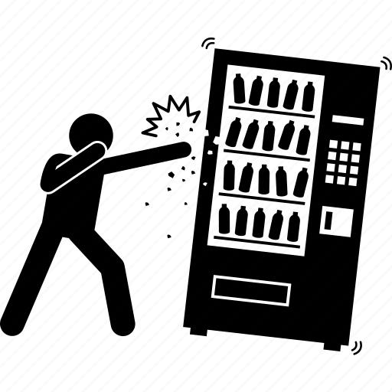
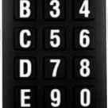
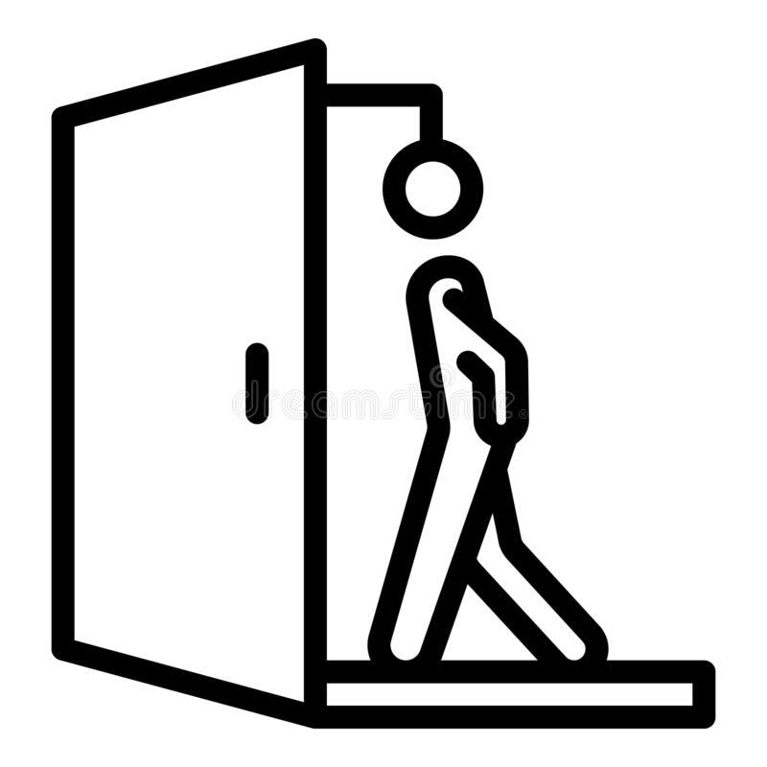
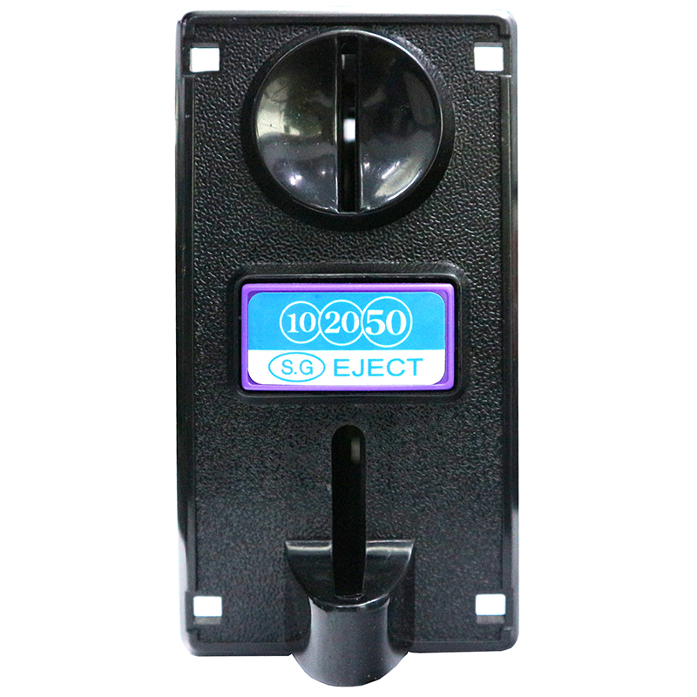
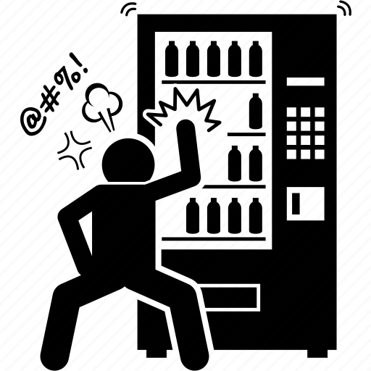
Notes:
Extinction Burst – Talk through the vending machine, then parallel to challenging behavior

Slide 12
Youth at Risk for Delinquency
“City within a city”
Model is compatible with a behavior-analytic approach to positive behavior change
A person’s environment impacts their behavior
https://www.boystown.org/locations/nebraska/about-boys-town-nebraska/Pages/default.aspx
Notes:
Village within Omaha that houses several hundreds of youth at a time and receive services for behavioral, emotional, and academic setbacks. Youth live in a single-family home, with about 8 youth in a house oversaw by a married family- teaching couple. The setup and arrangement takes the approach that the environment impacts behavior, in line with a behavior analytic approach to the principles of what impacts behavior, as noted by Dr. Friman in the video at the beginning of this presentation.

Slide 13
Brandon: Clinical Application
Break
Break
Notes:
Revisit Brandon
After determining why hair pulling, and aggression was happening. We understood his behavior, we understood what he was looking for and he was showing us the only way he knew how to get what he wanted. We didn’t try to change his behavior until we understood it. We need to understand what Brandon valued before trying to change his behavior because we wanted him to have the things he valued, but to get them through more appropriate means.
Preference Assessments
Fading
Differential Reinforcement
Functional Communication Training
Delay Tolerance
First worked on Brandon tolerating us keeping the door to the bathroom open. Then table at the bathroom door and a lounge nook.
Taught him a more appropriate location to go to have a moment to himself that also had a comfy chair and his favorite items.
Next there were moments he had to complete some tasks at the work table and upon completing his work, could go be by himself in the lounge area
Faded his individual worktable into the classroom with his peers
He learned there were things and people in the classroom he liked more than being alone. He began to choose to spend his time in the classroom participating with the class
By the end of the school year he went on a classroom outing to the zoo and loved it.
By taking the time to understand what Brandon valued, we were able to teach him appropriate ways to get the things he wanted, but also expose him to new people and environments he didn’t have the opportunity to access by self-isolation.

Slide 14
Objectives
What Behavior
Analysis is
and isn’t
Single-Subject Research
History of Behavior Analysis
Real-world Applications
History of Regulation

Slide 15
Single Subject Research Design
Defining Characteristics:
Continuous Measurement
Within-subject Replication
Visual Inspection
Pierce & Cheney, 2013

Slide 16
Experimental Control
Dependent variable only changes with a manipulation to the independent variable
Demonstrated via repeated replications with the same individual
Baseline Logic:
Prediction: Predicted behavior without introduction of the IV
Verification: Verifies behavior would have remained unchanged
Replication: Repeating previously observed change with the IV
Pierce & Cheney, 2013

Slide 17
Reversal Design Example
Replication
Prediction
Verification

Slide 18
Single-Subject Experimental Designs
Reversal Design
Multiple Baseline Design
Multielement Design
Changing Criterion Design
These designs are used in standard clinical practice
Providers in ABA are highly trained to clinically implement experimental logic with the same scientific rigor as research

Slide 19
Peer-Reviewed Journals
Journal of Applied Behavior Analysis
Journal of the Experimental Analysis of Behavior
The Analysis of Verbal Behavior
Behavior Analysis in Practice
Publications in these peer-reviewed journals inform standard clinical practice
Notes:
Referenced when seeking assessment and treatment information for Brandon

Slide 20
Objectives
What Behavior
Analysis is
and isn’t
Single-Subject Research
History of Behavior Analysis
Real-world Applications
History of Regulation

Slide 21
Seminal Articles
Ayllon &Azrin, 1965: Reinforcement impacting behavior of institutionalized individuals with Schizophrenia
Baer, Wolf, and Risley, 1968: Dimensions of Behavior Analysis
Iwata et al., 1982/1994: Functional Analysis Methodology
Bannerman, Sheldon, and Sherman, 1990: Client Rights
Carr and Durand, 1985: Functional Communication Training
Wolf, Risley, and Mees, 1964: First published study with behavior analysis and autism

Slide 22
Objectives
What Behavior
Analysis is
and isn’t
Single-Subject Research
History of Behavior Analysis
Real-world Applications
History of Regulation

Slide 23
History of Regulation for Behavior Analysis
Certification:
Jurisdiction over those who voluntarily meet the requirements to become certified
Does not have jurisdiction over those who do not meet certification standards, but practice and provide services to consumers
Licensure:
Jurisdiction is at the state level
Does have jurisdiction over those who do not meet standards to practice
Provides an avenue for consumers to report an individual engaging in illegal practice

Slide 24
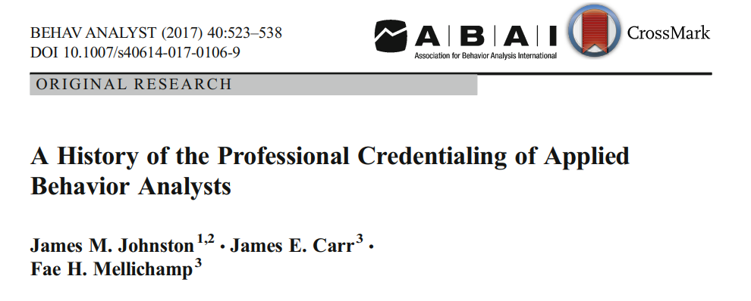
Johnston, Carr, and Mellichamp, 2017
Notes:
The following historical recap is summarized from an article published in 2017 by Johnston, Carr, and Mellichamp

Slide 25
History of Regulation for Behavior Analysis
Since 2007:
Workforce has increased by 1322.8%
3,811 certificates in 2007
54,223 certificates in 2021
More funders and local state governments recognizing the profession
Dozens of new training programs have been established to meet consumer demand
Increased publications directed towards practitioners
Association of Professional Behavior Analysts (APBA) founded
https://www.bacb.com/bacb-certificant-data/
Notes:
The current certification body, the Behavior Analysis Certification Board was founded in 1998, but attempts at establishing regulation date back nearly 60 years.

Slide 26
History of Regulation for Behavior Analysis
Behavior Modification:
Term that describes any attempt to change behavior, regardless of the theoretical orientations
The field of behavior analysis has moved away from behavior modification
Notes:
Research advancements and new knowledge of the technology has moved the field of behavior analysis away from simple behavior modification and now takes the approach of understanding variables that impact behavior before attempting to modify it.

Slide 27
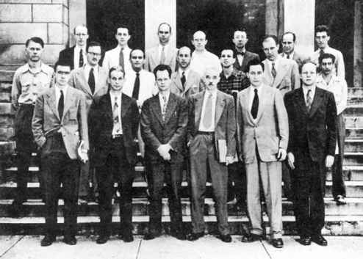
History of Regulation for Behavior Analysis
1970s
Graduates from the few behavior analysis programs began working with individuals with intellectual and developmental disabilities.
Demand grew throughout the 1970s
First interest in regulating the profession
Notes:
The rationale for regulation was to protect the consumers from poorly trained individuals using harmful interventions. At the time individuals were known to have implemented abusive behavior modification including forced masturbation for individuals caught masturbating. There was public shaming for being caught lying, contingent beatings for running away, excessive timeout from enriched environments, to name a few

Slide 28
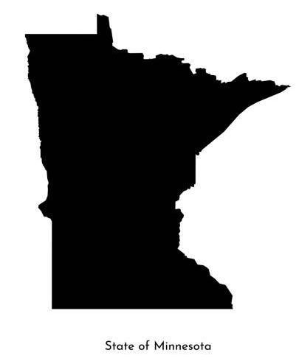
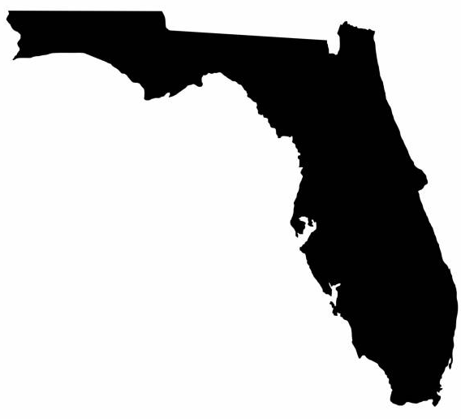
History of Regulation for Behavior Analysis
In 1977, Minnesota’s Department of Public Welfare developed a “career ladder” to better identify professionals with formal training in behavior analysis
Included testing and oversight during a probationary period
Florida began a model where doctoral-level experts in behavior analysis oversaw the delivery of services.
Developed trainings and offered certification for completion
This effort ended after only a few years
Notes:
Without more funding and administrative support, this effort ended within a decade, but was the first demonstration of the need to identify properly trained individuals to protect the consumers they worked with.
These doctoral-level experts quickly noticed the widespread issue of individuals being ill-prepared to implement this work.

Slide 29
History of Regulation for Behavior Analysis
Another project in Florida resulted in a contract between the State of Florida and Goodson and Associates
Resulted in an early version of a professional task list
First pilot examination to certify behavior analysts in Florida was in 1983
During its operation, it certified more than 2,000 individuals
By the mid-1990s, five additional states adopted use of the Florida Certification Model
Need for regulation was now at the national level
Notes:
Goodson and Associates: a firm in Tallahassee that specialized in the development of exams

Slide 30
History of Regulation for Behavior Analysis
Behavior Analysis Certification Board (BACB) was founded in May of 1998
By 2005, all state-level certification had been transferred to the jurisdiction of the BACB
BACB began issuing national certification exams in 2000

Slide 31
History of Regulation for Behavior Analysis
BACB updated
Task Lists https://www.bacb.com/wp-content/uploads/2020/08/BCBA-task-list-5th-ed-211019.pdf
Educational Standards https://www.bacb.com/bcba/
Coursework Requirements https://www.bacb.com/wp-content/uploads/2020/05/170113-BCBA-BCaBA-coursework-requirements-5th-ed.pdf
Increased Practicum Requirements https://www.bacb.com/wp-content/uploads/BACB_Experience-Standards_200501.pdf
Most recent update took effect January 1st, 2022

Slide 32
History of Regulation for Behavior Analysis
Mature professions develop and enforce codes of conduct for ethical practice of members of the profession
The BACB issued the Guidelines for Responsible Conduct for Behavior Analysts in 2001
Most recent version, The Ethics Code for Behavior Analysts, took effect January 1st, 2022 https://www.bacb.com/wp-content/uploads/2020/11/Ethics-Code-for-Behavior-Analysts-210902.pdf

Slide 33
History of Regulation for Behavior Analysis
“The National Commission for Certifying Agencies (NCCA) were established as an accreditation arm of the Institute for Credentialing Excellence (ICE). Organizations that achieve NCCA accreditation of its certification programs have demonstrated a valid and reliable process for development, implementation, maintenance, and governance of their certification programs. The BACB applied and was awarded accreditation in 2007 and recredentialed in 2012.”
Other professions with NCCA accreditation:
Nurses
Respiratory Therapists
Counselors
315 programs and 130 organizations
https://www.credentialingexcellence.org/Accreditation/Earn-Accreditation/NCCA#:~:text=NCCA%20accredited%20programs%20certify%20individuals,technicians%2C%20crane%20operators%20and%20more.
Notes:
Important to note that the BACB’s formulation of the examination, eligibility standards, task lists, and ethics system are all based on NCCA requirements.

Slide 34
History of Regulation for Behavior Analysis
Insurance reform and work from Autism Speaks has been a catalyst for many states adopting licensure for behavior analysts
In many states, licensure for behavior analysts were linked to autism insurance legislation
Some health care plans will not cover services unless the services are provided by a licensed provider
In Nebraska, the Medicaid waiver passed in 2014 provided coverage of ABA-based therapy for autism, billed under CPT codes, yet Nebraska does not yet have a system for regulating the practice of the professionals providing services, mostly with children.

Slide 35
History of Regulation for Behavior Analysis
Current certification body (BACB) was founded in 1998
The BACB began administering exams in 2000
First states to pass licensure laws were Nevada and Oklahoma in 2009
Since 2009, a total of 33 states have enacted licensure for behavior analysts due to the increased demand for services and the need to protect consumers from individuals practicing outside the jurisdiction of the BACB

Slide 36
Thank You

Slide 37
Questions?

Slide 38
References
About Boys Town. Boys Town. (n.d.). Retrieved February 1, 2022, from https://www.boystown.org/about/Pages/default.aspx
Ayllon, T., & Azrin, N. H. (1965). The measurement and reinforcement of behavior of psychotics. Journal of the Experimental Analysis of Behavior, 8(6), 357–
383. https://doi.org/10.1901/jeab.1965.8-357
BACB – About Behavior Analysis. Behavior Analyst Certification Board. (2022, February 3). Retrieved February 1, 2022, from https://www.bacb.com/about-behavior-analysis/
BACB Certificant Data. Behavior Analyst Certification Board. (2022, January 28). Retrieved February 4, 2022, from https://www.bacb.com/bacb-certificant-data/
BCBA Task List (5th ed.). Behavior Analyst Certification Board. (2017, January). Retrieved February 4, 2022, from https://www.bacb.com/wp-content/uploads/2020/08/BCBA-task-list-5th-ed-
211019.pdf
BCBA/BCABA Coursework Requirements. Behavior Analyst Certification Board. (n.d.). Retrieved February 5, 2022, from https://www.bacb.com/wp-content/uploads/2020/05/170113-BCBA-BCaBA-
coursework-requirements-5th-ed.pdf
BCBA/BCABA Experience Standards - BACB. Behavior Analyst Certification Board. (n.d.). Retrieved February 4, 2022, from https://www.bacb.com/wp-content/uploads/BACB_Experience-
Standards_200501.pdf
Board Certified Behavior Analysts (BCBA). Behavior Analyst Certification Board. (2022, January 31). Retrieved February 4, 2022, from https://www.bacb.com/bcba/
Baer, D. M., Wolf, M. M., & Risley, T. R. (1968). Some current dimensions of applied behavior analysis. Journal of Applied Behavior Analysis, 1(1), 91–97. https://doi.org/10.1901/jaba.1968.1-91

Slide 39
References
Bailey, J., & Burch, M. (2011). Ethics for Behavior Analysts (2nd expanded ed.). Routledge/Taylor & Francis Group.
Bannerman, D. J., Sheldon, J. B., Sherman, J. A., & Harchik, A. E. (1990). Balancing the right to habilitation with the right to personal liberties: The rights of people with developmental disabilities to eat too many
doughnuts and take a nap. Journal of Applied Behavior Analysis, 23(1), 79–89. https://doi.org/10.1901/jaba.1990.23-79
Carr, E. G., & Durand, V. M. (1985). Reducing behavior problems through functional communication training. Journal of Applied Behavior Analysis, 18(2), 111–126. https://doi.org/10.1901/jaba.1985.18-111
Cooper, J. O., Heron, T. E., & Heward, W. L. (2020). Applied Behavior Analysis (3rd ed.). Pearson.
Ethics Code for Behavior Analysts. Behavior Analysts Certification Board. (n.d.). Retrieved February 4, 2022, from https://www.bacb.com/wp-content/uploads/2020/11/Ethics-Code-for-Behavior-Analysts-210902.pdf
Iwata, B. A., Dorsey, M. F., Slifer, K. J., Bauman, K. E., & Richman, G. S. (1994). Toward a functional analysis of self-injury. Journal of Applied Behavior Analysis, 27(2), 197–209.
https://doi.org/10.1901/jaba.1994.27-197
Johnston, J. M., Carr, J. E., & Mellichamp, F. H. (2017). A history of the professional credentialing of applied behavior analysts. The Behavior Analyst, 40(2), 523–538. https://doi.org/10.1007/s40614-017-0106-9
NCCA Accreditation. Institute for Credentialing Excellence. (n.d.). Retrieved February 4, 2022, from https://www.credentialingexcellence.org/Accreditation/Earn-
Accreditation/NCCA#:~:text=NCCA%20accredited%20programs%20certify%20individuals,technicians%2C%20crane%20operators%20and%20more.
Pierce, W. D., & Cheney, C. D. (2013). Behavior Analysis and Learning (5th ed.). Psychology Press.
Wolf, M.M., Risley, T., & Mees, H. (1964). Application of operant conditioning procedures to the behavior problems of an autistic child. Behaviour Research and Therapy 1, 305-312.

