Slide 1

NNP
Technical Review
Committee #1
Karen Wenner, APRN, DNP
Ann Young, APRN
Jillian Negri, APRN, DNP
Cora Schrader

Slide 2

Agenda: 3/19/25
Introduction
NP 101
Goals
Basics of Fluoroscopy
Restriction
Current NP Practices
Proposed Change
Benefits
Potential Risks
Risk Mitigation
Review of Criteria
Summary/Questions

Slide 3
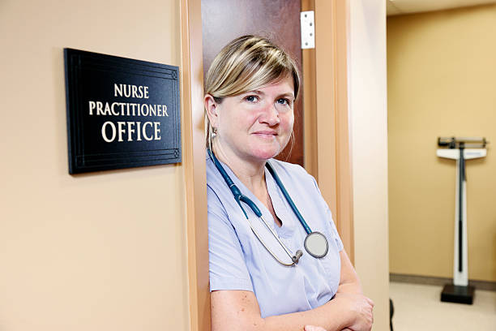
Nurse Practitioner 101
NPs provide healthcare in family medicine, internal medicine and every specialty across the lifespan of the patient
Nurse Practitioners are one of four licensed APRN providers and make up nearly 88% of licensed APRNs (3,474 NPs)
Other licensed APRNs include:
    Certified Nurse Midwives
    Certified Registered Nurse Anesthetists
    Clinical Nurse Specialists

Slide 4
Goals of the 407 Review
Update Nebraska Medical Radiography Statute to include Nurse Practitioners.
Remove barriers to allow Nurse Practitioners to practice to the full extent of education and training.
Define Nebraska state regulated training/education requirements for fluoroscopy.

Slide 5
Fluoroscopy
Fluoroscopy makes a real-time video of the movements inside a part of the body. Images are captured by passing x-rays through the body over a period of time
There can be higher radiation doses compared to plain x-ray, but the benefits of using fluoroscopy when needed outweigh the risks of the added radiation exposure

Slide 6
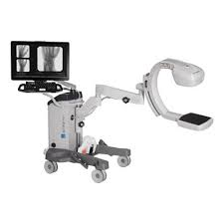
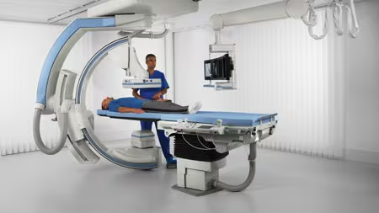
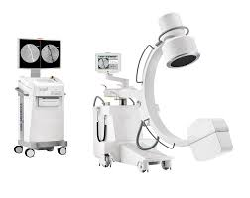
Fluoroscopy Equipment

Slide 7
Current Restriction
The Nebraska Board of Radiography recognizes a ‘licensed practitioner’ as a person licensed to practice medicine, dentistry, podiatry, chiropractic, osteopathic medicine and surgery, or as an osteopathic physician
A ‘licensed practitioner’ may perform and supervise fluoroscopy without any further training requirements set forth by the State
Nurse practitioners are not recognized as a “licensed practitioner”. This was not an intentional statutory limitation. Per the Board of Radiography, the statute was created in the 1980s before NPs were prevalent and practicing in Nebraska

Slide 8
NP Specialties – Fluoroscopy
  Specialties: Orthopedic Surgery, Neurosurgery, Cardiology, Pain Management, Urology, Emergency Medicine, Fertility, Gastroenterology, Nephrology, OB/GYN, Surgical First Assisting.
  NPs are educated and trained in radiation. NPs order x-rays, CT scans, nuclear medicine studies, interventional radiology procedures, and all other facets of radiation exposing diagnostics, many of which have higher levels or radiation exposure to the patient.
  Cannot fulfill the specialty role and standard of care because of the fluoroscopy barrier. NPs cannot be hired in Interventional Radiology in Nebraska.
  NPs are trained/credentialed to perform the procedure but cannot use fluoroscopic guidance.
  Joint/fracture reductions
  Intra-articular injections
  Lumbar puncture
  Paracentesis
  Central line placement
  Insert chest tubes
  First Assist in operating room

Slide 9
Need for the Proposal: Patient Access
  Shortages of specialty services especially in rural communities
  Limits patient access to care
  Lack of ability to recruit trained specialists to Nebraska
  Unnecessary work arounds
  Prolonged procedures, repeat sedation/x-rays
  Patients must travel for specialized procedures
Notes:
SHARE EXPERIENCES, OR/ER/IR Ellen

Slide 10
Need for the Proposal: Workforce
NPs cannot practice to the full extent of their training
Nebraska statute is out of date with current healthcare practices and standards of care
Specialists cannot hire highly qualified NPs for desired roles
NPs cannot bring their expertise from other states

Slide 11

Proposed Change
NNP proposes to update the Medical Radiography Statute to include nurse practitioners as ‘licensed providers’.
This would allow nurse practitioners to supervise and/or perform fluoroscopy after didactic and clinical training requirements have been met.

Slide 12
Benefits
Increased Access to Care: Allowing NPs to perform fluoroscopy can improve access to diagnostic imaging and procedures, especially in rural and underserved areas where medical specialists may be scarce.
1
Efficiency in Healthcare Delivery: NPs can streamline patient care by managing imaging procedures directly, reducing wait times for patients and relieving burden on radiologists, physicians and surgeons.
2
Cost-Effectiveness: Utilizing NPs for fluoroscopy can lower healthcare costs by minimizing the need for specialist referrals and optimizing resource use within healthcare systems, such as reducing patient transfers from critical access emergency rooms.
3
Quality of Care: NPs are highly trained professionals who can provide high-quality care, and their involvement in fluoroscopy could enhance patient outcomes through timely interventions and better follow-up.
4
Workforce Utilization: With a growing demand for healthcare services, expanding the scope of practice for NPs can help address workforce shortages and ensure more patients receive necessary specialty services.
5

Slide 13
Potential Risks
Prolonged fluoroscopy can cause tissue damage, burns, or hair loss to the region
  This is extremely rare and several safety mechanisms are in place to avoid this occurrence
Stochastic
  Increased risk of cancer with cumulative radiation dose over time
Misinterpretation of imaging
Insufficient radiation/inadequate study requiring repeat

Slide 14
Risk Mitigation
Education and training on radiation safety and equipment
Automatic dose rate control-machine optimizes
Alarm on machine
ALARA
Radiation safety members/committees/radiology techs
Oversight of collaborating physicians, surgeons, radiologists
Reporting systems already in place-time/cumulative dose
Credentialing/privileges
NNP did not find reported instances of harm from fluoroscopy in Nebraska

Slide 15
Proposed Education & Training
NNP proposes a minimum of four (4) hours of post graduate didactic education in fluoroscopy which includes: radiation safety, radiation production and characteristics, radiobiology, contrast media, and fluoroscopic unit operation
Clinical training must include a minimum of five (5) fluoroscopic procedures under the supervision of a formally trained preceptor (e.g. medical physicist, radiologist, or other properly trained and licensed physician)
With each license renewal, a nurse practitioner who utilizes fluoroscopy must have a minimum of one (1) hour of continuing education (CME) in fluoroscopy
Further training requirements may be set forth by the organization/fluoroscopy owner
Currently, 22 other states allow nurse practitioners to utilize fluoroscopy and no significant adverse outcomes have been reported. Bordering states include Iowa, Colorado, and Wyoming, with each varying in state regulated training requirements

Slide 16
Review of Criteria
  Criteria 1: The health, safety, and welfare of the public are inadequately addressed by the present scope of practice or limitations in the scope
  Criteria 2: Enactment of the proposed change in scope of practice would benefit the health, safety, or welfare of the public
  Criteria 3: The proposed change in scope of practice does not create significant new danger to the health, safety, or welfare of the public
  Criteria 4: The current education and training for the health profession adequately prepares practitioners to perform the new skill or service
  Criteria 5: There are appropriate post-professional programs and competence assessment measures available to assure that the practitioner is competent to perform the new skill or service in a safe manner
  Criteria 6: There are adequate measures to assess whether practitioners are competently performing the new skill or service and to take appropriate action if they are not performing appropriately

Slide 17
Thank you

