Slide 1
407 TRC Optometry Application
Christopher Wolfe, OD, FAAO, Dipl. ABO

Slide 2
Prior TRC Questions
Christopher Wolfe, OD, FAAO, Dipl. ABO

Slide 3
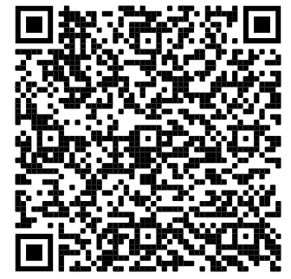
What occurred in other states authorizing Doctors of Optometry to perform SLT?
Criterion 2

Slide 4
What occurred in other states authorizing Doctors of Optometry to perform SLT?
Total CMS Procedures in 2014 – 1,148
Total CMS Procedures in 2019 – 1,261
~10% increase in SLTs = Reduced overall cost for meds
Criterion 2

Slide 5
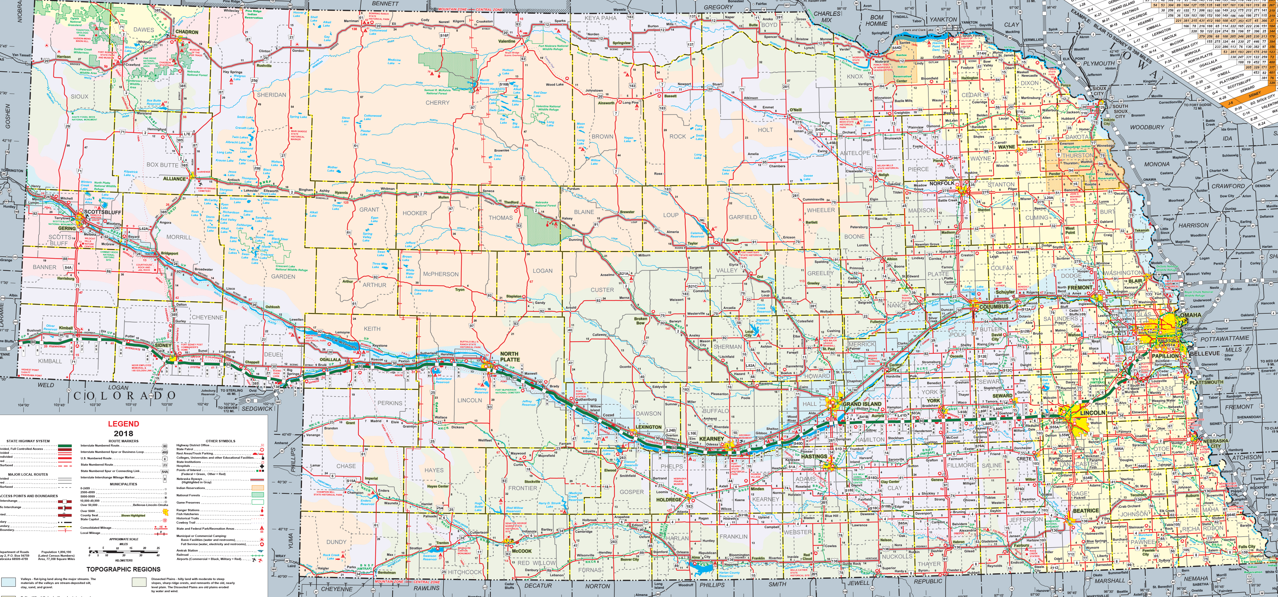
Current Locations of SLT Lasers in Nebraska
Criterion 1

Slide 6
What would we expect in NE? NOA Member Survey
Christopher Wolfe, OD, FAAO, Dipl. ABO

Slide 7
Do you treat and manage glaucoma?
Criterion 2

Slide 8
If the scope of practice for optometrists in NE was expanded to include SLT lasers for the treatment of glaucoma and if you had reasonable access to an SLT laser in your office, local hospital, or a nearby surgery center, would you perform SLTs on your patients?
What does this translate to?
Criterion 1 and 2

Slide 9
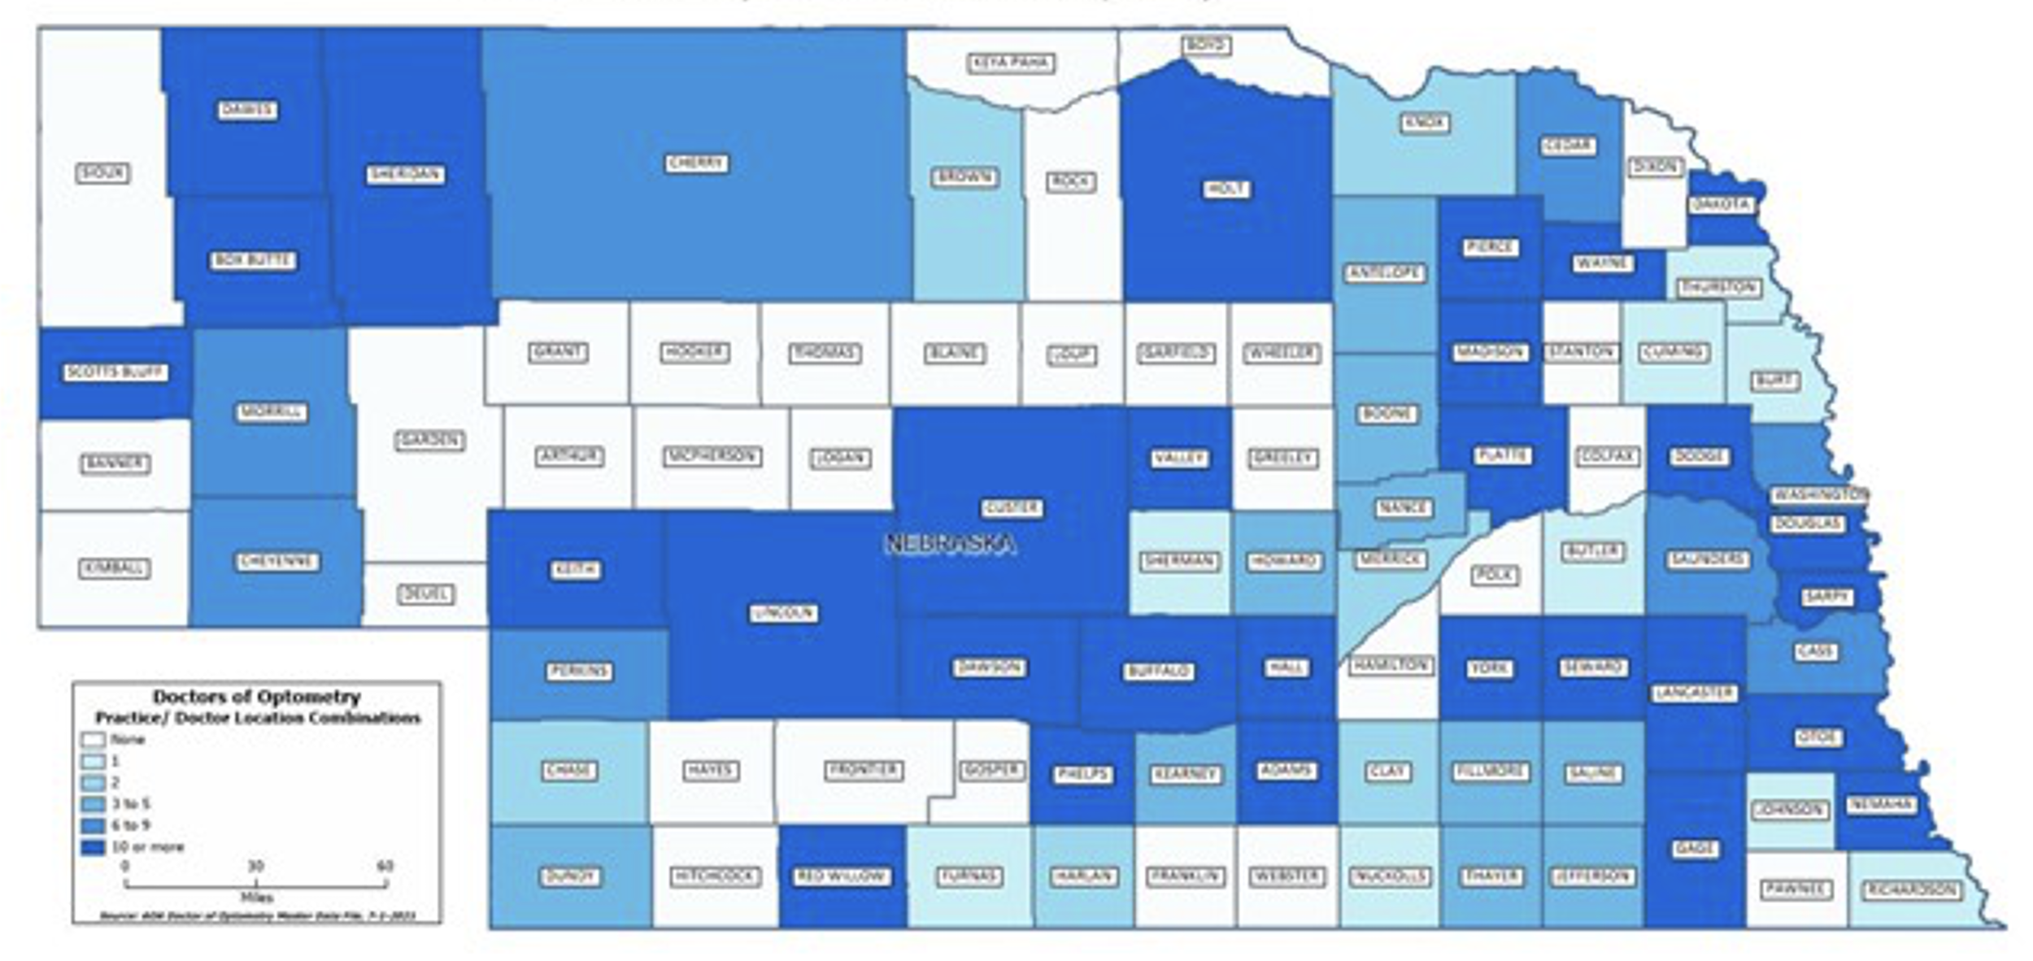
What does this translate to?
72 potential additional access points
Criterion 1, 2 and 4

Slide 10
What is the most common reason that your patients decline to get SLT? (choose one)
Criterion 1 and 4

Slide 11
What occurs if a patient has a complaint about an optometrist?
Robert Vandervort, OD, FAAO, Dipl. ABO

Slide 12
If a complaint is filed against an optometrist
A professional investigator who works for the HHS Department is assigned by the Department and investigates the complaint and writes a report.
That investigator presents their report, in a Closed Session, to the Board of Optometry with representatives of the Department and an Assistant Attorney General present.
If the Board determines that disciplinary action is warranted the Assistant AG and Department representatives guide the Board through available courses of actions that can be recommended to the Department and Attorney General's office.
Any approved action of the Board becomes public record.
No disciplinary actions have ever been taken against a Nebraska optometrist for exceeding or abusing the scope of practice of optometry.
Criteria 3 and 6

Slide 13
General considerations regarding public safety and scope of practice
It is the responsibility of the Board of Optometry to protect the public in matters related to the practice of optometry in Nebraska.
There has never been a complaint or accusation against the Board of Optometry that the Board has not fulfilled its responsibility to protect the public. This includes its responsibility to discipline any potential "rogue optometrist" who would abuse the scope of practice of optometry.
All of us involved in the Credentialling Review need to keep in mind the roles of the Board of Optometry, the Department of HHS, and the Attorney General's Office that are already in place to address individual cases of incompetence or abuse.
Therefore, please do not let opponents of our proposal successfully use scare tactics that have never materialized and for which proven methods are in place to address whatever "boogey man" is being presented.
Criteria 3 and 6

Slide 14
What occurs in rural NE?
Tori Gengenbach, OD
Grant, NE
Creston Myers, OD
Alliance, NE

