Slide 1

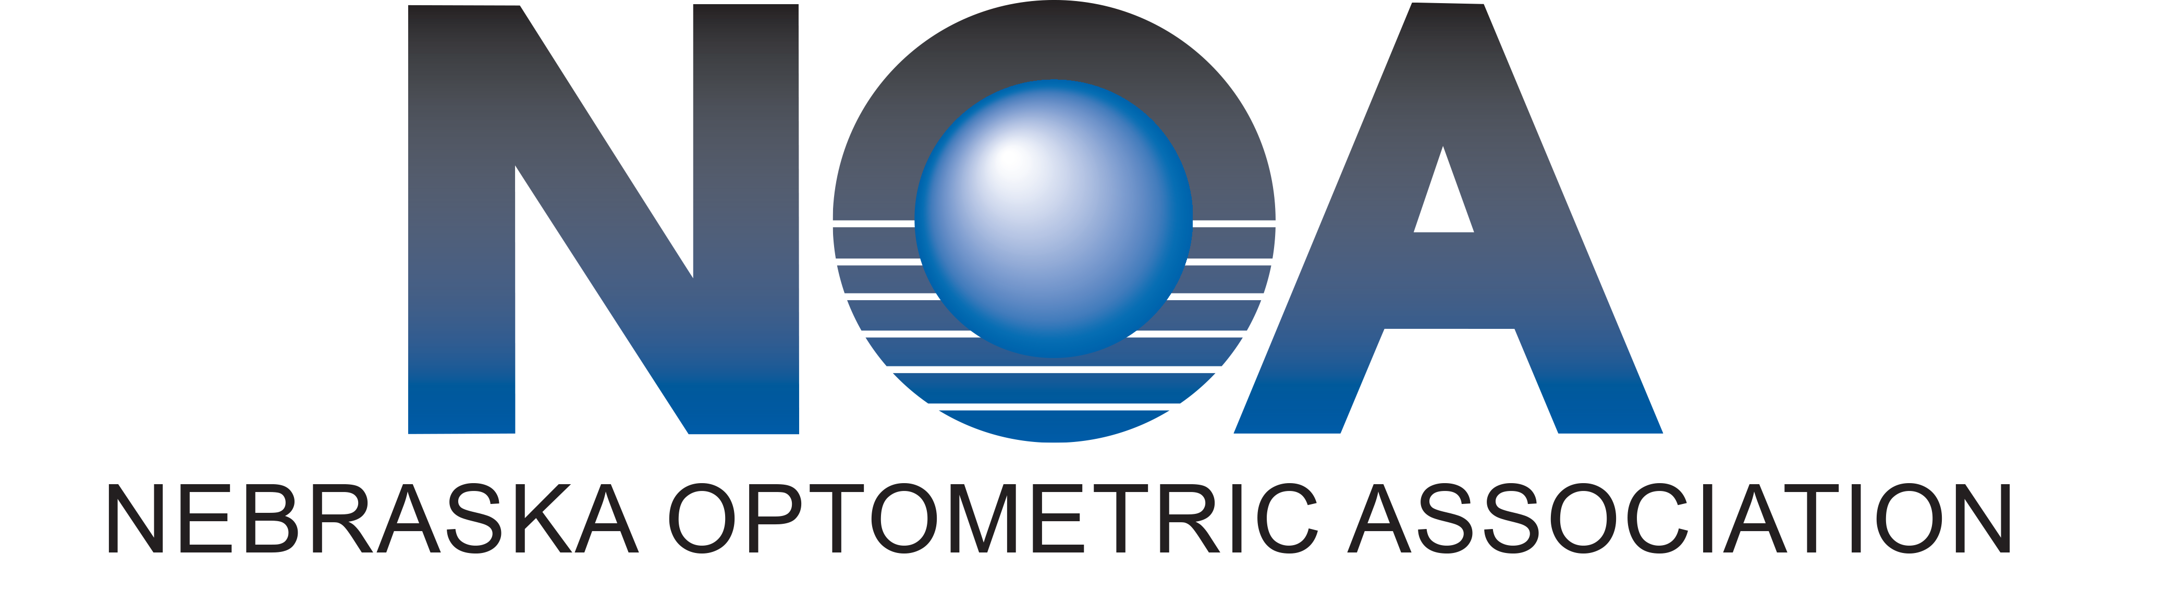
Public Hearing
Christopher Wolfe, OD, FAAO, Dipl. ABO

Slide 2
Public Hearing
Richard Castillo, O.D., D.O.

Slide 3
Public Hearing
Nate Lighthizer, O.D., F.A.A.O

Slide 4
Laser Procedures
Training students receive during 4 years of optometry school
  Didactically in the classroom
  Practical/hands on training in the lab

Slide 5
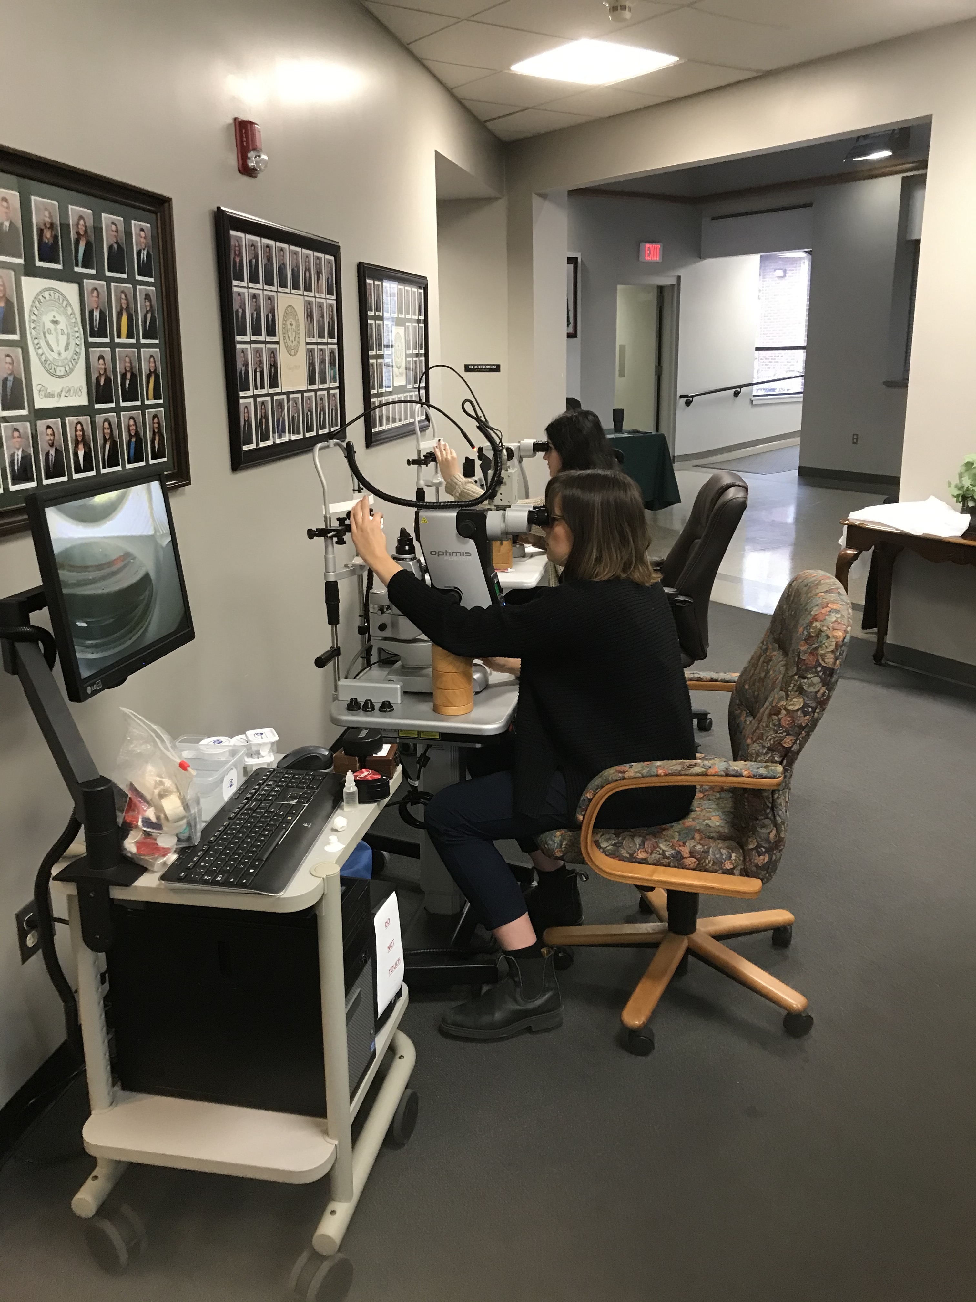

Slide 6
Laser Procedures
Training students receive during 4 years of optometry school
  Didactically in the classroom
  Practical/hands on training in the lab
  Written and proficiency testing
  Treating patients in the clinic
    Doing procedures on actual patients

Slide 7
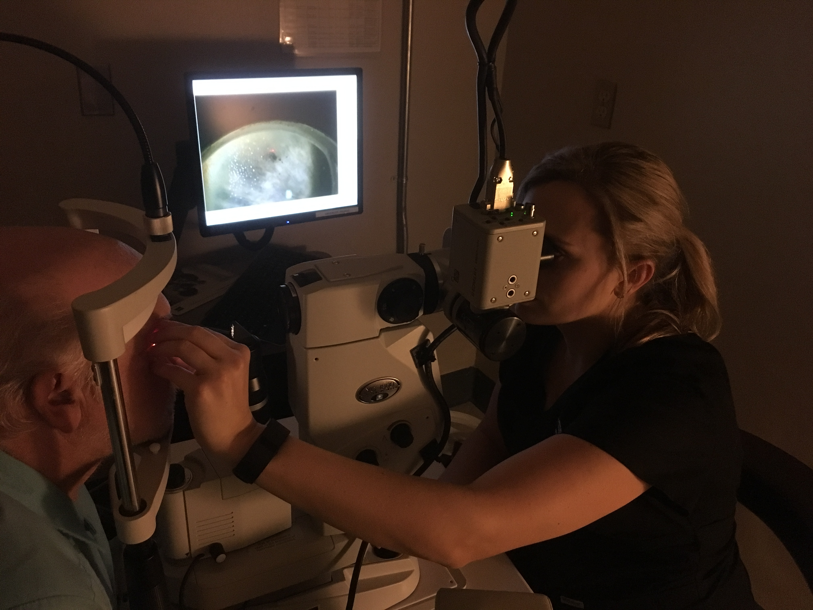

Slide 8
What if a doctor graduated from optometry school 25 years ago?

Slide 9
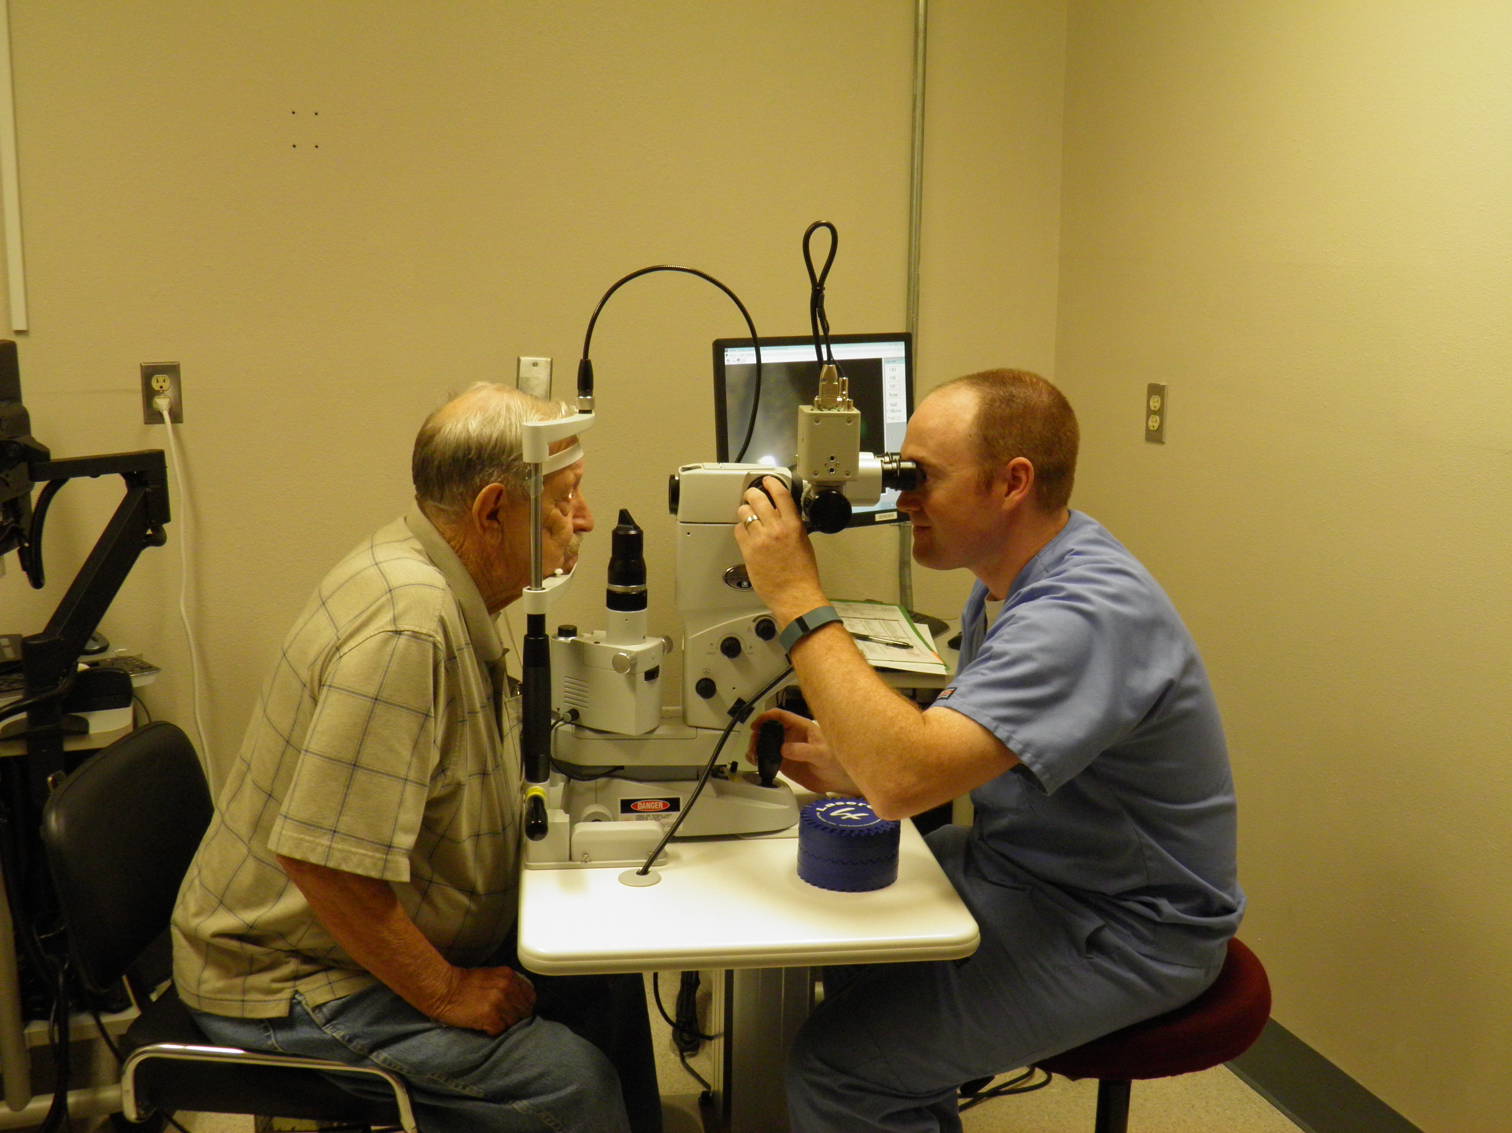

Slide 10
What if a doctor graduated from optometry school 25 years ago?
Education continues after graduation
  Training course that we put on all over the country in 30+ states
Just like MD’s and DO’s
  What if an ophthalmologist graduated from medical school 25 years ago before Lasik came about?
    Went to a 1 day or weekend training seminar
How to get more privileges for doing procedures in other professions?
  apply for credentials at the hospital where the doctor practices. How do you get credentialed?
    Involves showing training was received at a continuing education seminar.
    This is the the process for MDs, DOs, dentists, podiatrists, nurses, physicians assistants, radiologists, etc

Slide 11
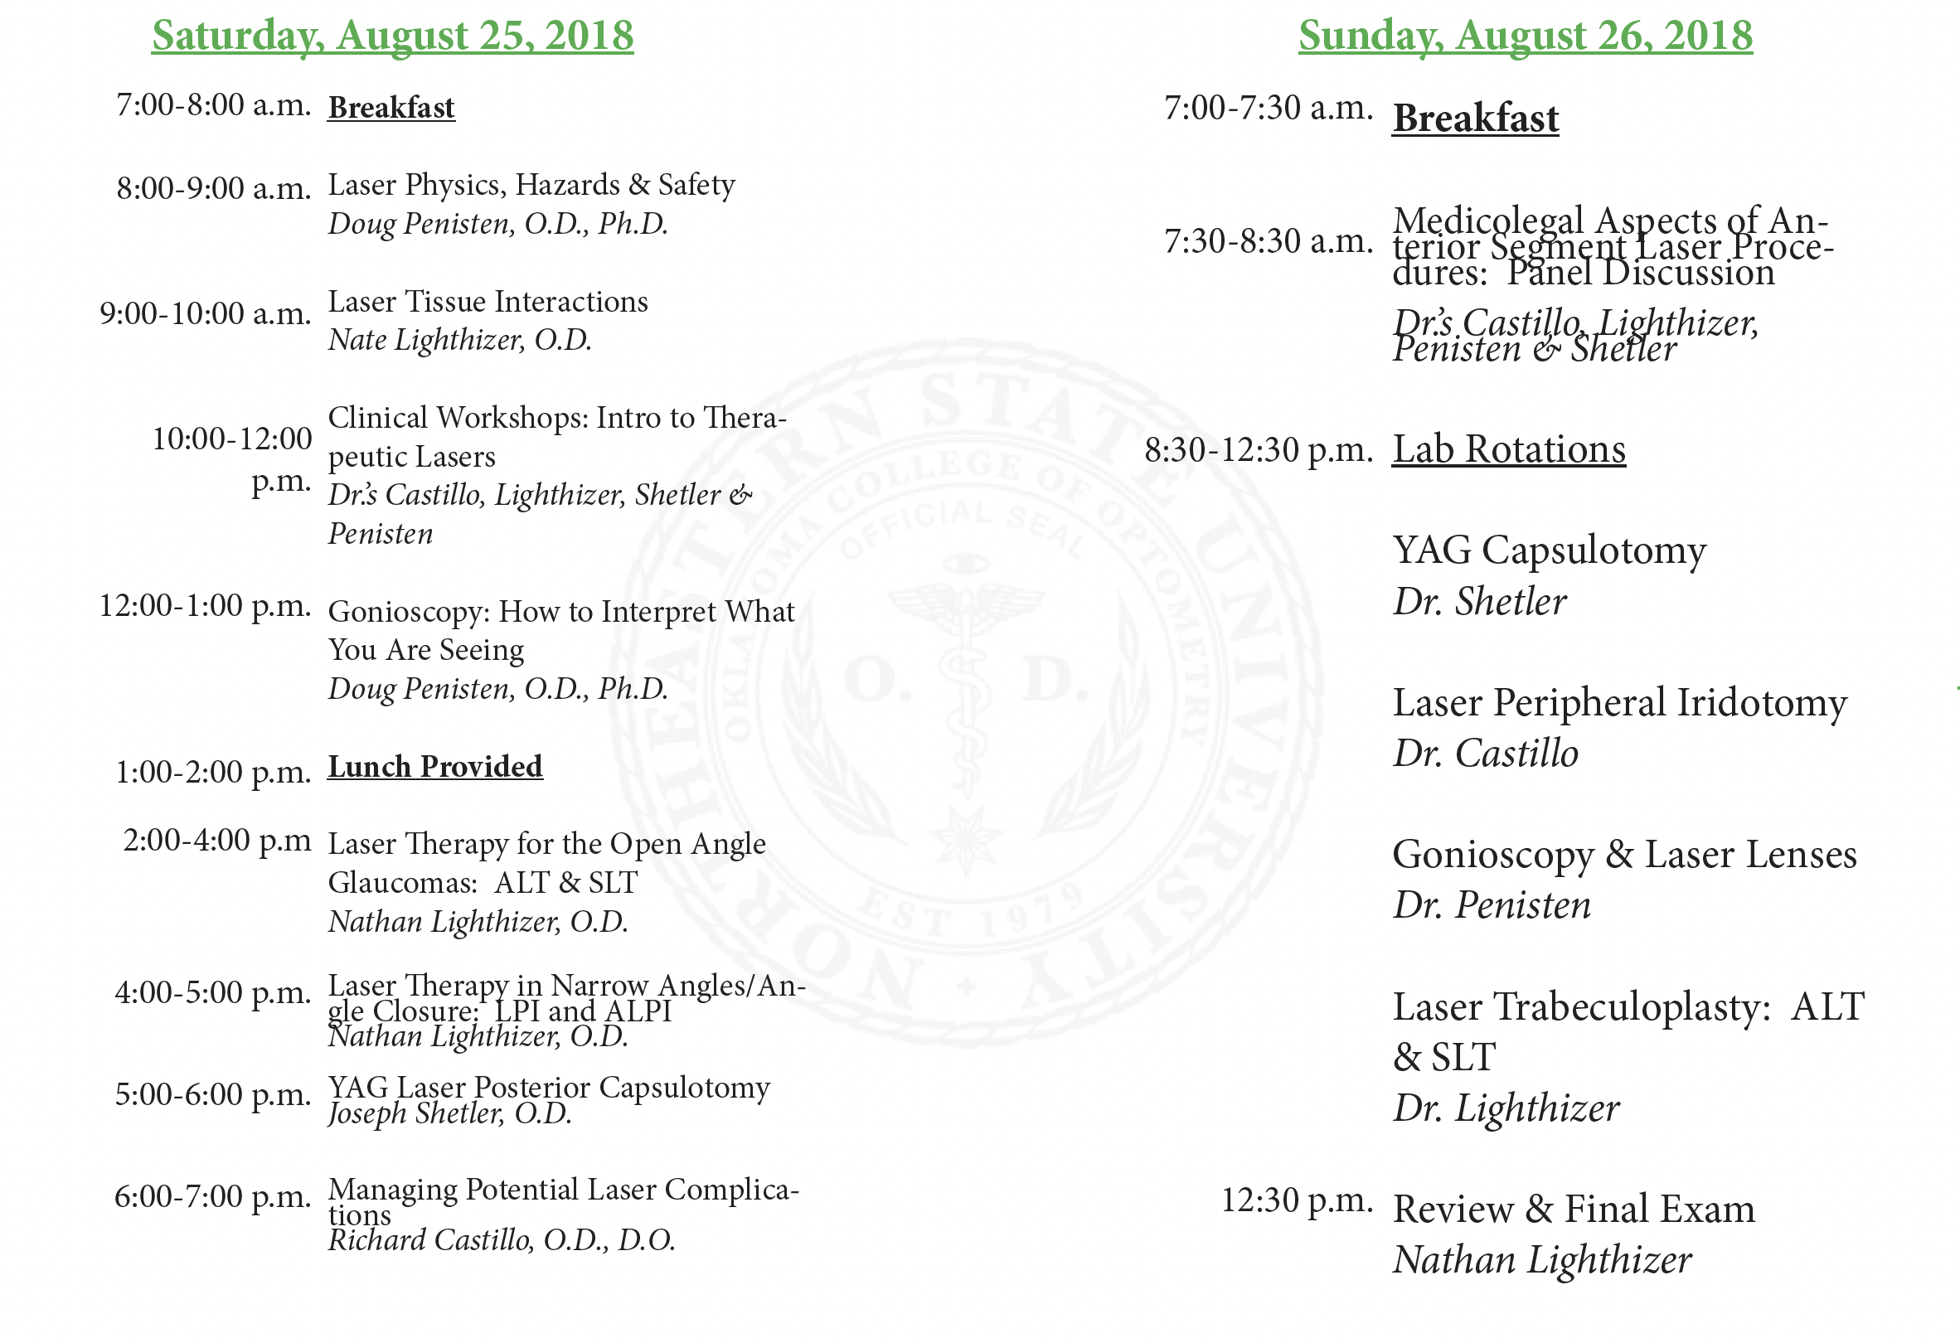
THE OKLAHOMA LASER COURSE

Slide 12
The role of SLT in glaucoma in 2022

Slide 13
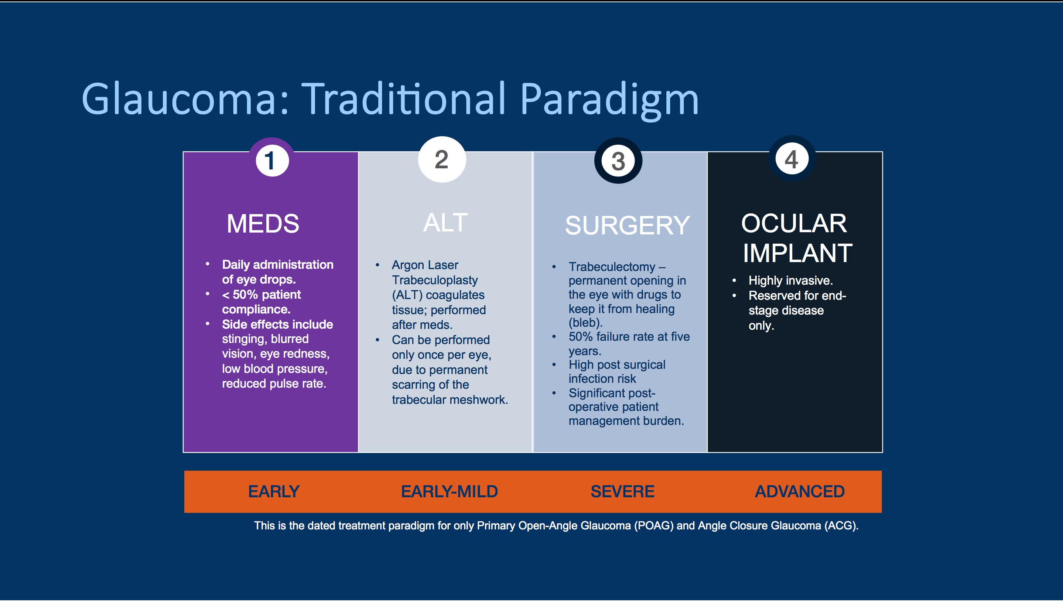
Notes:
Researchers used a mathematical model to compare cost effectiveness of treating newly diagnosed open-angle glaucoma patients with a prostaglandin, LTP or observation only.
Interestingly, they found that prostaglandins and LTP are both cost-effective treatment options for this patient population. However, when patients have “optimal medication adherence,” then prostaglandin therapy is a better value than LTP. Yet, as we know, patients are more likely to be noncompliant than compliant with therapy. Given this reality, the researchers concluded, LTP may be a more cost-effective alternative than prostaglandins at current prices.8 For instance, Medicare reimburses physicians about $336 for LTP. The patient’s responsibility is 20% of that, unless they have supplemental insurance. Copayment and other deductibles may also apply.

Slide 14
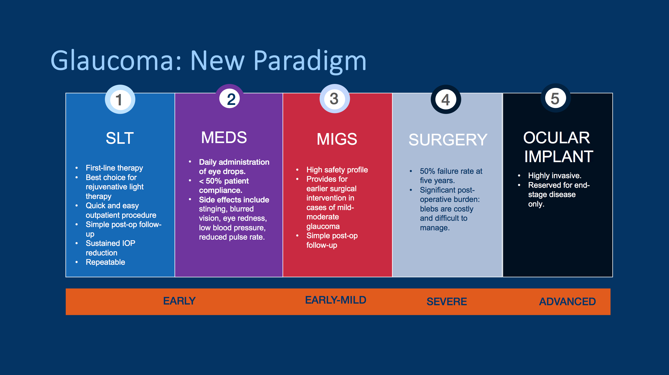
Notes:
Researchers used a mathematical model to compare cost effectiveness of treating newly diagnosed open-angle glaucoma patients with a prostaglandin, LTP or observation only.
Interestingly, they found that prostaglandins and LTP are both cost-effective treatment options for this patient population. However, when patients have “optimal medication adherence,” then prostaglandin therapy is a better value than LTP. Yet, as we know, patients are more likely to be noncompliant than compliant with therapy. Given this reality, the researchers concluded, LTP may be a more cost-effective alternative than prostaglandins at current prices.8 For instance, Medicare reimburses physicians about $336 for LTP. The patient’s responsibility is 20% of that, unless they have supplemental insurance. Copayment and other deductibles may also apply.

Slide 15
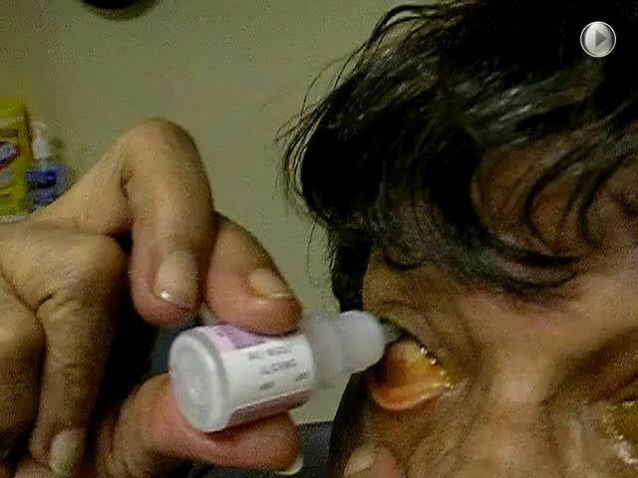
More than 90% of patients are nonadherent to their ocular medication dosing regimens, and nearly 50% discontinue taking their medications before 6 months¹
Nordstrom BL. Persistence and adherence with topical glaucoma therapy. Am J Ophthalmol. 2005;140:598-596

Slide 16
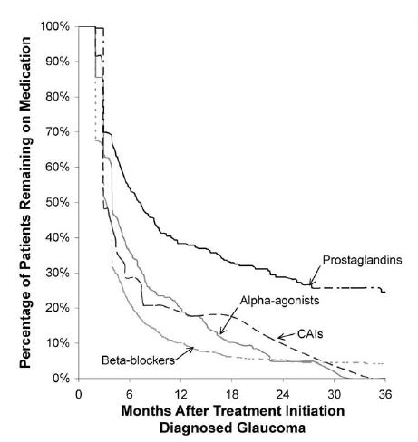

Slide 17
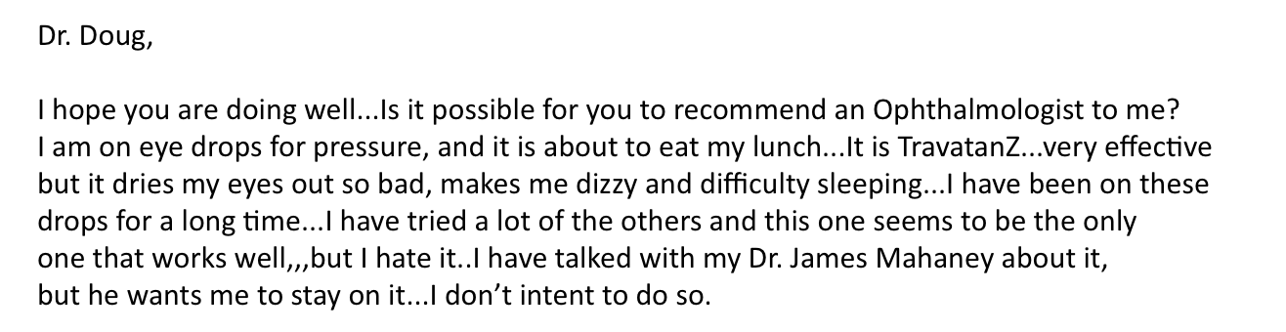
Notes:
Ocular surface disease (OSD) often coexists with other eye conditions, especially glaucoma. In fact, approximately 60% of glaucoma patients show some signs of OSD.¹ This is not surprising considering the demographic overlay — both diseases increase in prevalence with increasing age. Topical agents, including beta blockers, alpha-adrenergic agonists, and prostaglandins, are most commonly used to treat glaucoma. These agents, however, can exacerbate OSD and meibomian gland dysfunction,^{2,3} and thereby reduce patient compliance with treatment. When it comes to using glaucoma drops in these patients, less is more, as many studies have demonstrated poor adherence as a leading issue in chronic glaucoma therapy.⁴

Slide 18
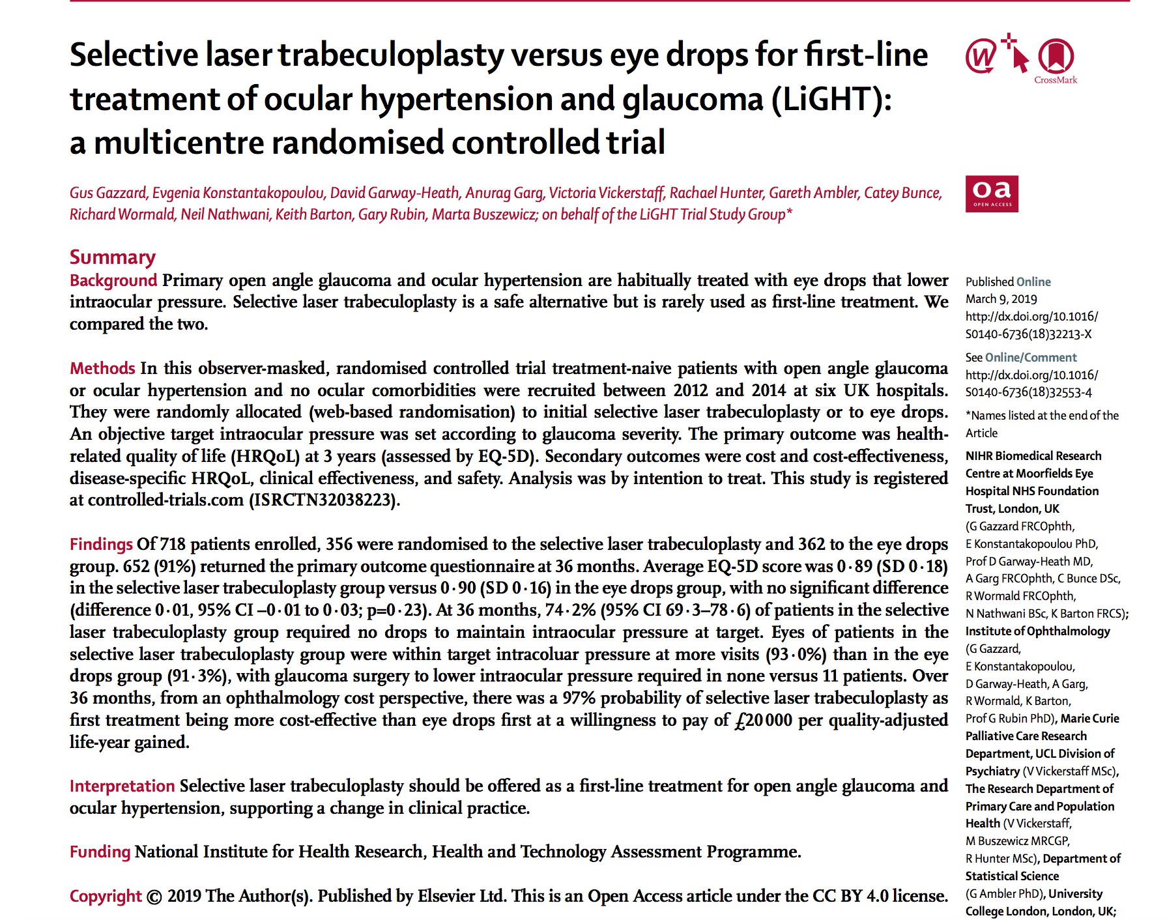
SLT as first line?

Slide 19
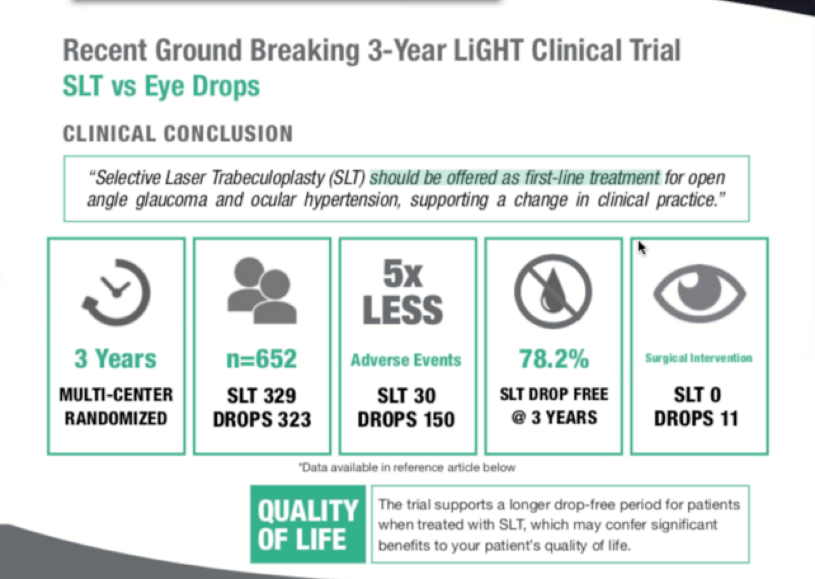
SLT as first line?

Slide 20
Selective Laser Trabeculoplasty (SLT)
SLT complications/risks
  IOP spike/elevation
    Most often transient
    High risk pt – may consider Diamox
  Inflammation (iritis/uveitis)
    Anti-inflammatory
    Use appropriate laser energy
  Stromal haze/edema/decreased endothelial cell count
    Rare – usually responds to a topical steroid
  Peripheral Anterior Synechie (PAS)
    Less likely due to less/no scar tissue formation
    May increase IOP long-term
Optometrist’s are already managing these complications in the post-op lasers that MD’s perform
These complications are not unique to lasers. These same complications can occur from many other things (trauma, glaucoma, etc). Optometrists have been managing these day in and day out as part of general practice
There is zero data that shows optometrists do laser procedures less effectively or have increased complications when doing laser procedures compared to ophthalmologists
  20+ year track record in OK
  10+ year track record in KY
  Many other states OD’s doing laser procedures as well
Notes:
Most often transient IOP spikes – that is why we use Alphagan pre and post laser, that is also why we continue the glc meds for at least the first month after the laser
I have never read of the complication of stromal haze/edema after an SLT but talking with Bill Markolini of the NJ optometric association at our Atlantic City meeting, he has had 2 patients who developed a stromal haze after an SLT. Both were present 4-5 days post-SLT, and both responded to a topical steroids. So keep stromal haze in the back of your mind. It is not common but can occur.
Inflammation and PAS – can reduce those complications by use the correct laser energy and # of burns – also put the burns in the correct location

Slide 21
Public Hearing
Joseph Shetler, O.D., Dipl. ABO

Slide 22
Public Hearing
Paul Barney, O.D., Dipl. ABO

Slide 23
Public Hearing
David McBride

Slide 24
Evidence
“The greatest weight should be given to evidence that has been generated by unbiased sources, sources that explicitly take into account the protection of the public and which provide statistical or scientific data to support conclusions.”

Slide 25
Criterion 1
Health safety, and welfare of the
public are inadequately addressed by present scope of practice

Slide 26
1: Health safety, and welfare of the public are inadequately addressed by present scope of practice
  FACT: SLT is an accepted front line treatment option for glaucoma. There are only 11 cities in Nebraska where patients can currently have this procedure done.
  FACT: Patients are currently declining to receive this frontline treatment because it requires travel and/or an appointment with a new doctor. These patients are choosing treatment options that result in higher long-term costs to the healthcare system
  FACT: NE ODs are required by law to provide the same standard of care as MDs in treating glaucoma. Patients in 10 other states can receive this frontline care from optometrists.

Slide 27
Criterion 2
The enactment of the proposed changes in scope of practice would produce widespread benefits for the public, and the amount and extent of the benefits would outweigh any potential harm or danger to the public that might be caused by enactment of these changes

Slide 28
2: Enactment of the proposed change in scope of practice would benefit the health, safety or welfare of the public.
FACT: Letters have been submitted from Nebraska optometrists who plan to offer SLT to patients when the law is changed. Nebraska Optometric Association surveys indicate 72 optometrists in NE are Highly likely or Likely to offer SLT services in their practices.
FACT: An increased number of locations where SLT could be performed would save travel time and costs for patients and their families. Costs to the overall healthcare system would be reduced through some reduction in redundant appointments.
FACT: Nebraska patients who could have benefitted from SLT have declined the procedure due to inability or unwillingness to travel for additional appointments. Enactment of this proposal is certain to increase the number patients who would receive this front line treatment.

Slide 29
Criterion 3
The proposed change in scope of practice does not create a significant new danger to the health, safety, or welfare of the public

Slide 30
3: The proposed change in scope of practice does not create a significant new danger to the health, safety, or welfare of the public
FACT: 10 other states already allow optometrists to do what is requested in this proposal.
FACT: Documentation from licensing bodies in those states verifies that there has been no significant new danger to the health, safety or welfare of the public.
FACT: This proposal outlines training, preparation, and certification requirements for Nebraska ODs that would be AT LEAST identical to the doctors in these other states.

Slide 31
Criterion 4
Current education and
training adequately prepares practitioners to perform the new skill or service

Slide 32
4: Current education and training adequately prepares practitioners to perform the new skill or service
FACT: Educational requirements outlined in this proposal are the same as those for other states that already allow optometrists to perform SLT.
FACT: ODs in other states have safely performed over 100,000 of these procedures with nothing to indicate that their training was insufficient.
FACT: There is no evidence to suggest why Nebraska ODs would be any less capable than their counterparts in these other states.
FACT: There have been no increases in malpractice rates in states that have allowed optometrists to perform SLT.
FACT: Key skills for SLT include proper diagnosis and identification of cases for which SLT is appropriate and management of any post-surgical complications. Nebraska optometrists have had extensive classroom education AND hands-on experience with these skills for more than 30 years and all are part of everyday, primary care optometric practice. Diagnosis and treatment of glaucoma have been part of optometric practice in Nebraska since 1998. Nebraska optometrists already have extensive knowledge of the disease and its treatment. SLT does not involve learning a brand new, foreign subject.

Slide 33
4: Current education and training adequately prepares practitioners to perform the new skill or service
FACT: SLT is an in-office procedure that in their practice, especially relies heavily on technology, technique, judgment and clinical skills which ODs already use every day and including gonioscopy.

Slide 34
Criterion 5
Appropriate post-professional programs and competence assessment to ensure being performed in a safe and effective manner

Slide 35
5: Appropriate post-professional programs and competence assessment to ensure being performed in a safe and effective manner
FACT: The postgraduate training outlined in this proposal has been utilized in the other states that allow this authority for optometrists. None of those states has determined that training to be inadequate.
FACT: New graduates from optometry school are all being trained on SLT. While training experiences may not be identical in every school, competencies must be such that every graduate can pass a standardized national exam covering use of lasers. The Nebraska Board of Optometry must assure that education and training of new licensees from every College of Optometry meets Nebraska’s standards. If not, additional postgraduate education requirements will apply to those new licensees.

Slide 36
5: Appropriate post-professional programs and competence assessment to ensure being performed in a safe and effective manner
FACT: As outlined in the proposal, certification for SLT would require a proctor to validate the doctor’s competence based on successful patient encounters, in addition to meeting other educational requirements. No OD would be licensed to perform the procedure just by completing a course.

Slide 37
Criterion 6
Adequate measures to assess if competently performing new skill or service and take appropriate measures if they are not

Slide 38
6: Adequate measures to assess if competently performing new skill or service and take appropriate measures if they are not
Ongoing CME is required for optometrists
NE BoO responds to issues and disciplines optometrists who are practicing outside unsafely or outside the boundaries of their scope of practice
There is NO EVIDENCE that the current infrastructure of the Attorney General, Department of Health and Human Services, Board of Health or Board of Optometry have been deficient in their duty to protect the public with any of the previously incorporated scope of practice enhancements by optometrists in Nebraska.

Slide 39
Questions?

