Slide 1
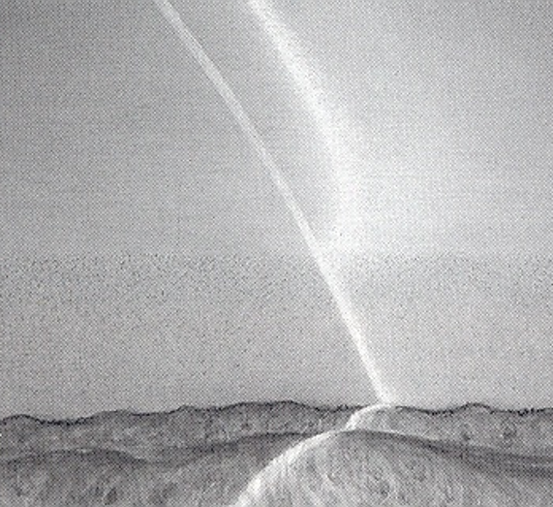
Technical Review Committee:
Selective Laser Trabeculoplasty
June 7, 2022

Slide 2
Laser Trabeculoplasty (ALT and SLT)
Mechanism of Action Theories
(ALT)
Tissue Contraction burns stretch adjacent tissue
(ALT/SLT)
Biologic Cascade
Cell Division and Repopulation
Macrophage Recruitment
Notes:
Mechanical theory (ALT): contraction burns open adjacent meshwork causing increased outflow
Biologic theory (ALT/SLT): laser works by inducing a biologic cascade in response to tissue injury
Damaged cells release cytokines a macrophage recruitment a engulfment and clearing of pigment and debris a increased outflow facility
Upregulation of matrix metalloproteinase expression a remodeling of extracellular matrix
Repopulation theory (ALT/SLT): laser stimulates increased cell division and repopulation of the meshwork

Slide 3
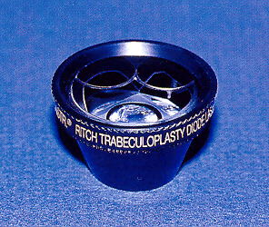
Selective Laser Trabeculoplasty (SLT) Technique
Mirrored laser gonioscopy lens
  Coupling gel

Slide 4
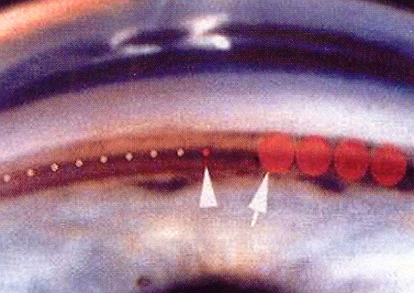
Selective Laser Trabeculoplasty (SLT)
Technique
400 micron spot centered over the trabecular meshwork
50 adjacent, spots over 180º or 100 over 360º
Initial energy 0.9 mJ adjusted just below formation of “champagne bubbles”
– average 0.6 mJ
ALT SLT

Slide 5
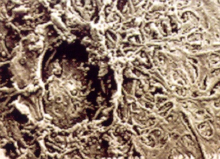
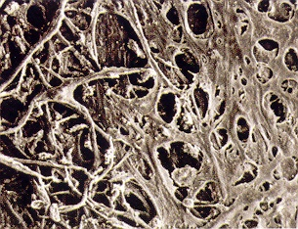
Selective Laser Trabeculoplasty (SLT)
532nm frequency doubled Q-switched Nd:YAG laser; 400 micron spot, 3 nanoseconds
Short pulse of laser confines damage to cells containing melanin
ALT SLT

Slide 6
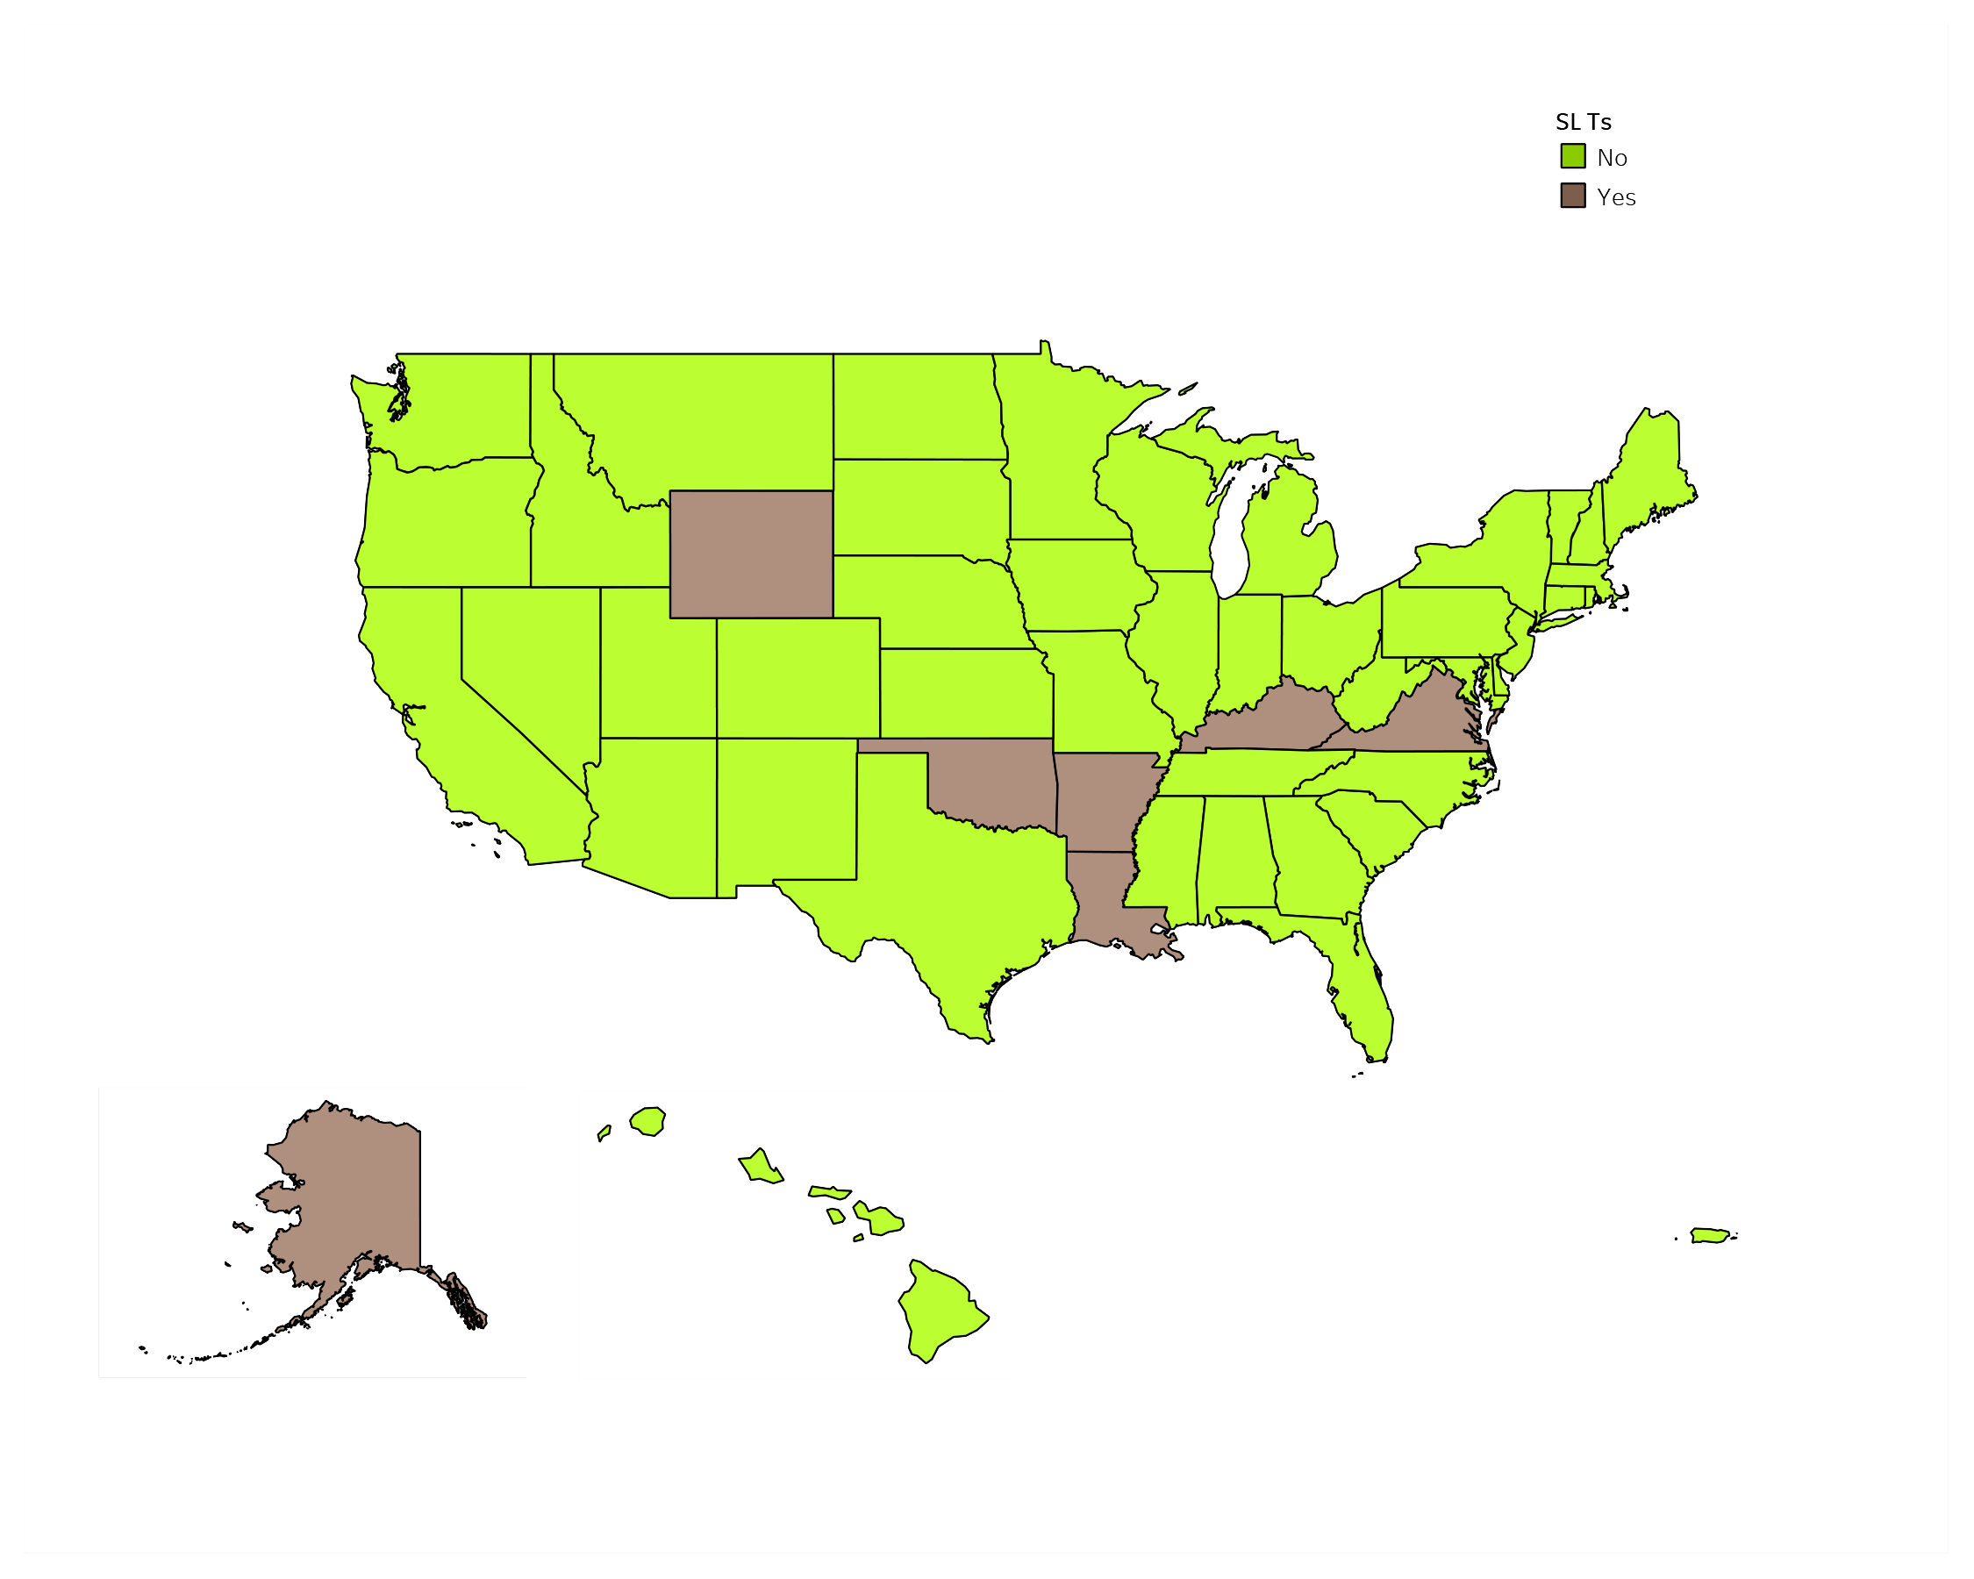
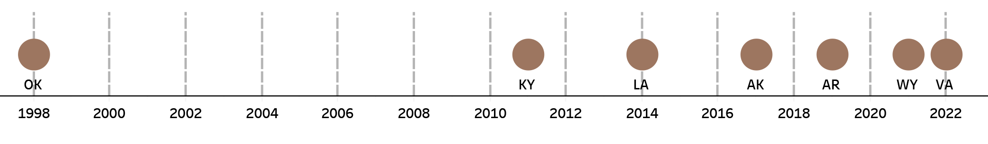
SLT Authority

Slide 7
Vermont Secretary of State Office of Professional Regulation
2019 Report
Study to evaluate the safety and public health needs of expanding the scope of practice of optometrists to include advanced procedures
“Finds there is little need for, and minimal cost savings associated with, expanding the optometric scope of practice to include advanced procedures.”
no demonstrated cost savings of expanded scope.
“Recommends against expanding the optometric scope of practice”

Slide 8
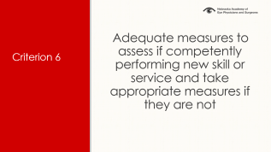
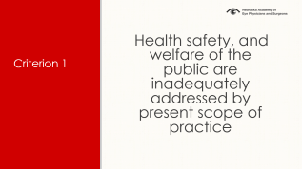
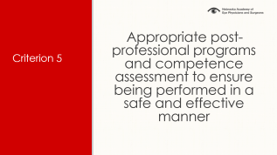
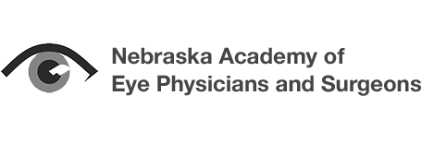
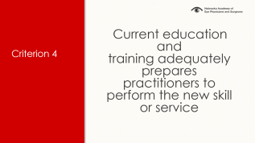
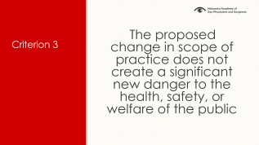
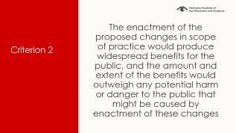
Technical Review Committee:
Six Criteria

Slide 9
Criterion 1
Health safety, and welfare of the
public are inadequately addressed by present scope of practice

Slide 10
Criterion 1: Health safety, and welfare of the public are inadequately addressed by present scope of practice
SLT never an urgent or emergent procedure
  takes 6 weeks to 3 months for full lOP lowering
Majority of time: SLT on same day as consult visit
Exam and SLT surgery bundled when same day
Follow-up can be with referring clinic
Current access maps and referral model is meeting Nebraskan’s need for SLT.
Notes:
First, SLTs are not an emergency surgery. That means that these surgeries can be done by ophthalmologists safely and effectively already.
Second, ODs are paid exactly the same amount for procedures. That means no cost savings.
Rural ophthalmologists typically perform these surgeries on same day as visit.
.

Slide 11
Criterion 1: Health safety, and welfare of the public are inadequately addressed by present scope of practice
Is access to SLT inadequate for Nebraskans?
Notes:
First, SLTs are not an emergency surgery. That means that these surgeries can be done by ophthalmologists safely and effectively already.
Second, ODs are paid exactly the same amount for procedures. That means no cost savings.
Rural ophthalmologists typically perform these surgeries on same day as visit.
.

Slide 12
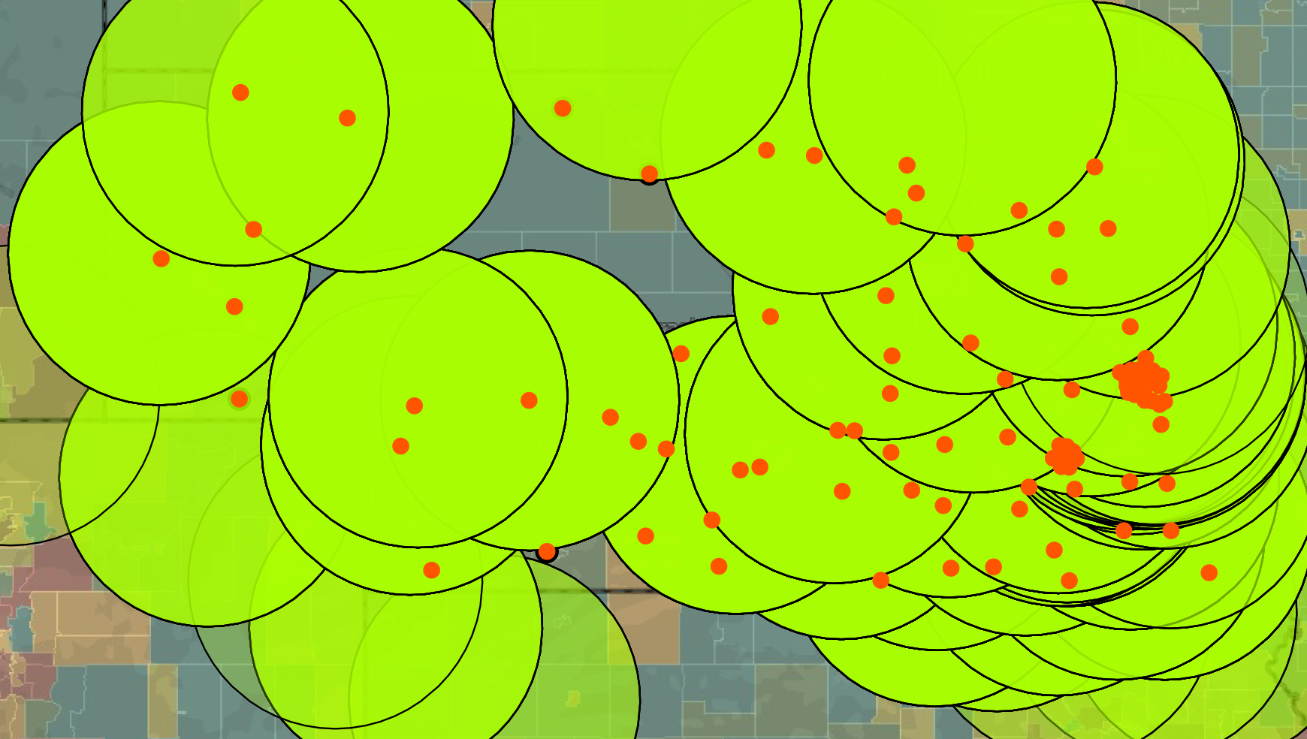
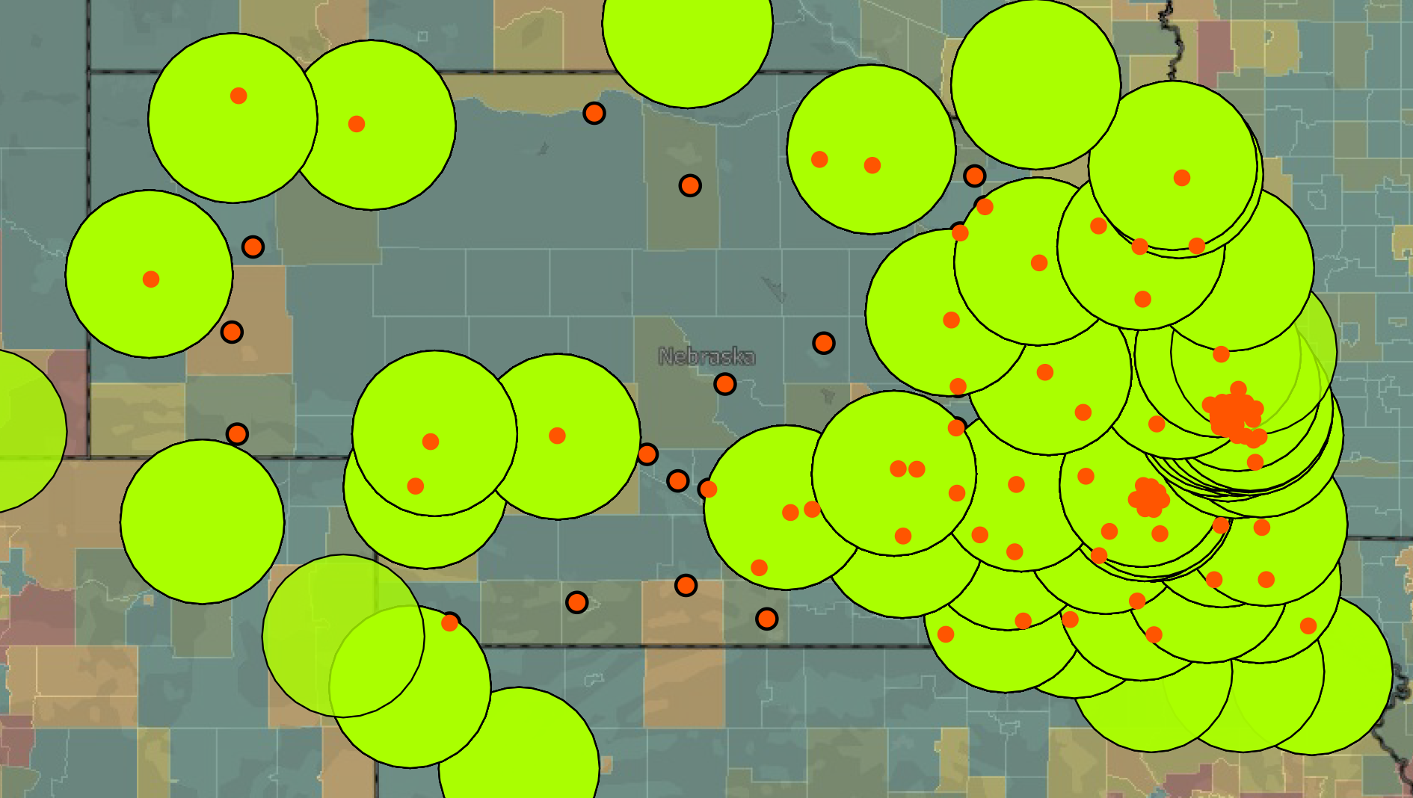
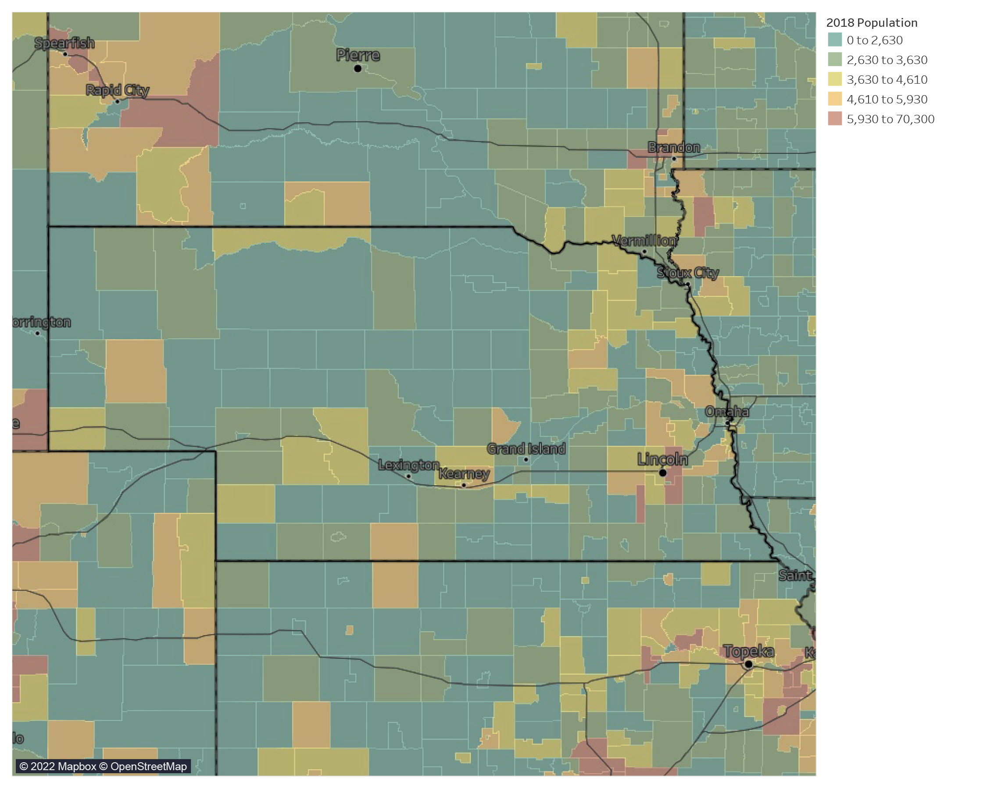
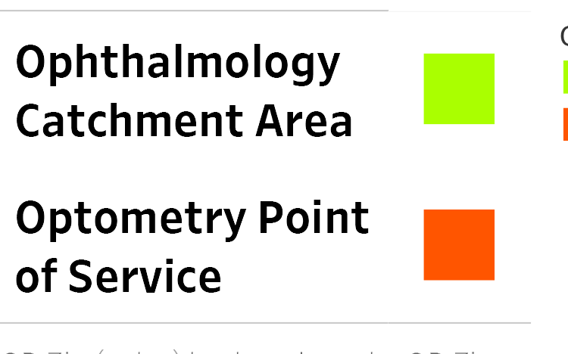
Nebraska’s Access to Care
30 Miles
60 Miles
Notes:
If you look at a population density map of Nebraska, you find that ophthalmologists are near most of the state’s population, but so are optometrists.
[CLICK] Only 13 zip codes have optometrists who filed claims under Medicare Part B in 2019 that are not within the 30-mile catchment area of an ophthalmologist.
[CLICK} Only 1 zip code is not within the 60-mile catchment area of an ophthalmologist.

Slide 13
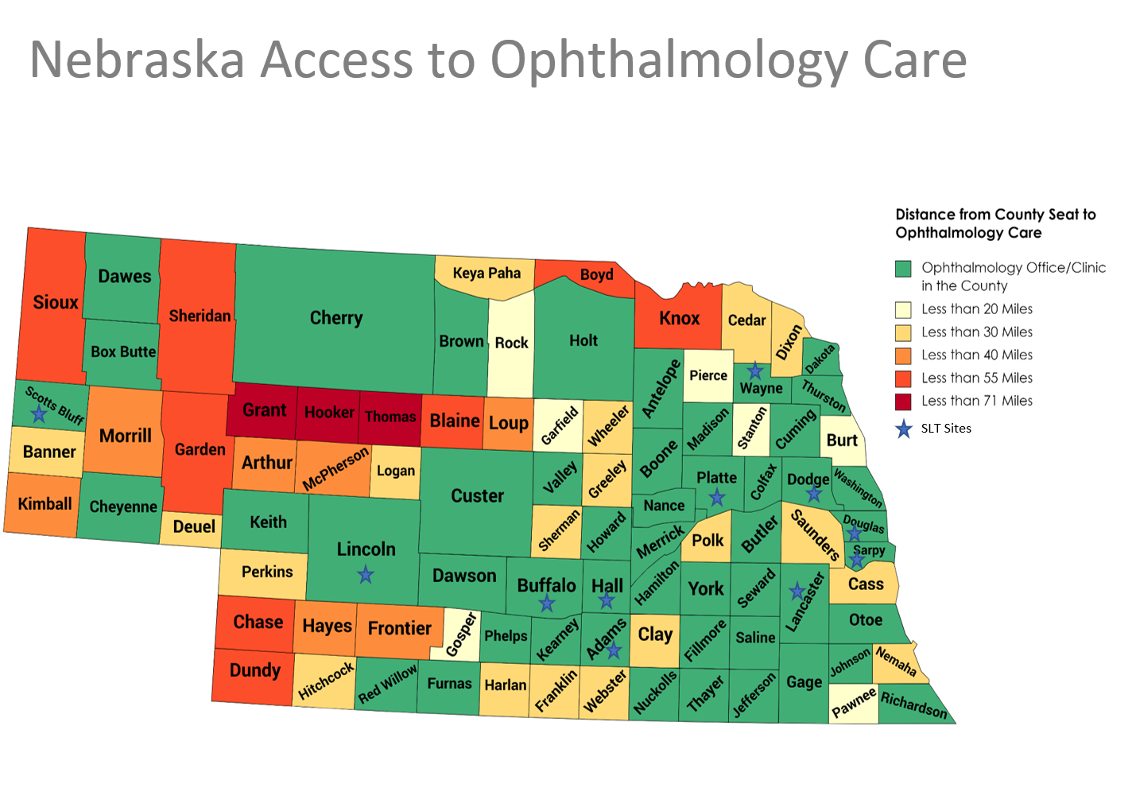

Slide 14
Access to an Ophthalmologist
SLT is not an emergency procedure
Takes 6-8 weeks to have maximal effect
SLT performed by ophthalmologists on same day as clinic visit, coordinated follow-up locally.
Drive Time | % of Pop
30 Minutes | 87.3%
60 Minutes | 97.0%
Notes:
90.3% was the population was an estimated 30 minute drive time to an ophthalmology point of service in the Medicare Physician Compare file. 97.3% of the population was 60 minute drive time away. SLT is not an emergency procedure
Takes 6-8 weeks to have maximal effect SLT performed by rural ophthalmologists on same day as clinic visit.

Slide 15
Is access to SLT an issue in Nebraska?
Estimated that approximately 2% of the US population have glaucoma.
Half of which are unaware that they have glaucoma or haven’t sought evaluation
1% aware of glaucoma diagnosis and seeking consultation
Data from glaucoma consult clinics in the Omaha:
Approximately 50% of patients opt for primary SLT as treatment for glaucoma
According to epidemiological data in the US:
About 0.5% of Nebraskan’s eligible for SLT

Slide 16
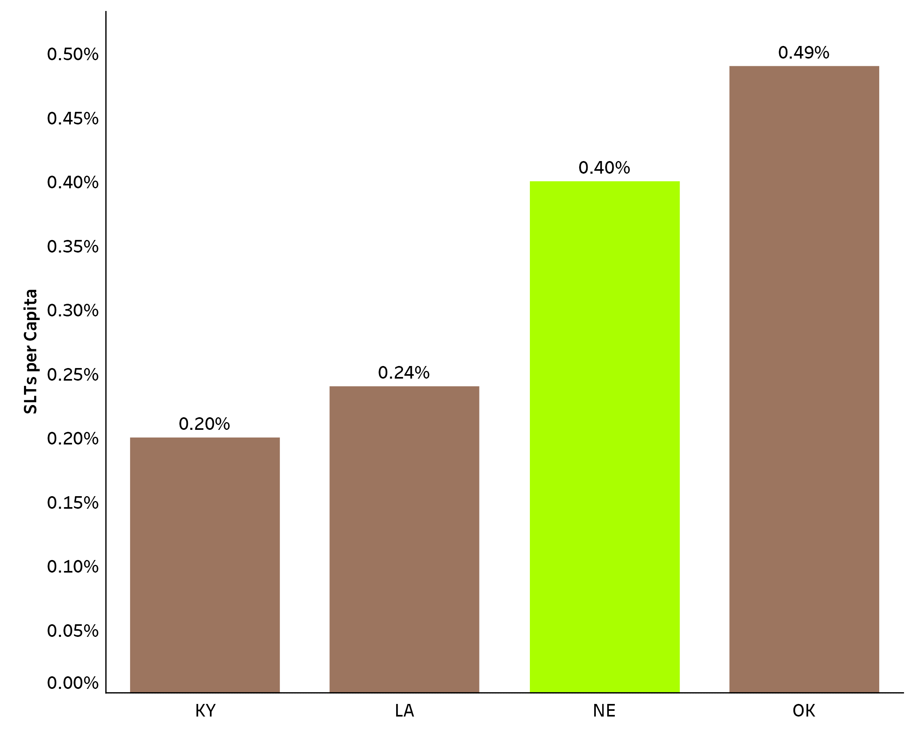
Comparative Rate of SLTs
Notes:
Comparing the number of SLTS per Medicare Beneficiary in 2019 between Nebraska and states where optometrists filed claims to perform these surgeries, there is no evidence that Nebraskans have inadequate access or that these surgeries are not being performed by ophthalmologists in this state. In fact, the rate of SLTs performed in Nebraska was HIGHER than the rate of SLTs performed in Kentucky and Louisiana and only slightly lower than Oklahoma.

Slide 17
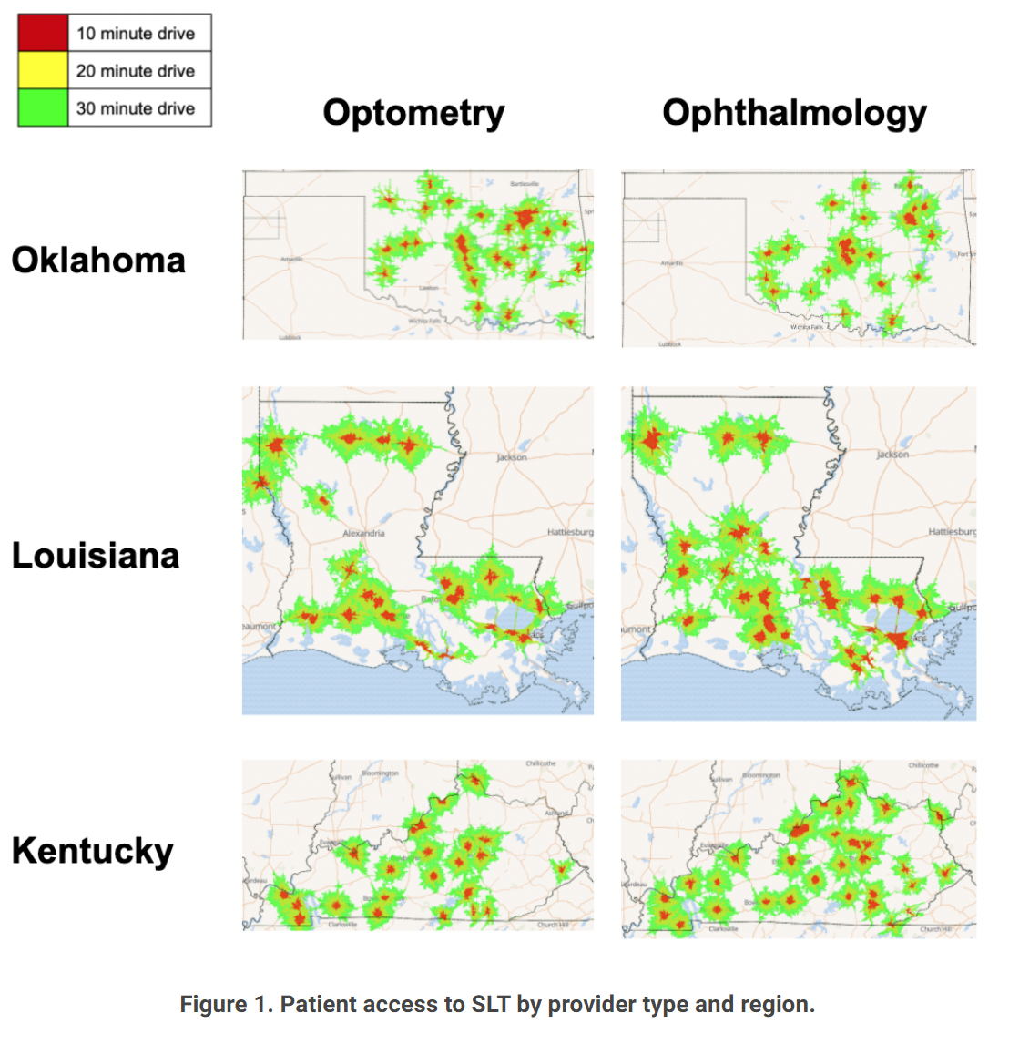
Has access to SLT improved in states with OD laser privileges?
ARVO 2022 study, Mayo and Univ of WA
Population within 30 min drive time
  - 73.4% for OD
  - 84.1% for ophthalmologists
5.6% exclusive coverage by OD
6.1% exclusive coverage by Ophthal
Conclusion:
“The expansion of laser privileges to optometrists has not resulted in a statistically significant increase in access to laser procedures in KY, LA, and OK.”
Notes:
Evaluating access to laser therapy by driving distance using Medicare data and Geographic Information Systems mapping
Author Block: Jamie Shaffer¹, Darby Miller², Aaron Lee¹, Cecilia Lee¹
¹University of Washington Department of Medicine; ²Mayo Clinic

Slide 18
Which factors might affect access in States with OD laser privileges
Economic Feasibility
SLT laser cost $ 25,000-60,000
Financing 6.5% x 5 years $ 3,973
Installation $ 1,500
Maintenance Contract $ 1500-2500
OD training course $ 1,750
Laser lenses, supplies $ 400
Total $35,123 initial investment
  + $2500/yr maintenance

Slide 19
What factors might affect access in States with OD laser privileges
Economic Feasibility
Medicare payment per SLT $130 (office based), 190 (ASC based)
Average # procedures for MD/year 24
Average OD 3,400 patients/yr
Estimated incidence of needing SLT 0.5%
Total SLT per year 17
17 x $130 = $2,210/yr – 50% overhead = $1,105/yr
$35,123/$1,105= 31.8 years to pay off or until ROI
12 SLT per year to cover maintenance costs alone.

Slide 20
Which factors might affect access in States with OD laser privileges?
Economics of SLT favor referral clinics in metro areas.
Demonstrated in States with OD laser privileges.
Comfort level with SLT dependent on
Frequency of gonioscopy and SLT procedure
# of SLT referrals
Not likely to be adopted at small, lower volume, rural primary eye care clinics in Nebraska
Has not been adopted by small, lower volume, rural primary eye care clinics in States with OD laser privileges.

Slide 21
Vermont OPR 2019 Report
In states that have expanded scope, “few optometrists have chosen to perform these advanced procedures, and those who do are located near ophthalmologists (typically near a population center).” “Patients in rural areas did not see improved access.”
“OPR found no evidence that the current system requiring referrals to an ophthalmologist impacted patient safety.”

Slide 22
Criterion 2
The enactment of the proposed changes in scope of practice would produce widespread benefits for the public, and the amount and extent of the benefits would outweigh any potential harm or danger to the public that might be caused by enactment of these changes

Slide 23
Criterion 2: The enactment of the proposed changes in scope of practice would produce widespread benefits for the public, and the amount and extent of the benefits would outweigh any potential harm or danger to the public that might be caused by enactment of these changes
No clear data that suggest lack of access to SLT for Nebraskans
– Similar rates of SLT/capita than States with OD laser privileges.
Notes:
First, SLTs are not an emergency surgery. That means that these surgeries can be done by ophthalmologists safely and effectively already.
Second, ODs are paid exactly the same amount for procedures. That means no cost savings.
Rural ophthalmologists typically perform these surgeries on same day as visit.
A report from the Vermont Office of Professional regulation looking at a similar proposal found no appreciable cost savings.
A on LTPs published in the Journal of the AMA Ophthalmology found that ODs performed LTPs 189% more on the same patient. Also, ODs repeated the surgeries by ODs before results could b be known. This does not only mean increased risk, it also means increased costs.

Slide 24
Criteria 2: The enactment of the proposed changes in scope of practice would produce widespread benefits for the public, and the amount and extent of the benefits would outweigh any potential harm or danger to the public that might be caused by enactment of these changes
Access not shown to improve in States with OD laser privileges (ARVO 2022 study, 2018 JAMA study)
SLT provided at majority metro/referral centers in States with OD laser privileges as well.
Notes:
JAMA Ophthalmol. 2018 Jan; 136(1): 39–45. PMID 29167903

Slide 25
Criteria 2: The enactment of the proposed changes in scope of practice would produce widespread benefits for the public, and the amount and extent of the benefits would outweigh any potential harm or danger to the public that might be caused by enactment of these changes
No evidence of reduced cost in States with OD laser privileges
SLT paid the same amount in States with OD privileges
Cost of consult evaluation and SLT bundled when completed in the same day
Notes:
JAMA Ophthalmol. 2018 Jan; 136(1): 39–45. PMID 29167903

Slide 26
Vermont OPR 2019 Report
  No appreciable cost savings
  No significant increase in access to laser in States with laser privileges.

Slide 27
Criterion 3
The proposed change in scope of practice does not create a significant new danger to the health, safety, or welfare of the public

Slide 28
Criteria 3: The proposed change in scope of practice does not create a significant new danger to the health, safety, or welfare of the public
Potential increased costs/repeat treatments
Ineffective treatment
Potential complications
Delay of definitive surgical care with progression of disease can lead to irreversible loss of sight

Slide 29
Criteria 3: The proposed change in scope of practice does not create a significant new danger to the health, safety, or welfare of the public
Potential increased costs
  Global period of 10 days after SLT
  Repeat SLT after 10 days is billable
  Data from OK suggests more frequent repeat SLT by OD compared with MD from 2008-2013
  Data suggest 360-degree treatment as safe but more effective than 180-degree treatment

Slide 30
Criteria 3: The proposed change in scope of practice does not create a significant new danger to the health, safety, or welfare of the public
Ineffective treatment
  Subtle angle findings may decrease SLT success
    Prior trauma
    Subtle changes of prior intraocular inflammation
    Abnormal blood vessels in the angle
Delay in more definitive surgical consultation can result in irreversible vision loss

Slide 31
Criteria 3: The proposed change in scope of practice does not create a significant new danger to the health, safety, or welfare of the public
Potential complications
  Corneal scarring
    Placement and removal of Gonioscopy laser lens
      Risk of corneal abrasion/scarring in ABMD

Slide 32
Criteria 3: The proposed change in scope of practice does not create a significant new danger to the health, safety, or welfare of the public
Potential complications
Infrequent gonioscopy – skill atrophy
  Laser applied to:
    Perfectly: 3-5% risk of pressure spike, can persist
    Too anterior – corneal edema/decompensation
    Too posterior – ciliary body
      Inflammation and increased risk of pressure spike

Slide 33
Criteria 3: The proposed change in scope of practice does not create a significant new danger to the health, safety, or welfare of the public
Delay of definitive surgical care with progression of disease can lead to irreversible loss of sight
Severe glaucoma – may not have time for SLT effect to mature – risk of loss of vision
Repeat SLT treatments may further delay referral for glaucoma surgical consultation.
Notes:
Most commonly

Slide 34
Selective Laser Trabeculoplasty
Angle anatomy
Challenges
Minimal angle pigmentation
Unclear anatomy
  Difficult to ID target tissue
  Identify iris processes or scleral spur, presence of angle closure

Slide 35
Selective Laser Trabeculoplasty
Challenges
Narrow Angle
  Sampaolesi Line confused for TM
    laser applied to cornea
      corneal edema
        scarring and need for transplant

Slide 36
Selective Laser Trabeculoplasty
Challenges
Traumatic angle
  Subtle angle changes to suggest prior trauma
    Thin membrane over angle
    SLT ineffective, higher risk of IOP spike

Slide 37
Selective Laser Trabeculoplasty
Challenges
Pigmentary glaucoma
  Dense pigment in target tissue
    Greater risk of IOP spike
    Use less laser energy watching tissue response

Slide 38
Selective Laser Trabeculoplasty
Challenges
Inflammatory glaucoma
  Greater risk of IOP spike
    Use less laser energy watching tissue response
    Typically 50% of usual laser power

Slide 39
Selective Laser Trabeculoplasty
Challenges
Early Neovascular glaucoma
  Subtle abnormal blood vessels over target tissue
    Greater risk of IOP spike
    Very low chance of success

Slide 40
Criterion 4
Current education and
training adequately prepares practitioners to perform the new skill or service

Slide 41
Ophthalmology Training In NE
First year
  9 mo medicine, 3 mo ophthalmology clinics
Year 2-3: Comp Ophthalmology and consult clinics
  6 months in glaucoma consult clinics
    30-40 glaucoma patients/day, OR first-assistants
    1:1 with glaucoma fellowship-trained ophthalmologist
Year 4: Omaha VA eye clinic
  Supervised comprehensive and subspecialty consult clinics
  Supervised weekly glaucoma consult clinic and OR
  Avg. number of SLT by Nebraska Ophthalmology residents: 20
  Avg. number of lasers by Nebraska ophthalmology residents: 60-80
Notes:
ALL ophthalmology program residents perform multiple types of laser surgery over their 3-4 years of training
ALL ophthalmology residents are trained one-on-one by MDs over 3-4 year surgical residency; learn indications, follow over extended time to see results, complications, course of disease; trained by surgeons
Average number of lasers performed
Average number of LTP in USA per resident:
Average number of LTP in Nebraska per resident:

Slide 42
Ophthalmology Training in the US
Ophthalmology Residents = Multiple types of laser surgery
One-on-one Training by ABO eligible or certified surgeons
3-4 years surgical residency
  Learn indications, clinical evaluation, treatment 1:1
  Follow over extended time to see results, complications, course of disease
  Avg. number of SLT in USA per resident: 16.5
Avg. number of SLT in Nebraska per resident: 20
Notes:
ALL ophthalmology program residents perform multiple types of laser surgery over their 3-4 years of training
ALL ophthalmology residents are trained one-on-one by MDs over 3-4 year surgical residency; learn indications, follow over extended time to see results, complications, course of disease; trained by surgeons
Average number of lasers performed
Average number of LTP in USA per resident:
Average number of LTP in Nebraska per resident:

Slide 43
Vermont OPR 2019 Report
“…lack of evidence showing that optometric education prepares optometrists to perform these proposed advanced procedures.”
“Even the more stringent and comprehensive optometric educational programs do not provide the level of training and experience obtained by ophthalmologists”
“…cannot conclude that optometrists have the necessary education and training.”

Slide 44
Training Comparison
Optometrist
Ophthalmologist
1,910
17,280
hrs
clinical experience
hrs
clinical experience
4 years medical school
No medical school
3
years surgical residency
No medical or surgical internship
1
yr hybrid medical/surgical internship
No surgical fellowship
At least ½ do 1 year fellowship
Variable curricula
Standard curricula
No national standards for surgical
Clear national standards
training & experience
ACGME and AUPO

Slide 45
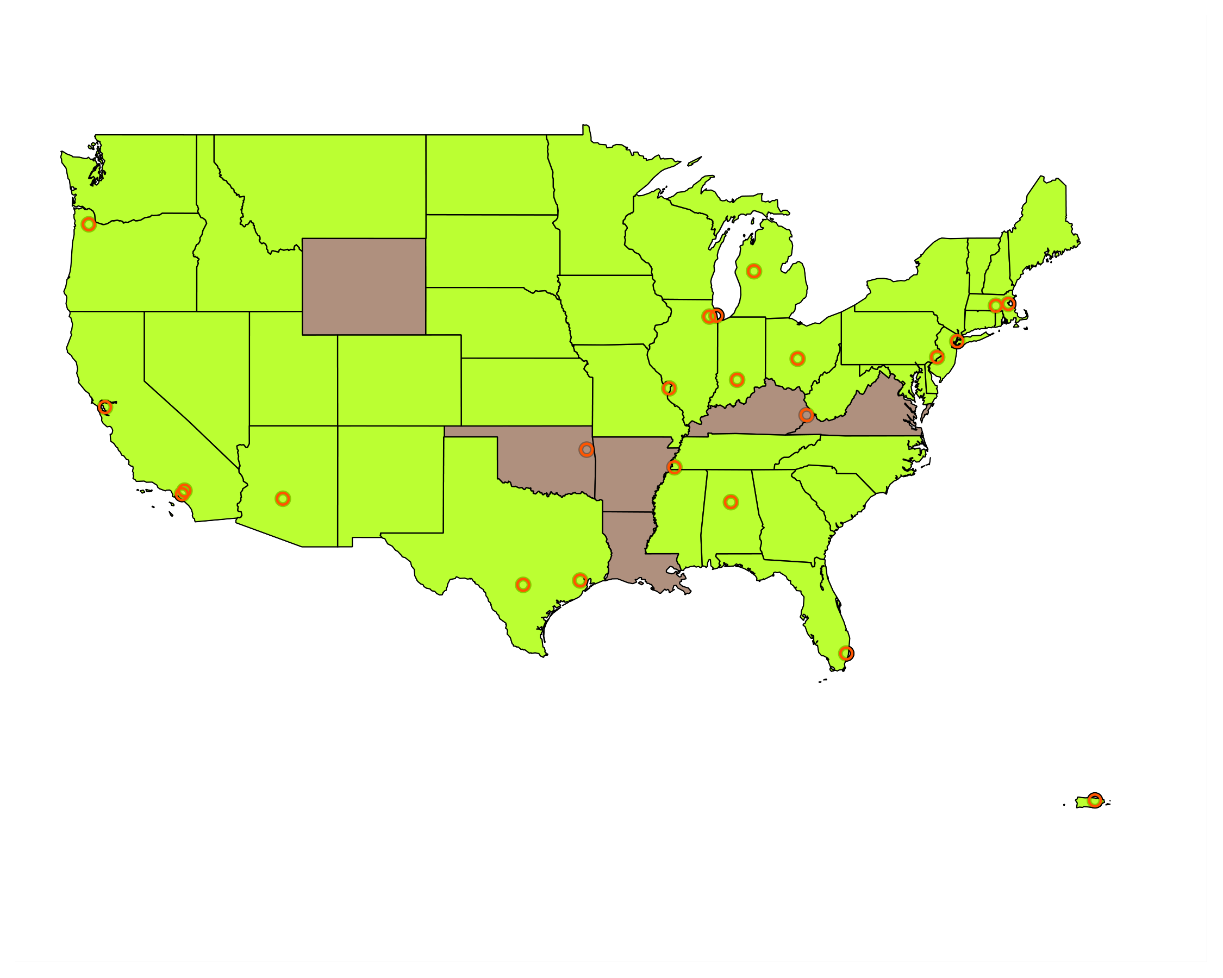
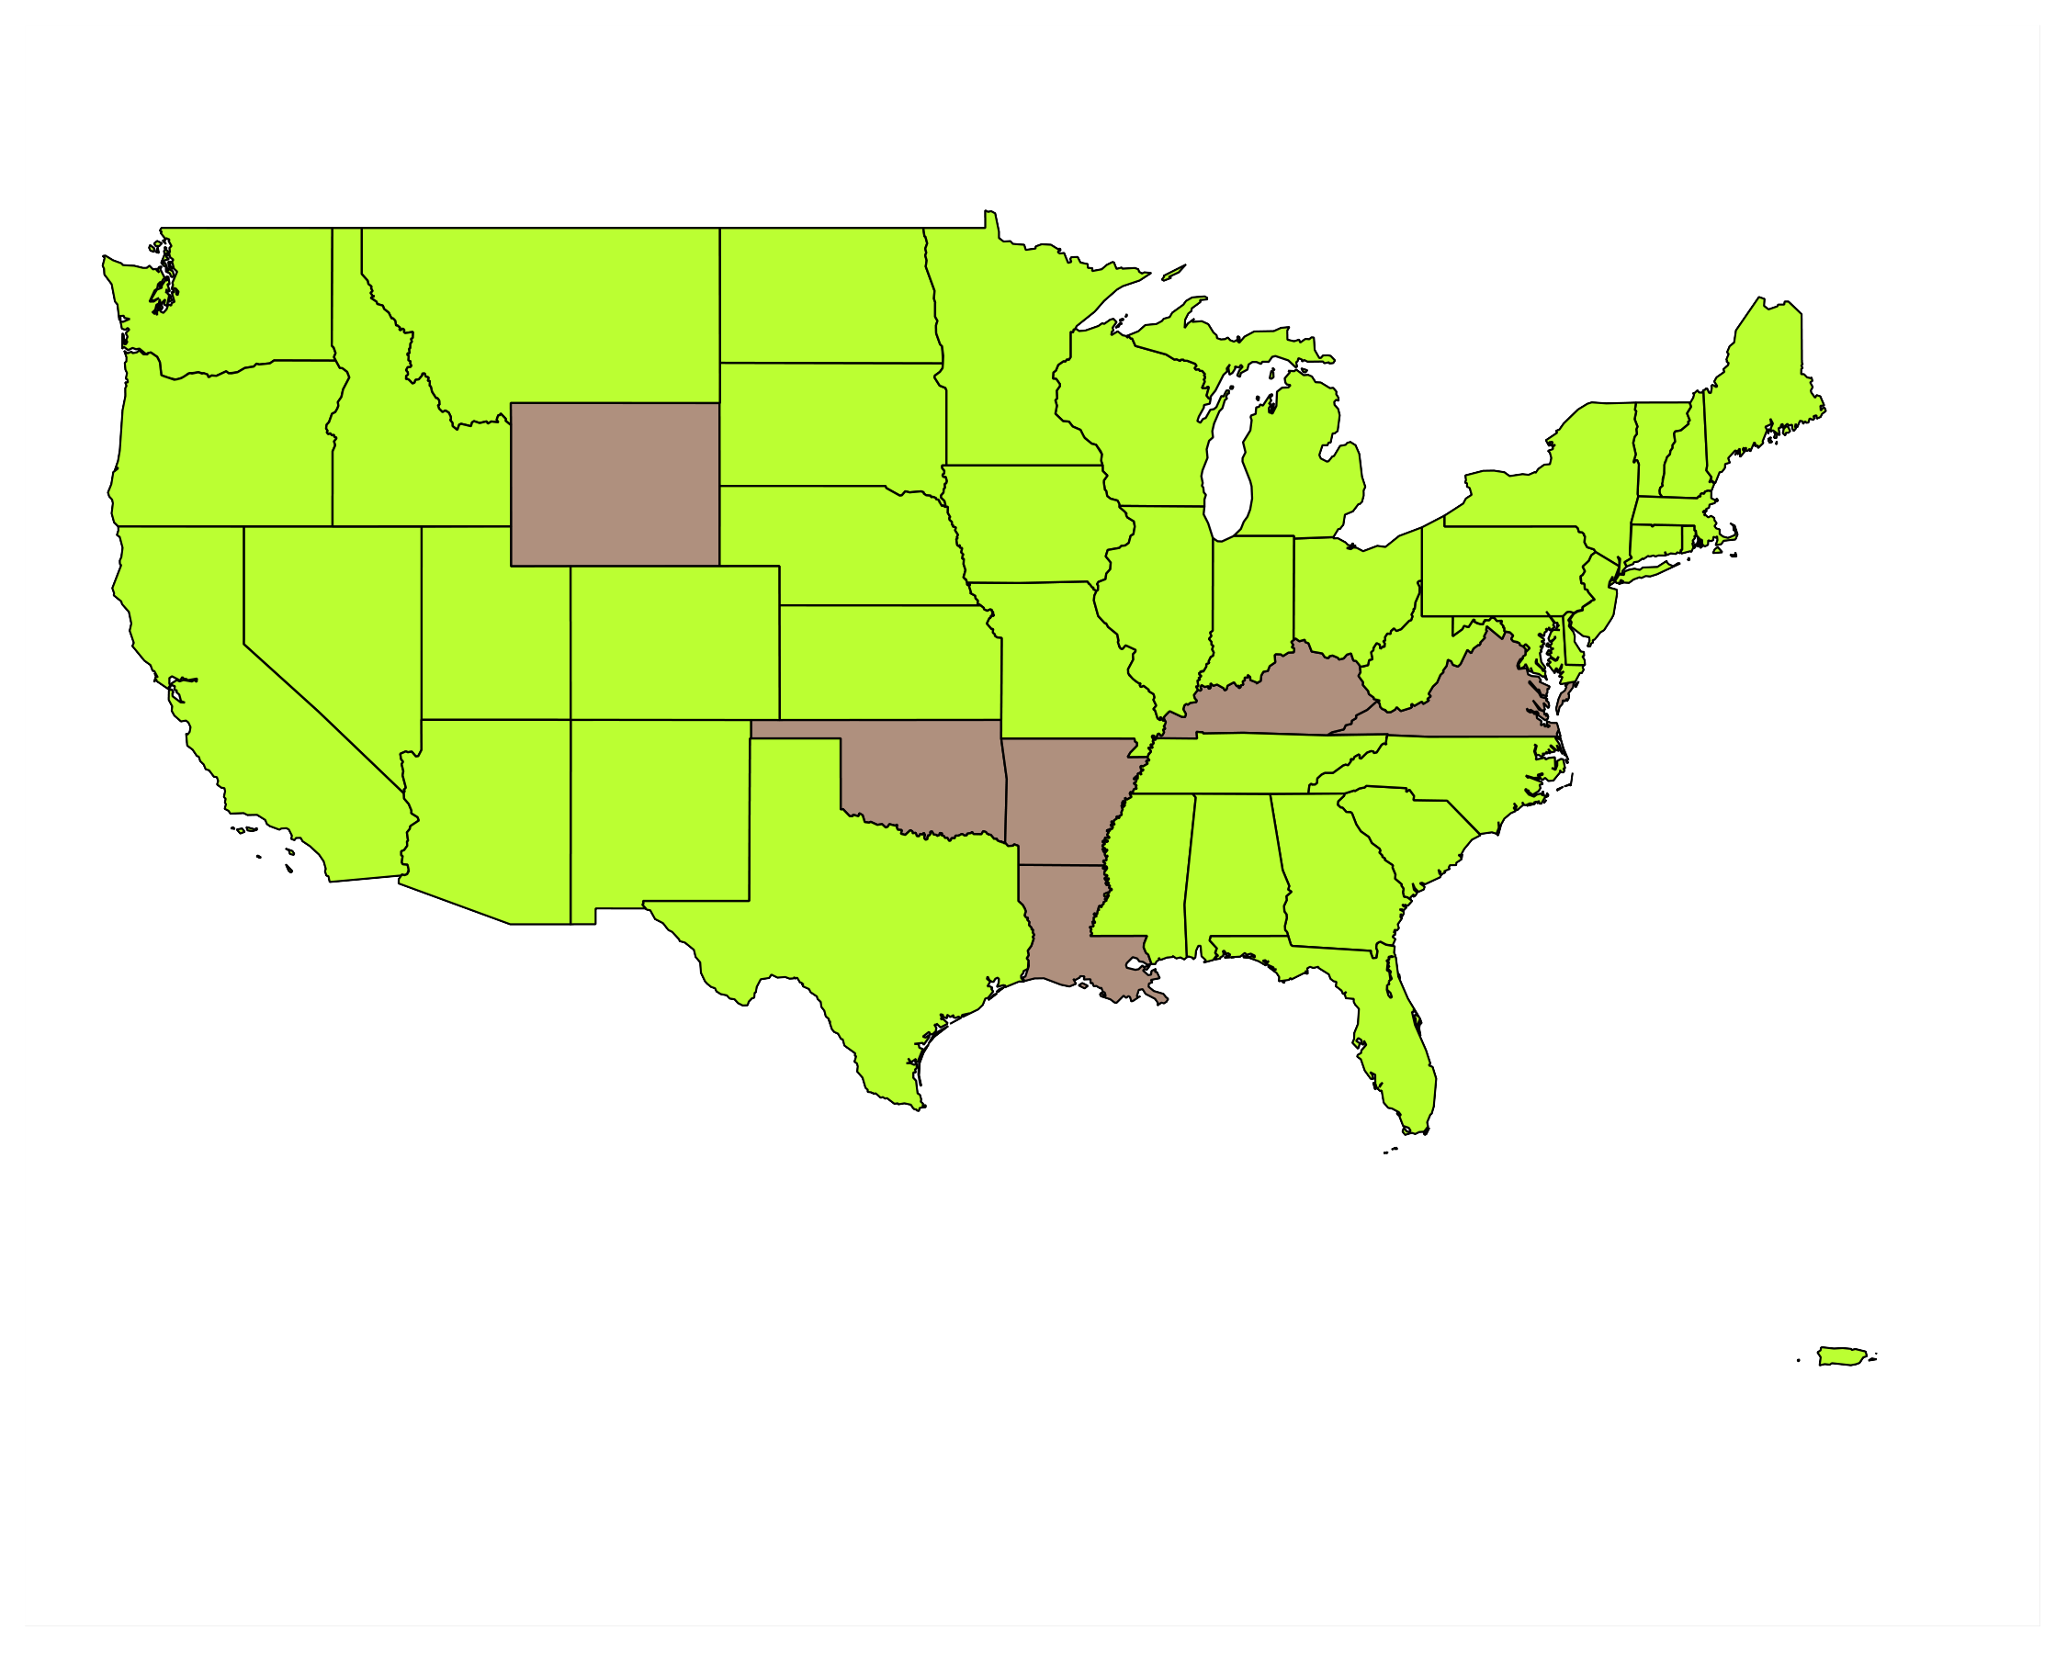
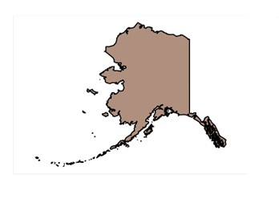


Optometric Education
OD Schools
Notes:
Only 2 out of 23 optometry schools reside in states where laser treatment is legal
How can live, hands-on experience with laser and scalpel surgery possibly be accomplished?

Slide 46
OD Training
21 out of 23 optometry programs are NOT in States with OD laser privileges
7,284 OD students
Avg 317 OD students per program
Not feasible to surgically train all on live patients

Slide 47
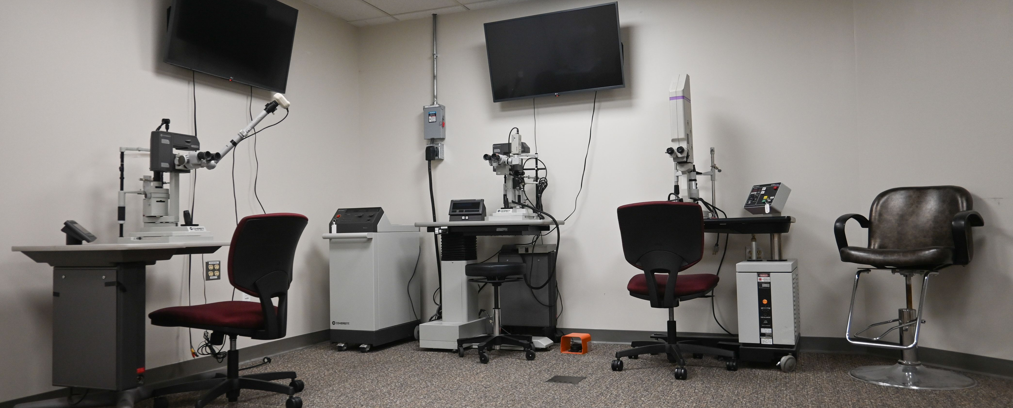
Laser Lab at the Pennsylvania OD School
Notes:
This is photo of the laser lab at Salus University, an optometry school in Pennsylvania. This is where optometry students get their training.

Slide 48
Criterion 5
Appropriate post-professional programs and competence assessment to ensure being performed in a safe and effective manner

Slide 49
Criteria 5: Appropriate post-professional programs and competence assessment to ensure being performed in a safe and effective manner
UNPROVEN
2 of 23 optometry schools in SLT states
Too many students to train on actual patients
Too few patients with disease to obtain surgical experience
Short time frame to learn essential surgical skills
Current course training
  Lack of comparative data to extensive experience and 1:1 time with content expert ophthalmologists in ophthalmology resident training
Notes:
What we can say about optometric programs and assessment to perform SLTs is that it is unproven.
Only 2 of 23 optometry schools in the country reside in states where laser surgery can legally be performed.
Too many students to train
Too few patients with disease to obtain surgery experience
Short time frame in OD school to learn skills, follow patients for disease progression, results of long-term complications
Unknown how ODs can gain this experience and skill at a weekend course vs extensive experience of ophthalmologists

Slide 50
Optometric Education
Knowns
Unknowns
21of 23 Schools NOT in States that Authorize SLTs
Large Class Sizes and few patients needing SLT
Simulated and real patient training
Avg. # Patients Needing SLT Evaluated
Avg. # Gonioscopy Exams
Avg. # of SLT Performed
Notes:
OD class size; how can enough live patients with disease needing surgery possibly be evaluated and treated by this many students
Average # patients seen by OD student
Average number of gonioscopy exams by optometry student:
Average number of LTP performed by each optometry student:

Slide 51
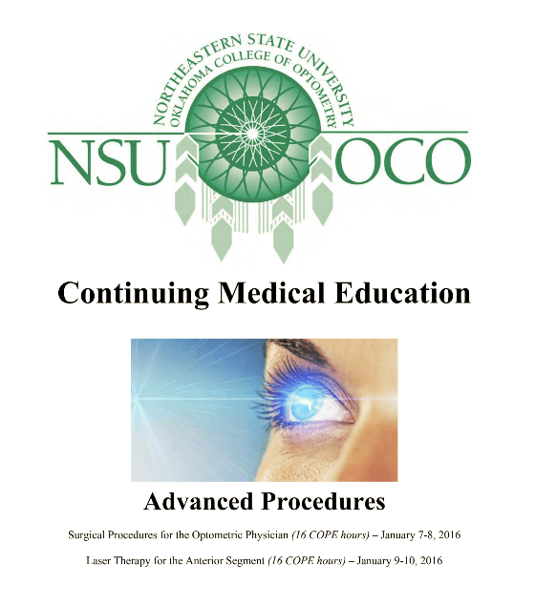
OD 16-Hour Laser Therapy to the Anterior Segment Course

Slide 52
Criterion 6
Adequate measures to assess if competently performing new skill or service and take appropriate measures if they are not

Slide 53
Criteria 6: Adequate measures to assess if competently performing new skill or service and take appropriate measures if they are not
Unknown competency assessment and corrective actions
Optometrists | Ophthalmologists
a 16-hour course in anterior segment laser therapy | ACGME RRC and AUPO defined minimal and competency standards before independent practice
Notes:
In Optometry, there are Unknown competency assessment and corrective actions
Giving practitioners surgical privileges legislatively, and THEN allowing them afterward to supposedly learn how to perform a surgery via a weekend course is inappropriate
Ophthalmologists achieve and demonstrate mastery of the surgical skills and disease management BEFORE being allowed to perform surgery independently

Slide 54
Comparative Perspective
American Board of Ophthalmology
American Council on Graduate Medical Education
Notes:
Leaders in American ophthalmology emphasize adequacy of training and the testing regarding the qualifications of ophthalmologists. www.abop.org
It does this through the American Board of Ophthalmology which assure competency, skill and patient safety through certification and re-certification programs.
The ACGME is an objective, independent accrediting organization for graduate medical education programs that ensures high and uniform standards across surgical residencies.
Optometry schools are not eligible to be a part of this system of quality standards.

Slide 55
American Council on Graduate Medical Education
Continuously Assessed Training, performance reviewed every 6 mo
  Clinical Competency Committee and ACGME standards
Large volume of 1:1 proctored Clinical Cases
Step-wise Surgeon-proctored Instruction
Graduated increase in responsibility and procedure performance
https://www.acgme.org/specialties/ophthalmology/overview/
Notes:
ACGME expertise, independent, objective www.acgme.org
125 programs; 1,698 residents and fellows
continuously assessed, updated with medical/surgical training institutions
ACGME: critical aspects of rigorous foundational medical education; large volume of clinical cases for experience; step-wise surgeon-proctored instruction; to obtain privilege to perform surgical procedures

Slide 56
American Academy of Ophthalmology
32,000 Ophthalmic surgeons, 7 Subspecialties
Gold Standard: Education and Training
ONE Network
IRIS Registry
Notes:
32,000 ophthalmic surgeons and 7 subspecialties
sets the standards for ophthalmic education and advocating for our patients and the public
ethics, practice management, research, advocacy, public education
ONE network
IRIS registry—largest patient encounter medical database of any specialty in the world (research, improved care processes, efficiency, cost savings)

Slide 57
Complexity of Patients MD vs OD
Comparative Study of Eye Care Patients
Ophthalmology:
  Older beneficiaries
  More racially diverse
  More medically complex beneficiaries
, https://journals.plos.org/plosone/article?id=10.1371/journal.pone.0227783
Notes:
A study in he Journal Plos.org, https://journals.plos.org/plosone/article?id=10.1371/journal.pone.0227783 found that
From 2012 through 2017, ophthalmologists in every state treated statistically significantly older beneficiaries;
In 46 states ophthalmologists saw a more racially diverse group of beneficiaries;
Ophthalmologists in all 50 states saw more medically complex beneficiaries and the differences were statistically significant in 47 states throughout all six years.

Slide 58
Typical Day in a Rural Ophthalmology Clinic
Cataract Evaluations- 7
YAG Laser Surgeries- 5
Post Operative Patients- 11
Cornea Patients- 5
Glaucoma Patients- 10
Retina Patients- 5
Plastics Patients- 1

Slide 59
Conclusion
Criterion 1 - Health, safety, and welfare of the
public are inadequately addressed by present scope of practice
The health, safety, and welfare of the public is currently being addressed adequately as shown on the data presented. Nebraskan’s access to SLT is adequate with the current referral to ophthalmology system.

Slide 60
Conclusion
Criterion 2 - The enactment of the proposed changes in scope of practice would produce widespread benefits for the public, and the amount and extent of the benefits would outweigh any potential harm or danger to the public that might be caused by enactment of these changes
Data from State’s with OD SLT privileges does not show increased benefits for the public or reduced cost to SLT delivery to the extent of outweighing any potential harm or damage to the public.

Slide 61
Conclusion
Criterion 3 - The proposed change in scope of practice does not create a significant new danger to the health, safety, or welfare of the public
The proposed change does create a significant new danger to the health, safety, and welfare of the public. Repeat SLT treatments or SLT performed in cases with low chances for success may result delayed referral for definitive surgical glaucoma care.
Repeat SLT billed in close succession outside of global period may increase costs of the procedure.

Slide 62
Conclusion
Criterion 4 - Current education and training adequately prepares practitioners to perform the new skill or service
The suggested education and training as outlined in the proposal does not adequately prepare optometrists to perform SLT. There is a lack of educational experience and supervision of SLT on real patients.
By comparison, NE ophthalmology residents receive 6 months of 1:1 proctored experience in glaucoma clinics and weekly VA glaucoma consult clinics. Ophthalmology residents perform an average of 20 supervised SLT lasers before being cleared for independent SLT.

Slide 63
Conclusion
Criterion 5 - Appropriate post-professional programs and competence assessment to ensure being performed in a safe and effective manner
Though OD licensure has requirements of Continuing Education to maintain licensure, it is unclear on what criteria are otherwise used to assess and ensure continued competency in States that allow OD laser privileges.
By comparison, the American Board of Ophthalmology certification and subsequent maintenance of certification include quarterly questions, impactful peer-reviewed ophthalmic publication review and questions, and clinical chart review to ensure compliant.

Slide 64
Conclusion
Criterion 6 - Adequate measures to assess if competently performing new skill or service and take appropriate measures if they are not
Based on the application, it is unclear that adequate measures and criteria are used to assess and ensure continued competency in States that allow OD laser privileges.
ABO and maintenance of certification has been proven to ensure competency among Ophthalmologists for decades.

Slide 65

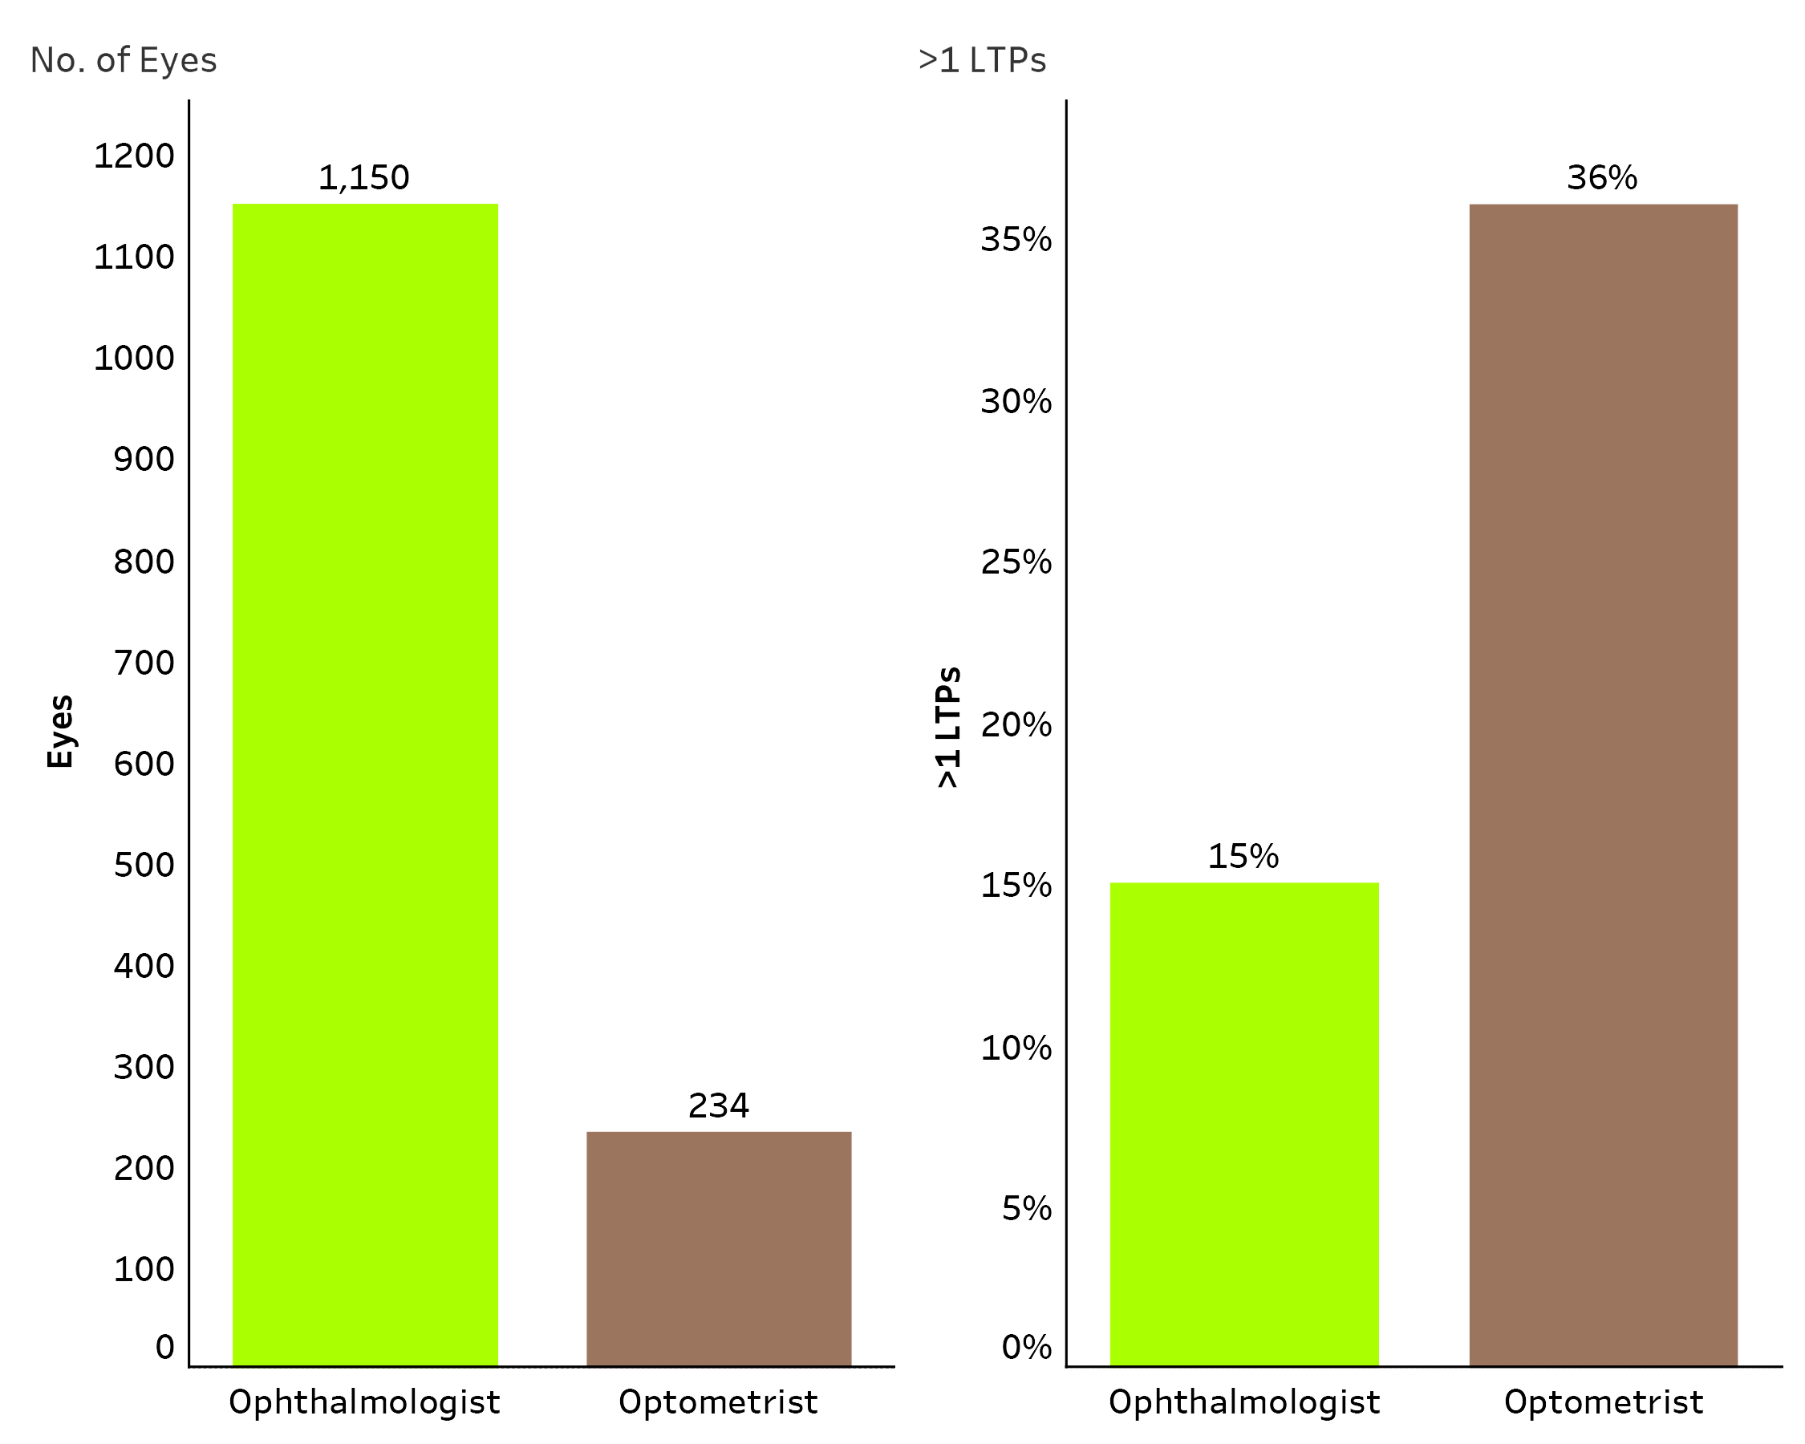
Oklahoma LTP Study
    Total of 1,384 eyes underwent LTP
    1,150 (83%) were performed by EyeMDs
    234 (17%) performed by ODs
    258 eyes (19%) underwent >1 LTP in the same eye by MDs
    OD patients (36%) another LTP; 2x likely to require repeat surgery
    Less proficient and/or overutilization
    More costly if 180 treatment completed outside of 10 day global
19%
Notes:
In Oklahoma, a total of 1384 eyes underwent LTP during 2008-2013.Among these:
- 1150 (83%) were performed by EyeMDs and 234 (17%) by ODs .
- Among the 1384 eyes receiving LTP, 258 eyes (19%) underwent >1 LTP in the same eye.
- The proportion of eyes undergoing LTP by an OD requiring ≥1 subsequent LTP session (36%) was more than double the proportion of eyes who received this procedure by an EyeMD (15%)

Slide 66
Could NE lose ODs to “Less Restrictive” States?
Notes:
Between 2011 and 2021, the population of Nebraska grew by 8%.
Optometrists claim that because of our scope of practice laws, optometrists are choosing to move to other states. That is false.
[CLICK], Data from the Medicare Physician Compare File shows that same period, the cumulative population growth of optometrists grew by 36% far outstripping the population growth.

Slide 67
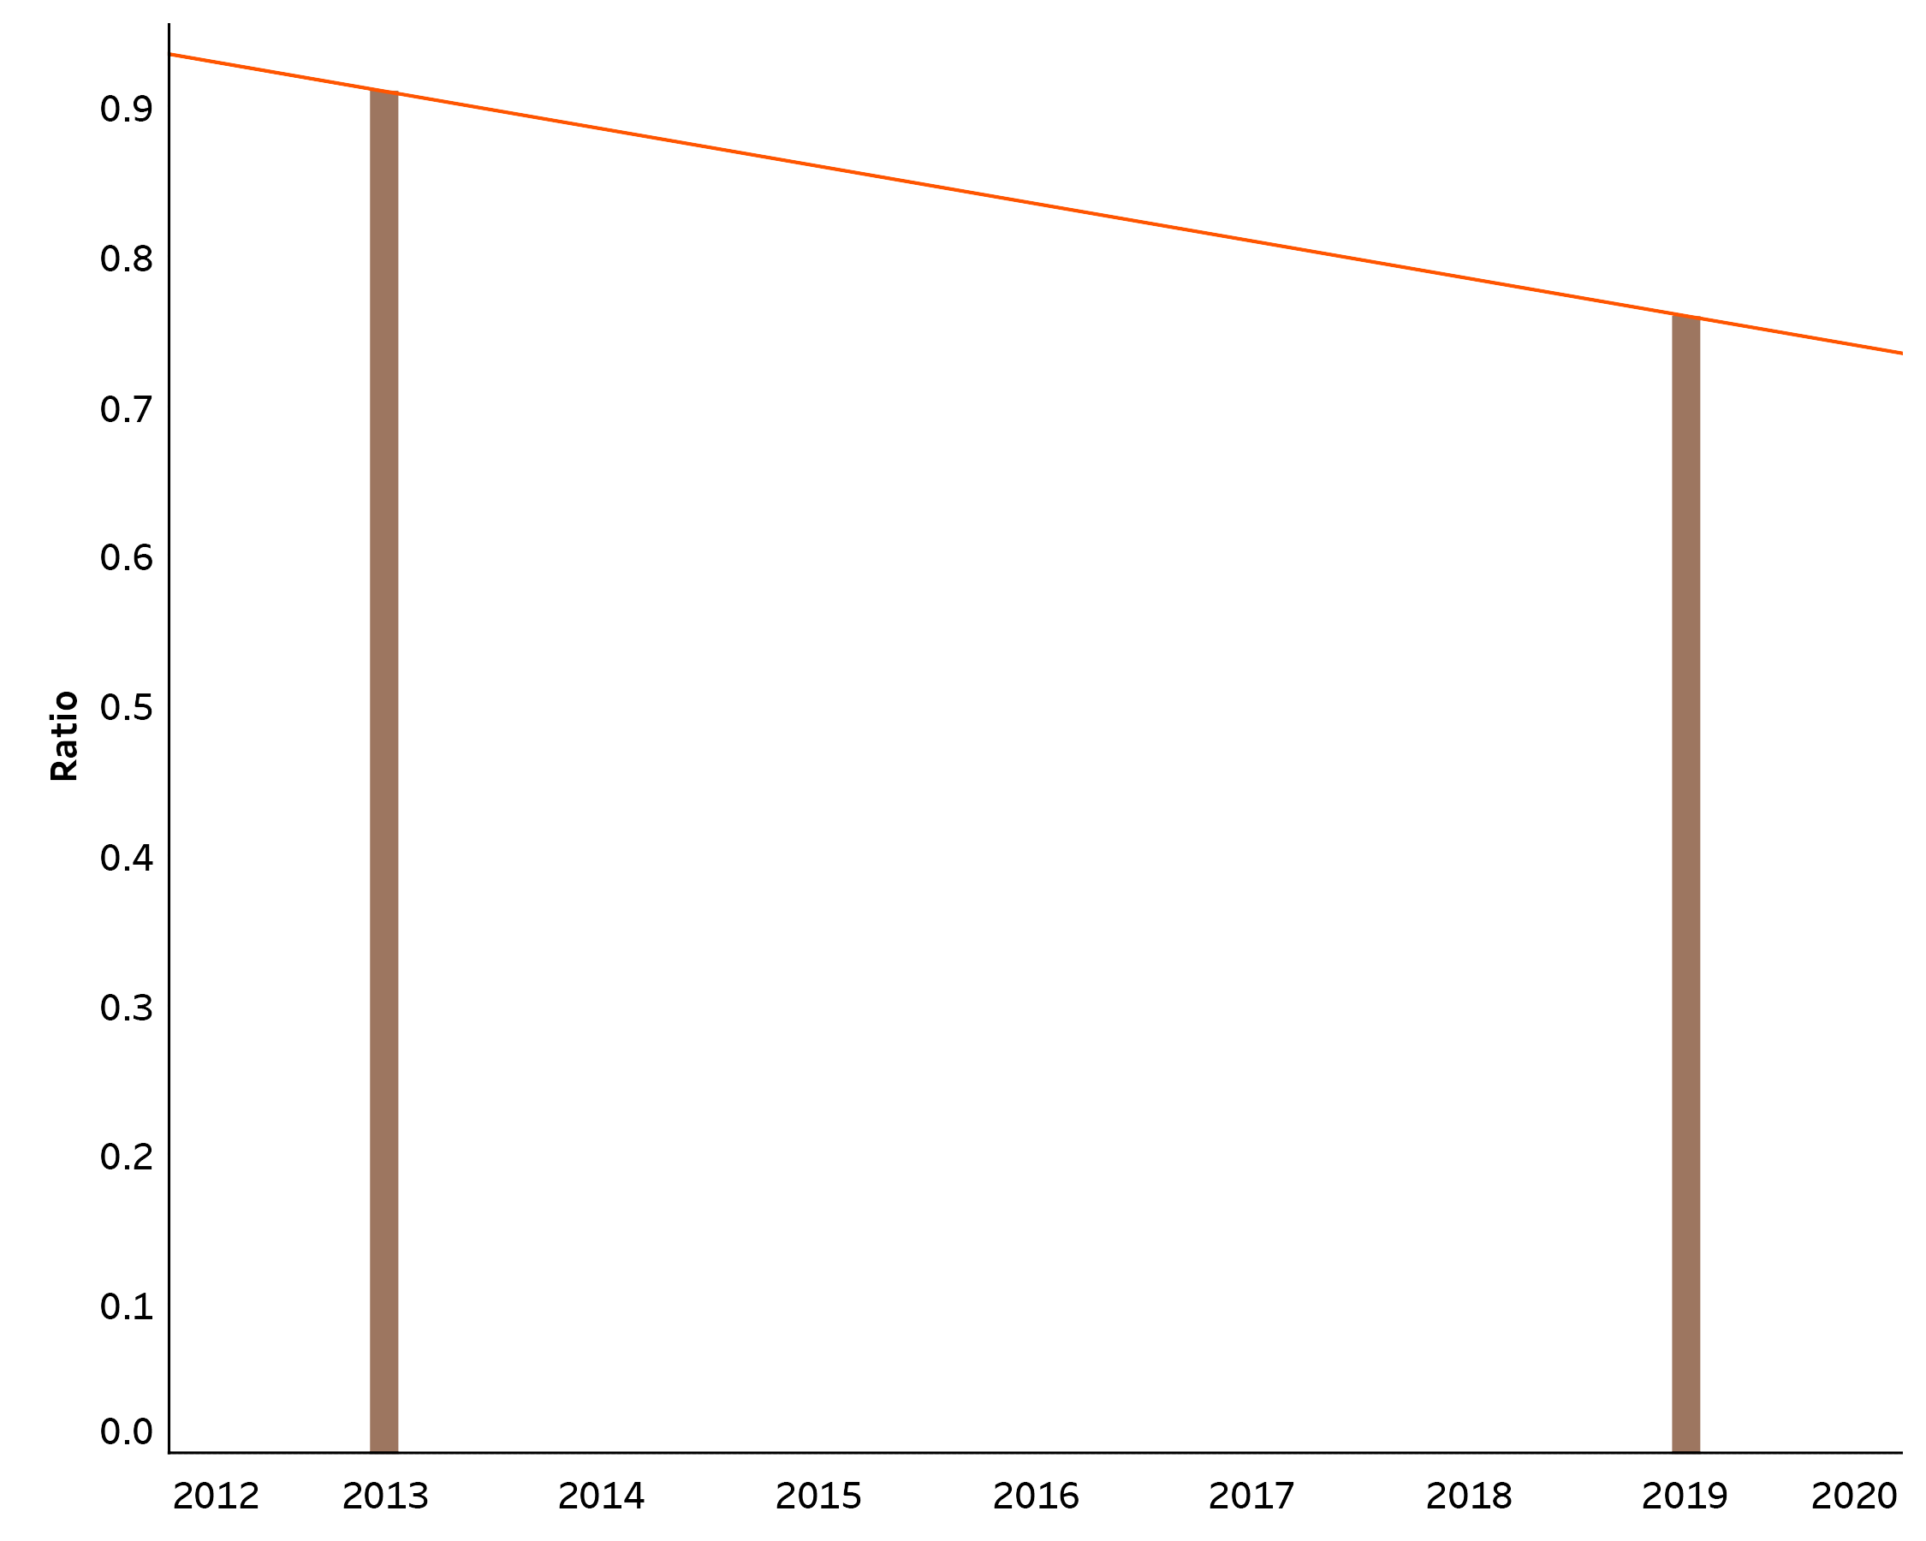
16.5% Shift of Nebraska Optometrists to Metro Areas
Ratio of Rural to Urban Nebraska Optometrists
Notes:
Nebraska optometrists may not be leaving the state because of scope of practice laws, but something else is happening. This chart shows the ratio of Rural to Urban Nebraska Optometrists Filing Claims under Medicare Part B in 2013 and 2019. Between those years the Ratio of Rural to Urban Optometrists Decreased from .91:1 to .76:1, a decrease of 16.5%. Simply put, Nebraska optometrists are increasingly shifting their operations to metro areas, not rural areas.

Slide 68
SLT and ALTP Studies
https://journals.lww.com/glaucomajournal/Abstract/2015/06000/A_Randomized_Clinical_Trial_of_Selective_Laser.2.aspx SLT and ALTP equivalent results at 6 months in PEX. June 2015
https://journals.lww.com/glaucomajournal/Abstract/2020/07000/Predictors_of_Success_in_Selective_Laser.8.aspx SLT not effective in 35% of patients. Effect in other eye main predictor of success.
https://journals.lww.com/glaucomajournal/Abstract/2021/07000/Low_energy_Selective_Laser_Trabeculoplasty.1.aspx COAST Trial; low energy SLT annually instead of prn SLT or medications.
https://journals.lww.com/glaucomajournal/Abstract/2017/03000/Transscleral_Selective_Laser_Trabeculoplasty.2.aspx Transscleral SLT may work as well as standard SLT for one year.
https://tvst.arvojournals.org/article.aspx?articleid=2772356 Automated direct SLT equivalent to SLT; 15 patients.
https://pubmed.ncbi.nlm.nih.gov/31028768/ LiGHT study; 75% effectiveness of SLT once or twice in treatment-naïve OHT or OAG.
https://www.thelancet.com/article/S0140-6736(18)32213-X/fulltext LiGHT study supporting SLT as first-line therapy.
https://pubmed.ncbi.nlm.nih.gov/31264958/ SLT more cost effective vs. medication, better outcomes.
https://pubmed.ncbi.nlm.nih.gov/16234442/ SLT of 360 degrees effective 60% of time; 90 and 180 degrees not as effective as Latanoprost.

Slide 69
SLT and ALTP Studies (continued)
https://pubmed.ncbi.nlm.nih.gov/32005561/ Repeat SLT appears as effective as initial SLT in treatment-naïve OHT and OAG.
https://pubmed.ncbi.nlm.nih.gov/19396790/ Retreatments slightly better with SLT vs ALTP (6 vs 4.5mm Hg).
https://pubmed.ncbi.nlm.nih.gov/15465546/ SLT and ALTP = over 5 years.
https://pubmed.ncbi.nlm.nih.gov/17385117/ SLT and ALTP appear =.
https://pubmed.ncbi.nlm.nih.gov/23769780/ SLT slightly better than ALTP.
https://www.aao.org/eyenet/article/zap-light-and-salt ZAP, LiGHT and SALT study reviews.
https://jamanetwork.com/journals/jamaophthalmology/fullarticle/2535226 Comparison of laser trabeculoplasty by ODs vs MDs in Oklahoma; Josh Stein, M.D.
https://www.ophthalmologyglaucoma.org/article/S2589-4196(21)00172-1/pdf LTP did not alter the need for incisional glaucoma surgery.
https://pubmed.ncbi.nlm.nih.gov/31028768/ Effectiveness of SLT.

